Slide 1
Therapy in the Treatment of Posttraumatic Dystrophy
David M. Klein, MD
Kennedy-White Orthopaedic Center
Sarasota, Florida

Slide 2
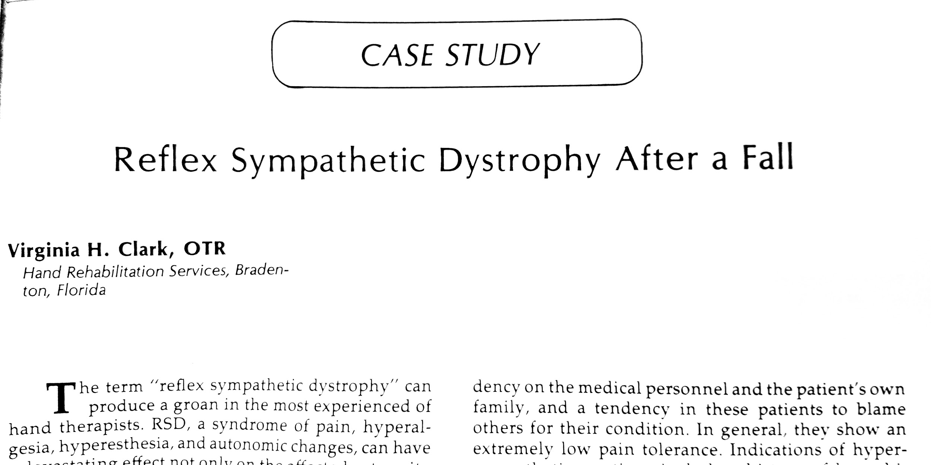
Local Literature

Slide 3
Outline
What is NORMAL after trauma?
Defining Dystrophy
Scope of treatment options
Therapy treatment options

Slide 4
What’s Normal?

Slide 5
Normal Responses to Trauma
Pain
Swelling
Stiffness
Increased blood flow

Slide 6
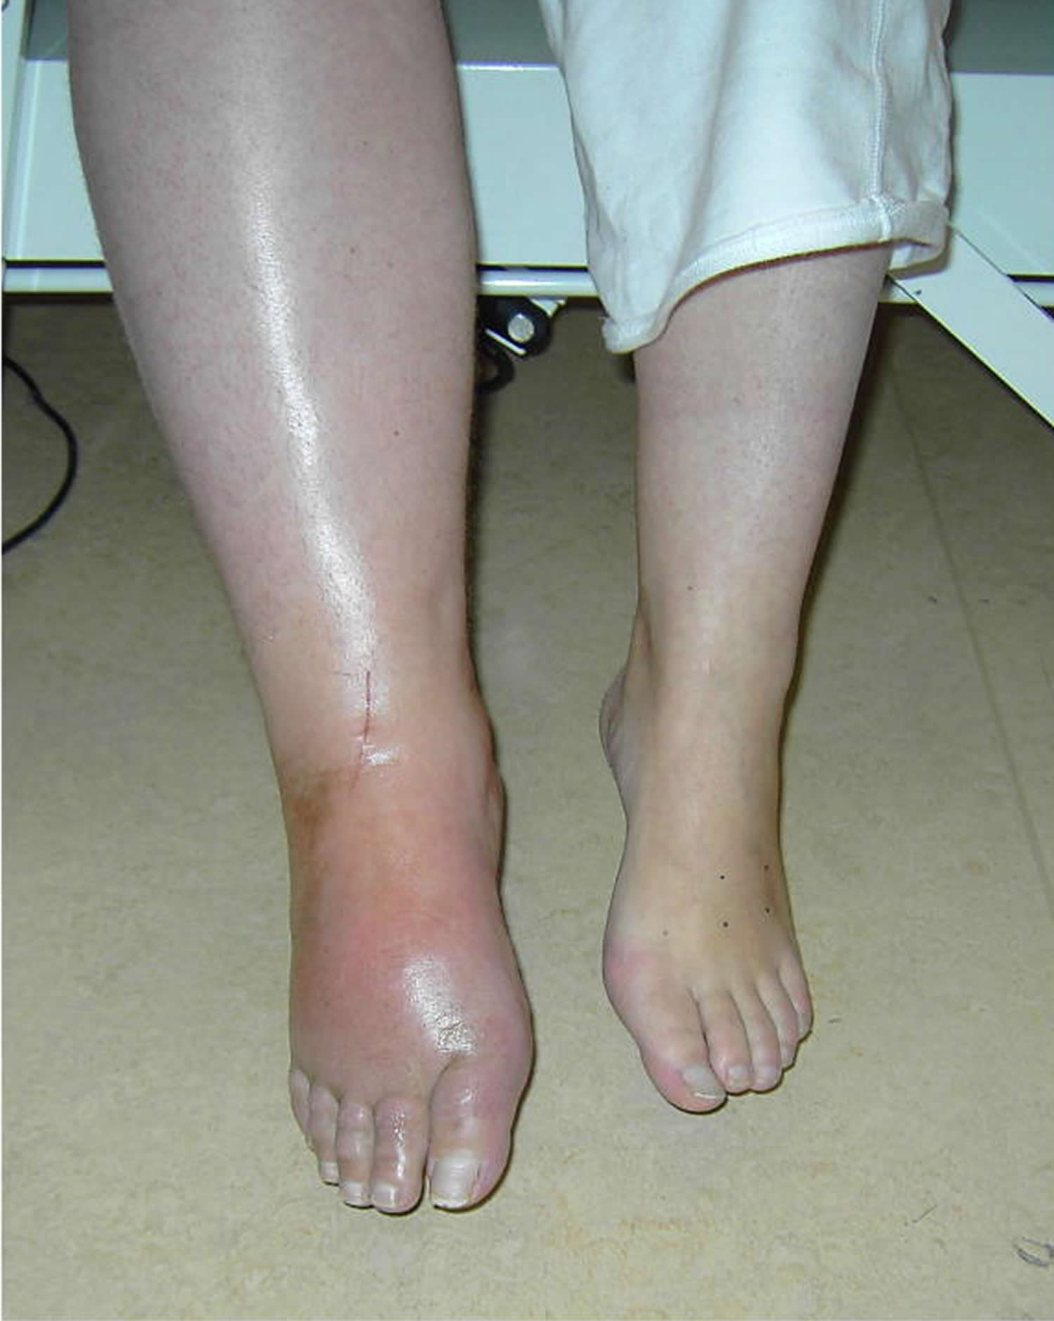
Image – Acute Dystrophy?

Slide 7
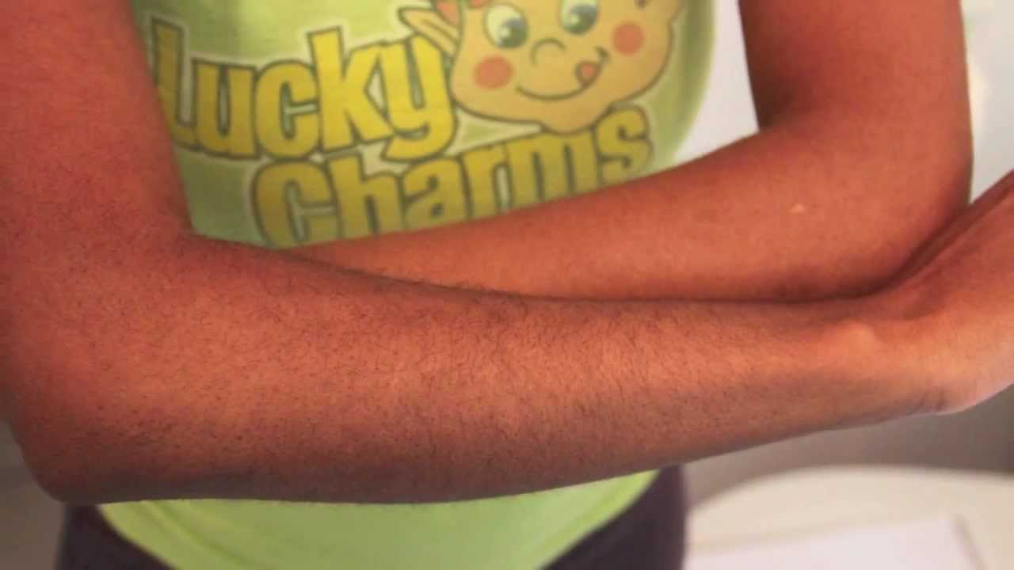
Image – Casting Response

Slide 8
Defining Dystrophy

Slide 9
Defining Dystrophy
Greater than normal responses
Geographic distribution outside zone of injury
Failure to respond to normal interventions

Slide 10
Is Dystrophy just PAIN?
No.
Definitions require Autonomic Involvement
The “Sympathetic Reflex” part of RSD
“Pain Out of Proportion to Injury” is NOT sufficient on its own

Slide 11
Dystrophy must have Autonomic involvement
Skin
Blood flow
Sweat glands
Hair changes
Nail changes
Patchy osteoporosis
Muscle tone changes

Slide 12
WHAT is Posttraumatic Dystrophy?
Involves autonomic responses
Blood flow
Temperature
Hair pattern
Sweat pattern
Likely cortical and spinal cord modulation
Persists in the ABSENCE of ongoing damage

Slide 13
Levels of Dystrophy
“Can I be a little bit Hypertensive?”
Yes
“Can I be a little bit Dystrophic?”
Yes
“Can I be a little bit Pregnant?”
No

Slide 14
Who has Dystrophy?
No definitive way to tell,
“...but I know it when I see it.” - Supreme Court Justice Potter Stewart, 1964

Slide 15
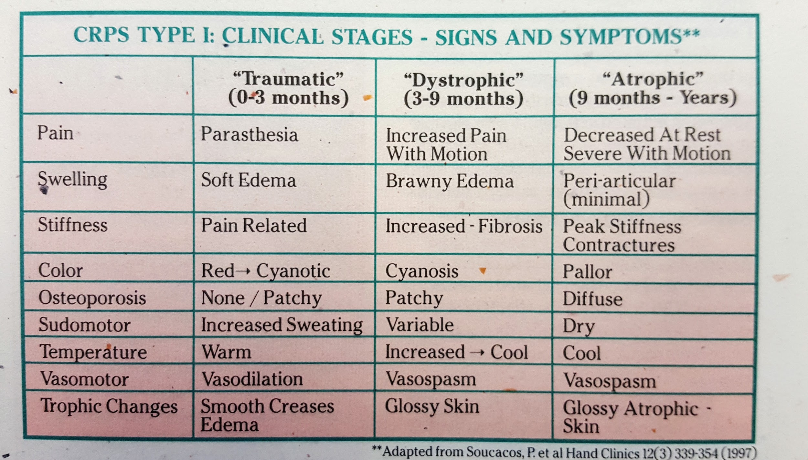
Dystrophy Stages

Slide 16
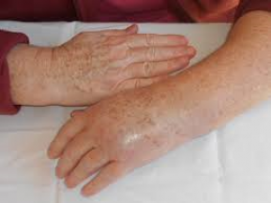
Image – Acute Dystrophy

Slide 17
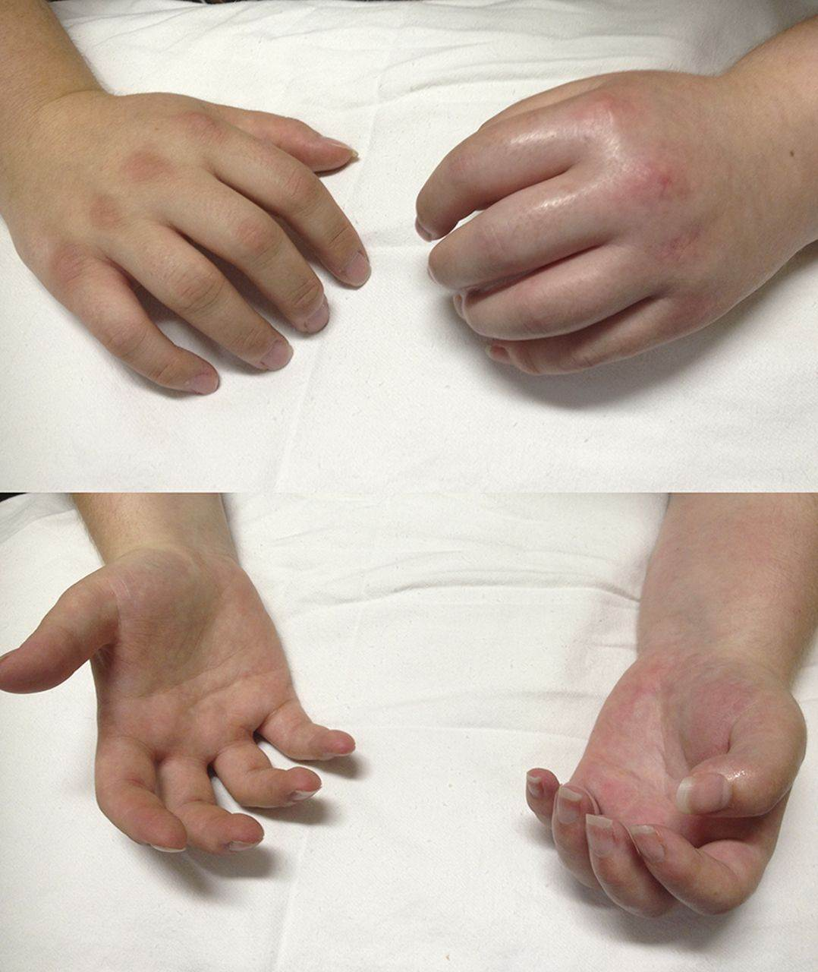
Image – Acute Dystrophy

Slide 18
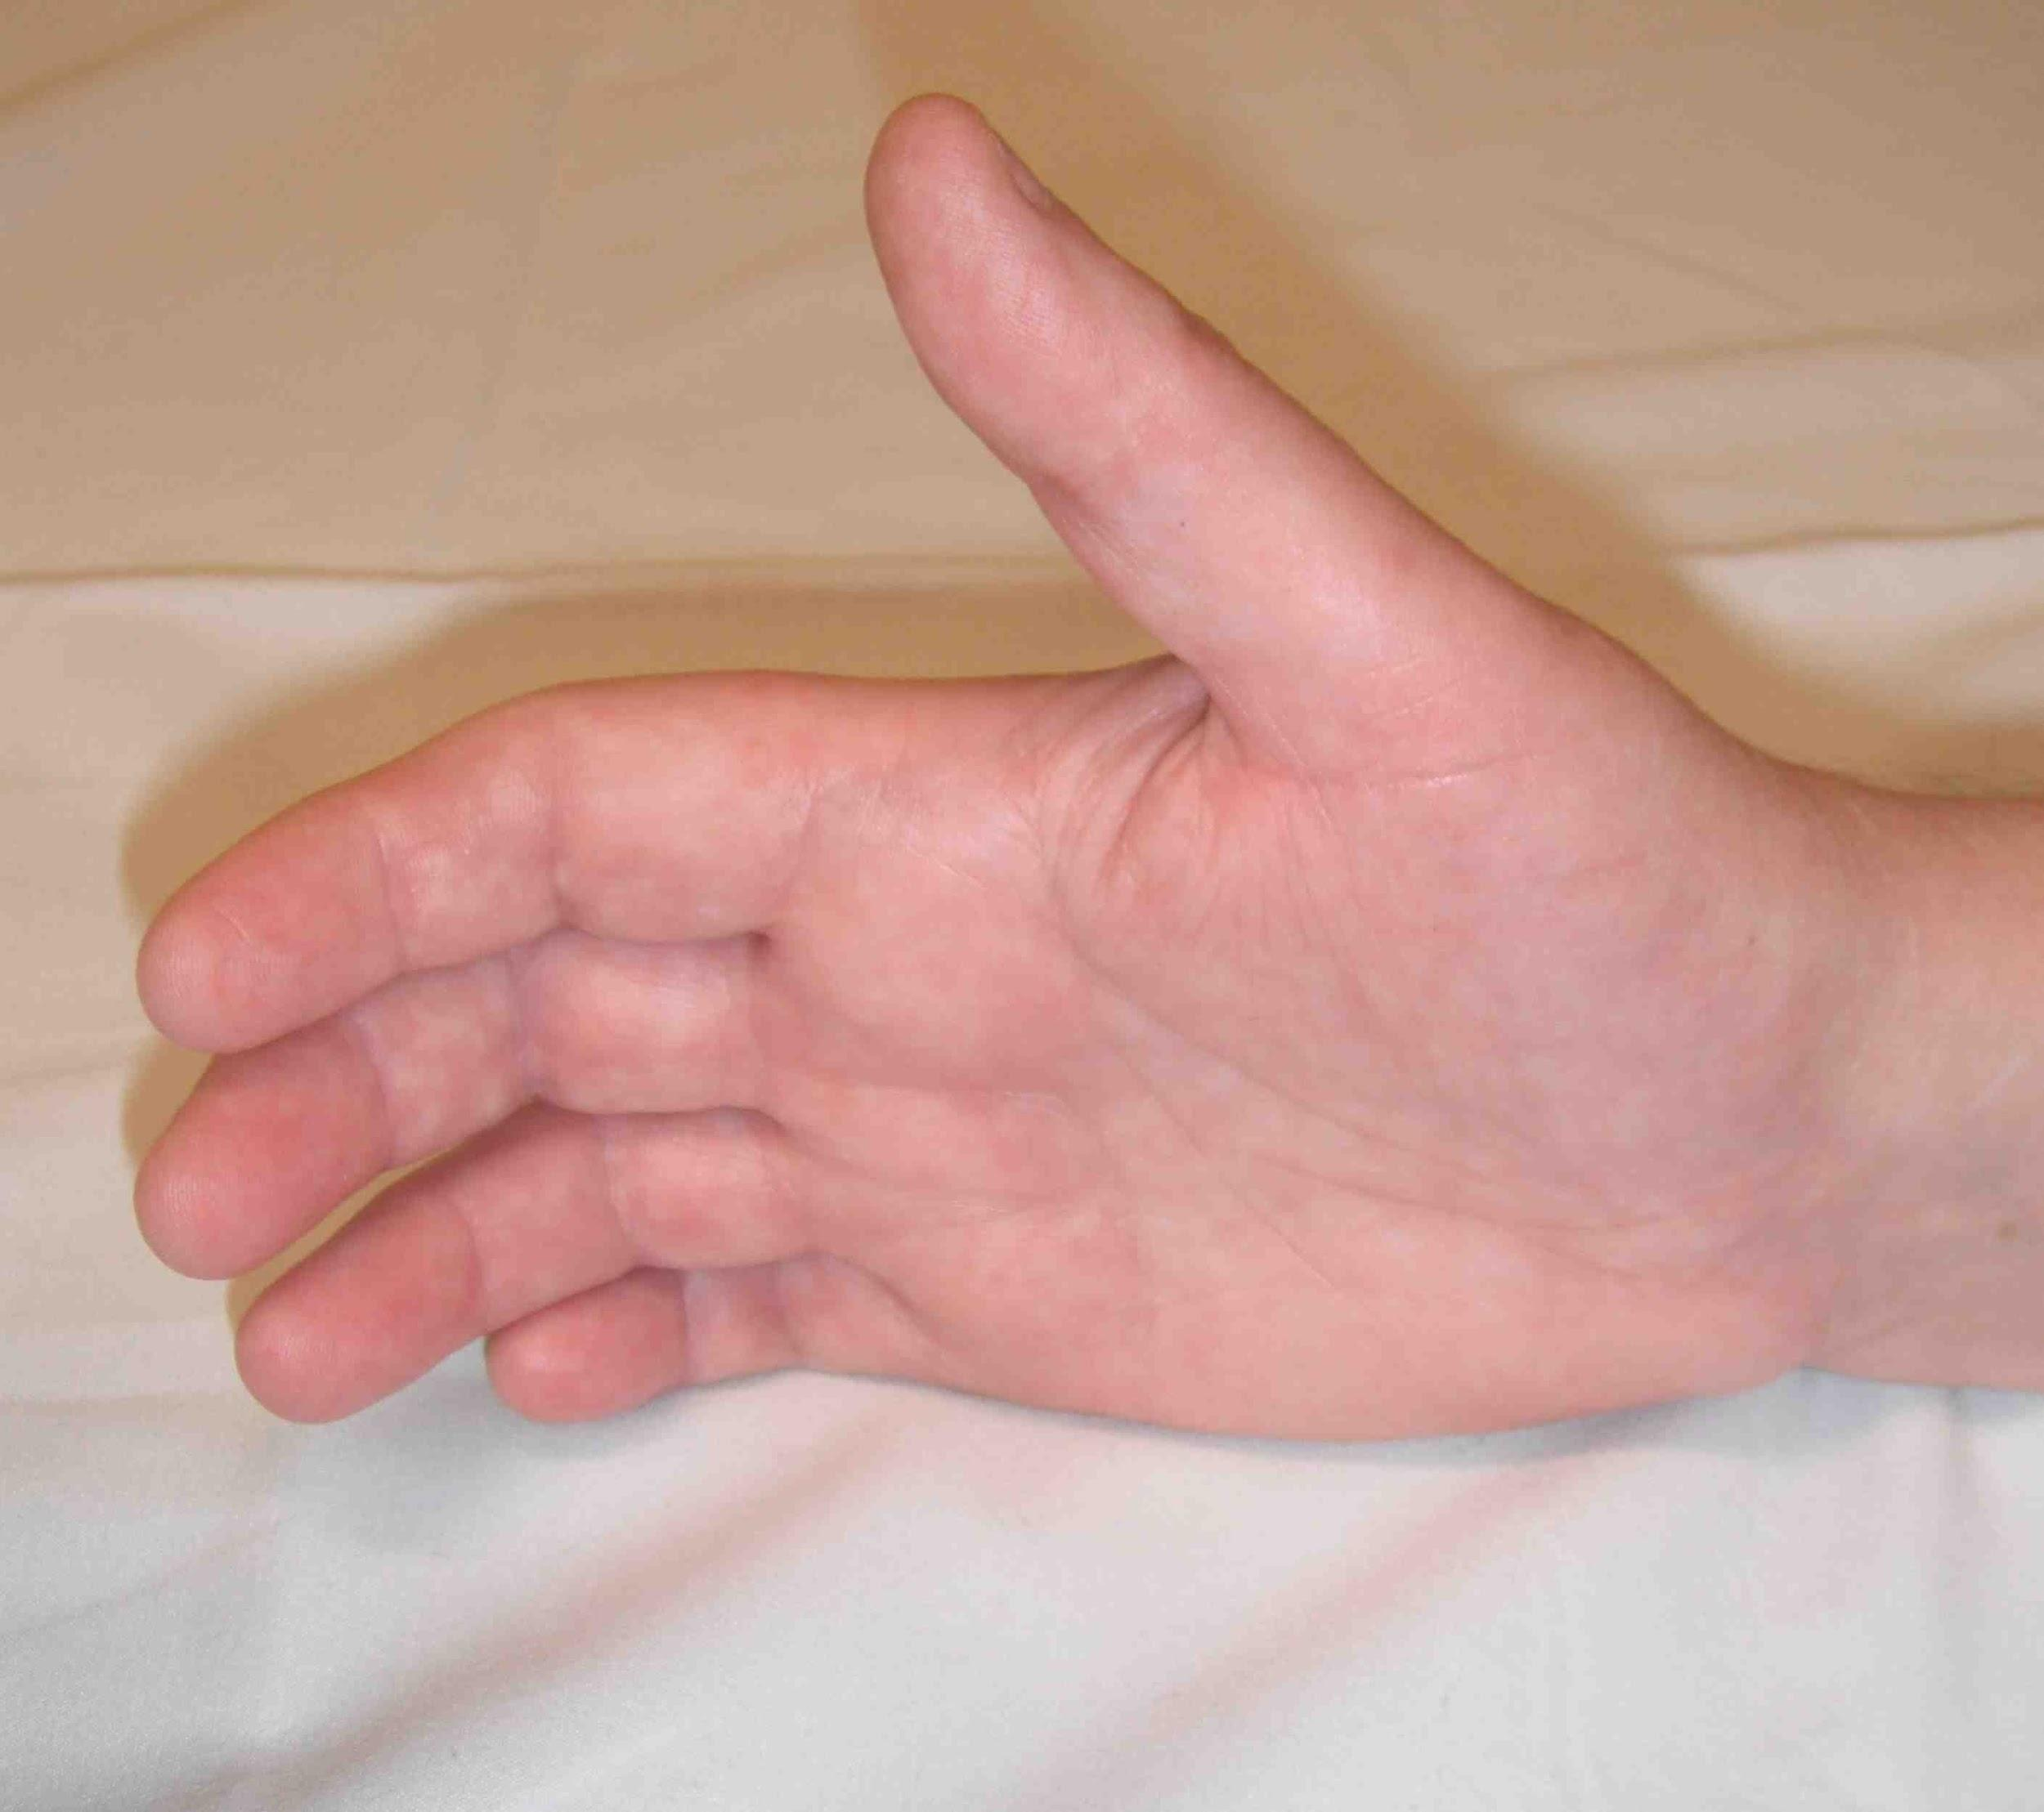
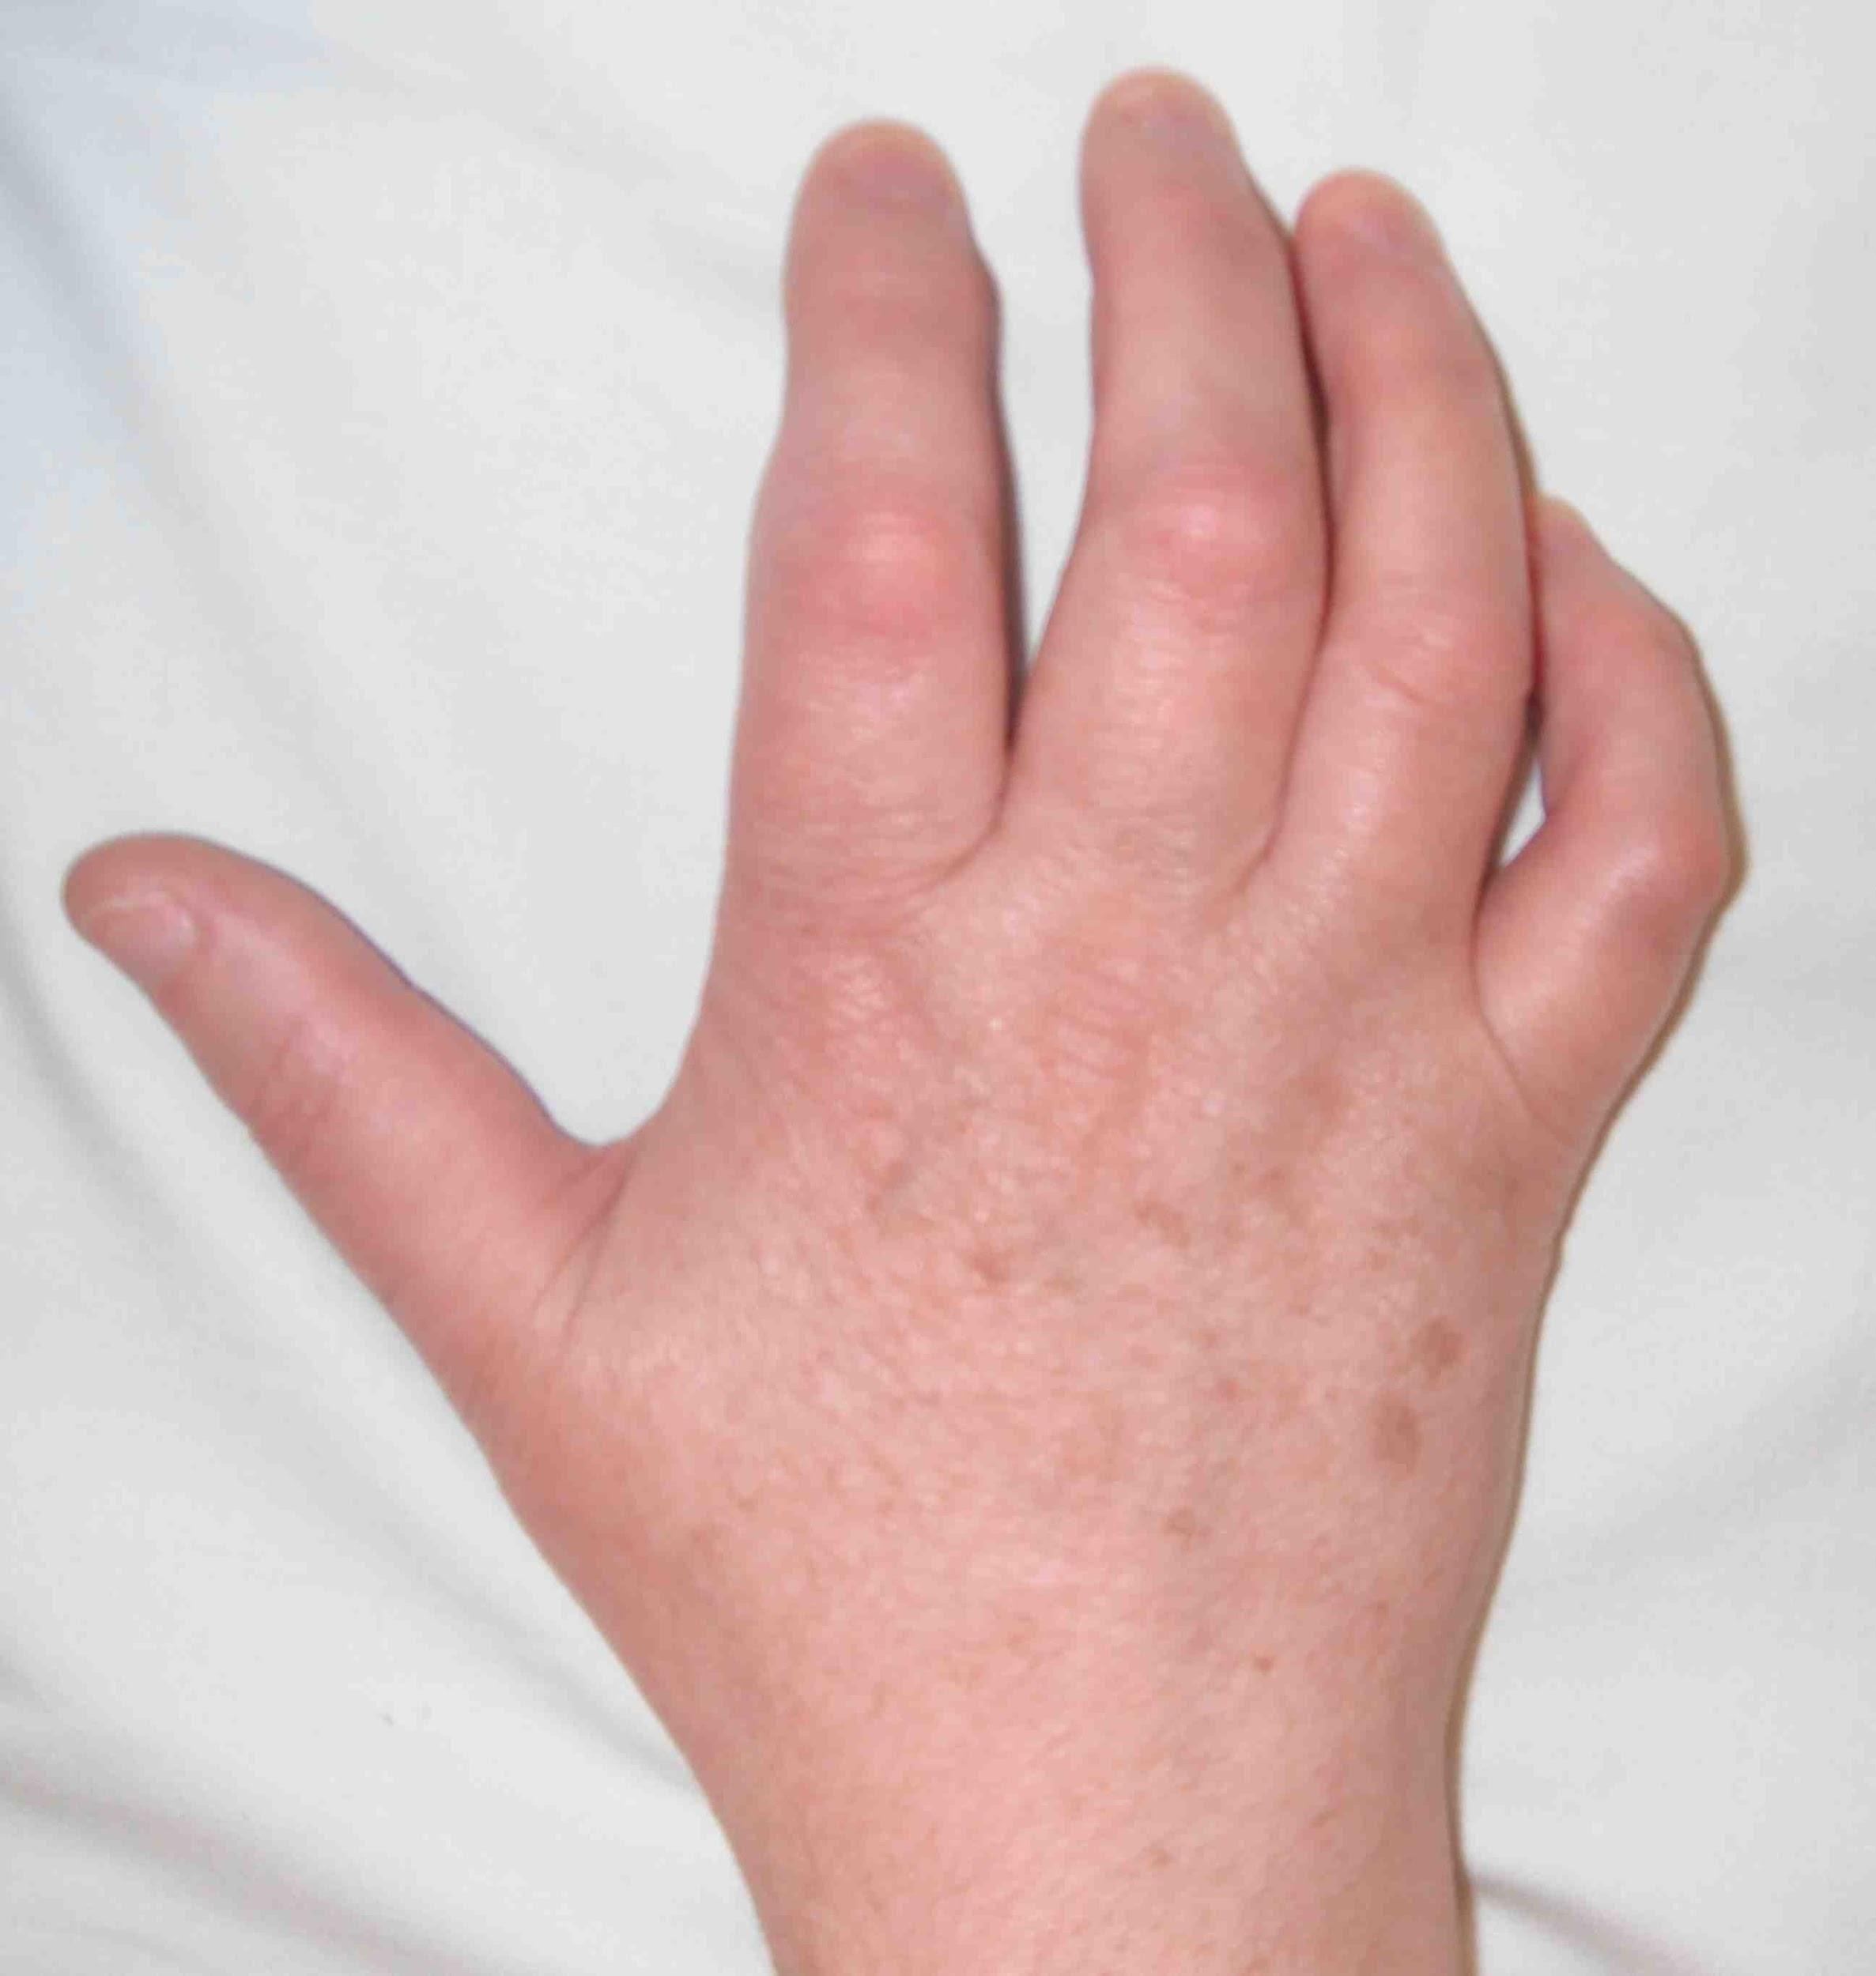
Image – Chronic Dystrophy

Slide 19
Label of Dystrophy?
Labeling is a bad thing
Labeling is a bad thing unless it severe
(and unless it allows them to get the medical attention that they need)

Slide 20
Levels of Dystrophy
Avoid labels - Use skillful communications:
“You’re just a bit more sensitive than most”
“You’re just a bit more stiff than most”
“… I’m confident that we can work through it.”

Slide 21
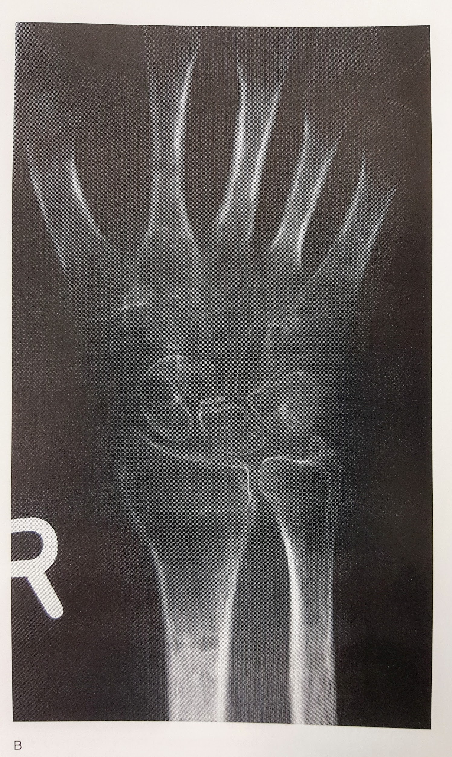
Is there a Gold Standard test?
Thermography? – No.
Bone scan? – No.
Radiographic osteopenia? – No.
Hair and sweat changes? – No.

Slide 22
Are there any Gold Standard tests?
No.

Slide 23
Are there any Gold Standard tests?
Unfortunately, the liability, insurance, and Worker’s Compensation world behaves as if there is a gold standard

Slide 24
Is Dystrophy Pervasive?
In majority of cases, No.
Should not be a reason to avoid other body parts

Slide 25
Is Dystrophy Permanent?
In many/most cases, No

Slide 26
Early Intervention is Key
Less than one year: 80% will improve
Greater than one year: 50% will improve
Therapy is more effective for acute than chronic dystrophy

Slide 27
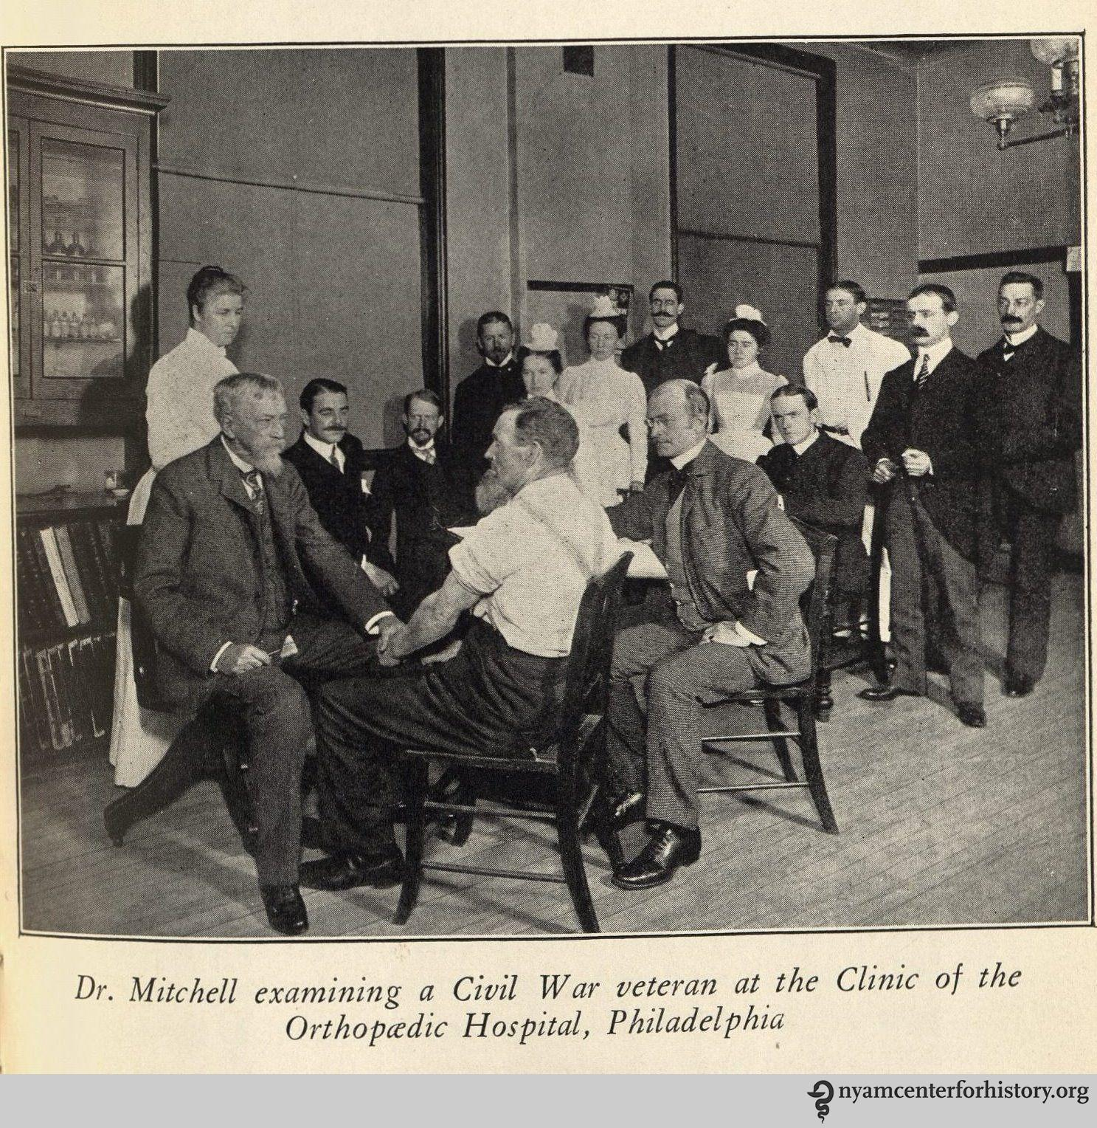
First Famous Historical Example
Silas Weir Mitchell, MD – American Civil War
Soldier with median nerve injury at the wrist
“Major causalgia”

Slide 28
Synonyms for Dystrophy
Causalgia
Major – defined nerve
Minor – undefined nerve
Sudeck’s Atrophy
RSD – Reflex sympathetic dystrophy
1 – defined nerve
2 – undefined nerve
Algodystrophy
Sympathetically mediated pain
CRPS – complex regional pain syndrome
Type I – undefined nerve
Type II – defined nerve

Slide 29
A Word on Pain
(a few, actually)

Slide 30
Aside: Pain scales
0 – 10
Zero is easy: absence of pain
10 is difficult
Worst pain imaginable?
Worst pain experience?
Severe pain?
“☹”?

Slide 31
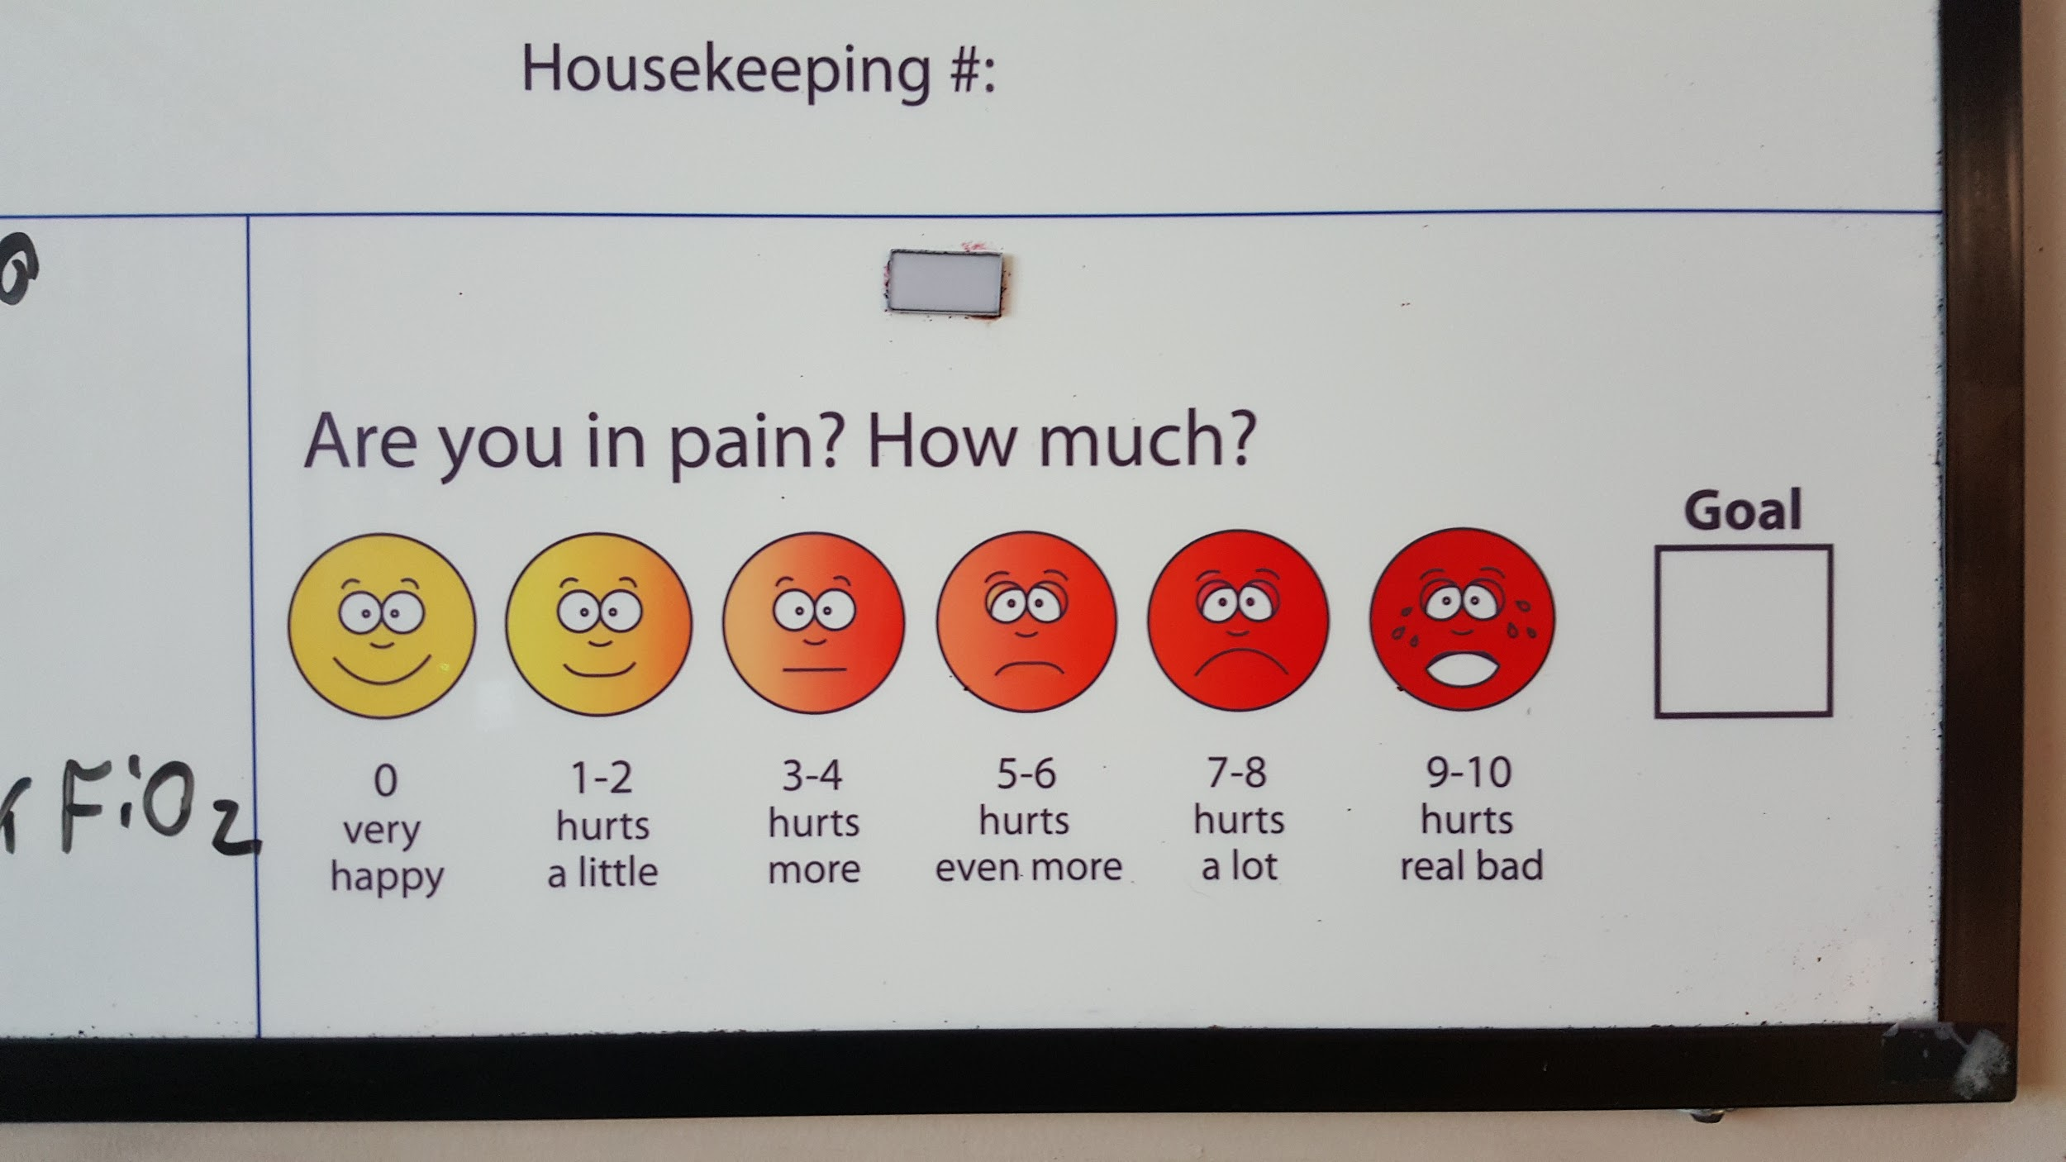
Aside: Pain scales

Slide 32
Aside: Pain scales

Slide 33
Words about PAIN
Dysesthesia – Abnormal sense of light touch
Allodynia – Pain from nonpainful stimulus
Hyperalgesia – Greater than expected for stimulus
Hyperpathia – Lasts longer and spreads greater

Slide 34
Non-Therapy Dystrophy Treatments

Slide 35
Chemotherapeutic Treatment Goals
Interrupt the abnormal response
Oral steroids
Injected anesthetic
Topical anesthetic
Calcium channel blockers
Antidepressant medications
Antiseizure medications

Slide 36
Chemotherapeutic Treatments
Corticosteroids
Stellate Ganglion Blocks (regional anesthesia)
Phentolamine (Regitine) (IV) - Reversible alpha-adrenergic antagonist (not in the US)
Guanethidine (IV) - Decreases norepinephrine
Bretylium (IV) - Competes against neurotransmitters
Antidepressants - Decrease norepinephrine, elevate mood
Calcium Channel blockers (Nifedipine) - Increase nutritional perfusion

Slide 37
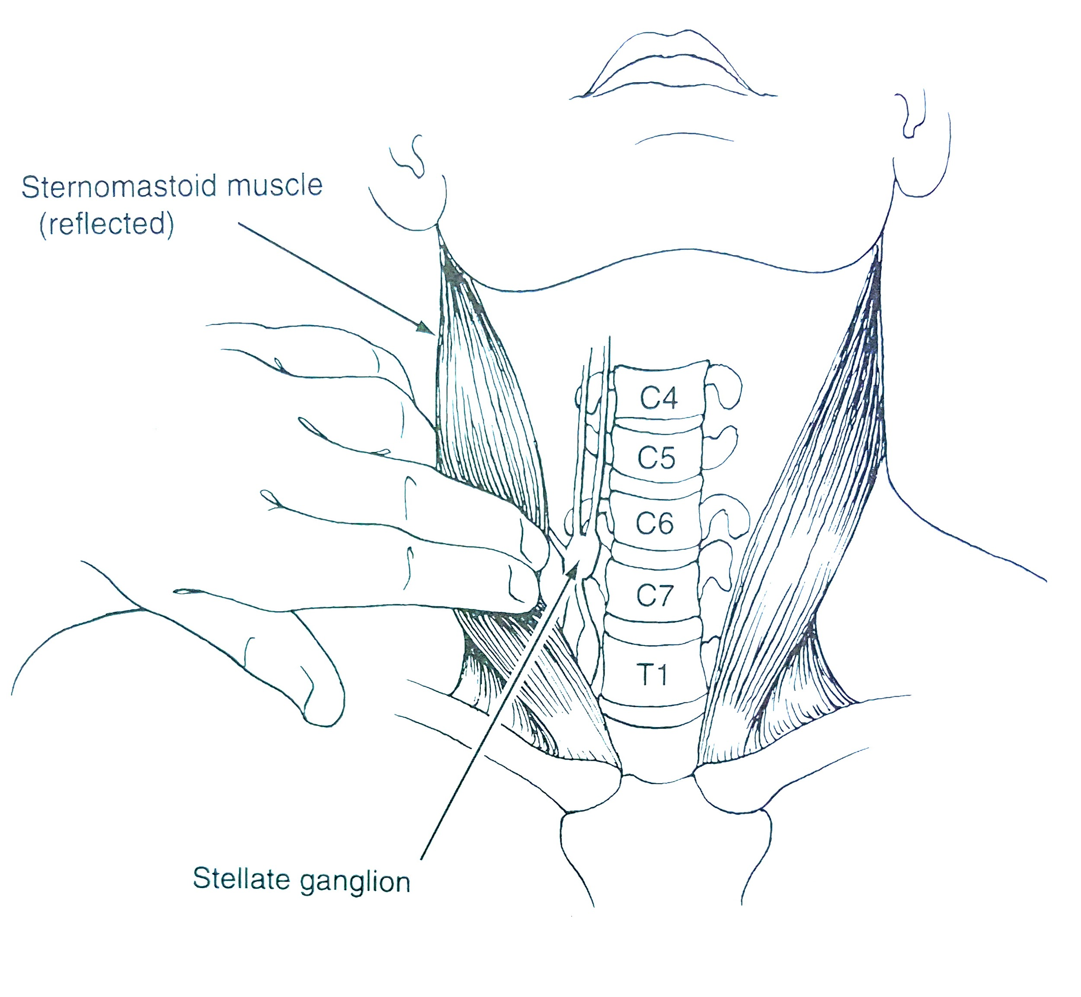
Stellate Ganglion Blocks
Sympathetic chain location

Slide 38
Causalgias and Correctable Nerve Lesions
Correct the nerve lesion early
CTS, for example
Surgery is paramount

Slide 39
Therapy Treatments for Dystrophy

Slide 40
Therapist Goals for Dystrophy
Decrease Pain - Don’t increase pain
Work, but don’t work through pain
Support, but don’t coddle
Be flexible with fluctuating signs and symptoms
Strength/Loading before range of motion
Emphasize Function - No useless limbs!
Patience, but appropriate adaptations of treatment

Slide 41
Therapy treatments
Pain management
Manual techniques
Desensitization
Fluido therapy
TENS (caution if nerve injury)
Edema control
Splinting (controversial for acute)
Stress-loading/Strengthening
Active range of motion

Slide 42
Therapy Modalities
Elevation
Electrical Modalities (TENS, Diapulse, Interferential, vibration)
“Simple and Effective” Exercise Program
Motion (as balanced against Pain Relief)
“Loading”
Splinting (controversial)
Hot/Cold/Contrast (controversial)

Slide 43
Other Modalities
Biofeedback
Heat or Cool (depending upon current state)
TENS for Vasoconstriction or Vasodilation
Postural training and Generalized conditioning
Mirror Box therapy
Purposeful Tasks - Emphasize use of troubled limb

Slide 44
Controversial Treatments
Avoid E-Stim and TENS? (caution if nerve injury)
Avoid Temperature extremes
Avoid Slings
Avoid Daytime static splints (in the acute phase)
Use caution with Dynamic splints
Avoid aggressive Passive motion

Slide 45
Treatment options
Modify the abnormal response
Emphasize “Loading” rather than Motion
Desensitization
Mirror box therapy
… “Ahead full speed, and damn the torpedoes”
The most difficult option, though some patients are capable of this once they understand the condition

Slide 46
Practical Treatments
If it’s warm, make it cool
If it’s cool, make it warm
(similar to dermatology with “if it’s wet, make it dry – if it’s dry, make it wet”)

Slide 47
Edema Control
Elevation
Compressive wraps
Retrograde massage
Active exercise (“White knuckle” fist)

Slide 48
Desensitization
Constant Contact
Differing textures
Differing force
Differing speed
Vibration
100-200 Hz for 45 min twice daily
Better for muscle than nerve symptoms

Slide 49
Using TENS
Controversial – Use if tolerated
Conventional TENS
High rate
Medium width
Comfortable amplitude
Patient control
High intensity pulse TENS – Vasodilator
Brief-intensity TENS – Vasoconstrictor

Slide 50
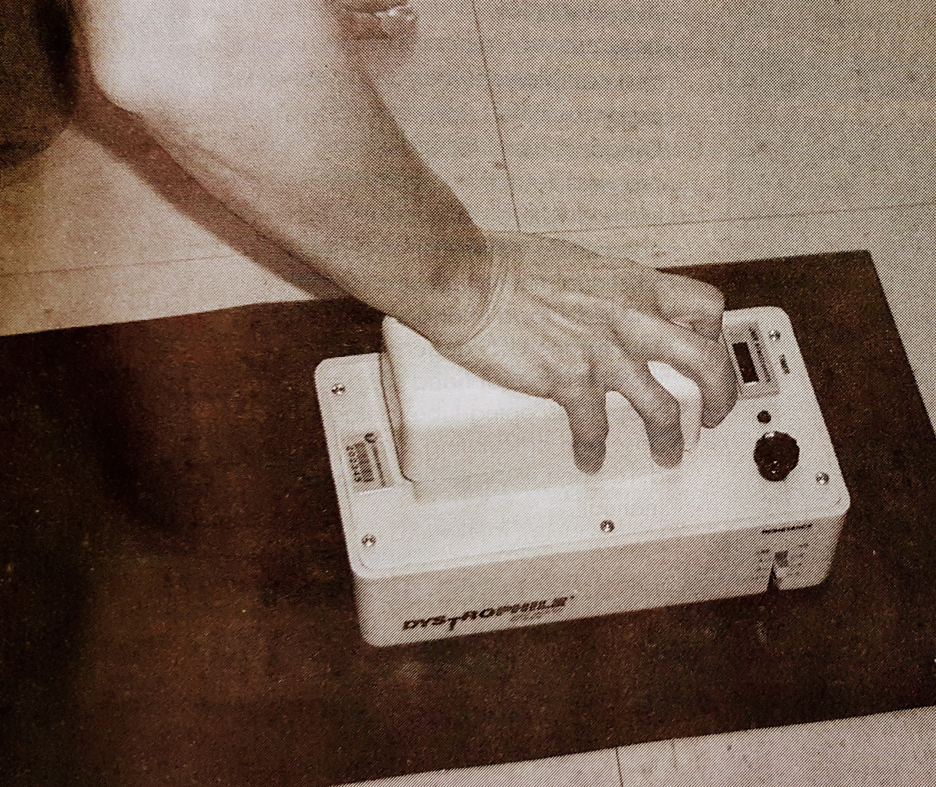
Treatment: Loading

Slide 51
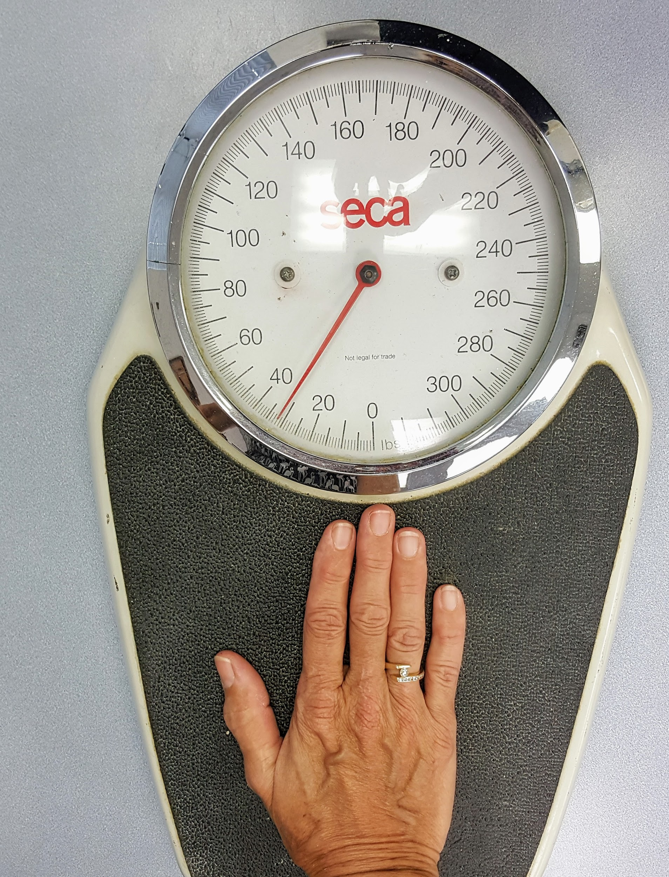
Treatment: Loading

Slide 52
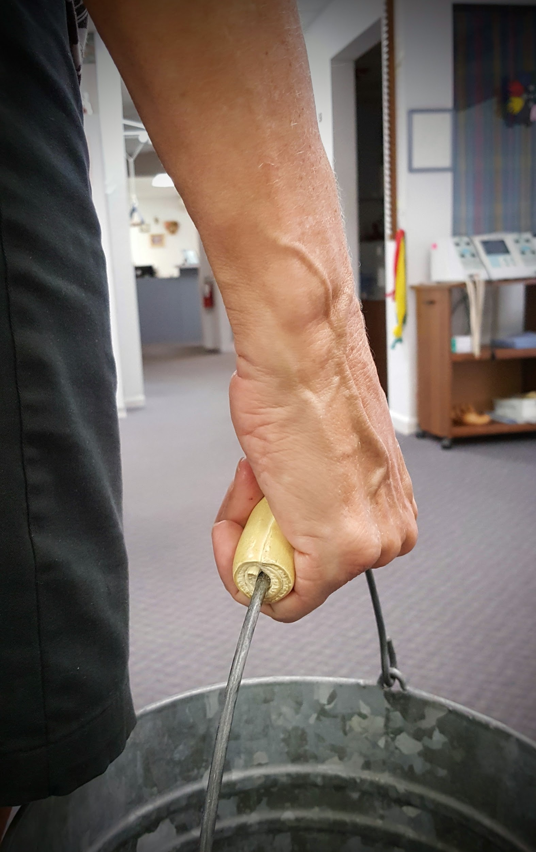
Treatment: Loading

Slide 53
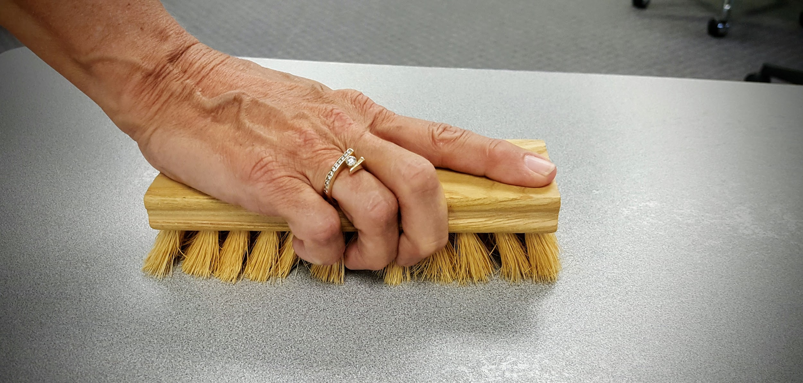
Treatment: Loading

Slide 54
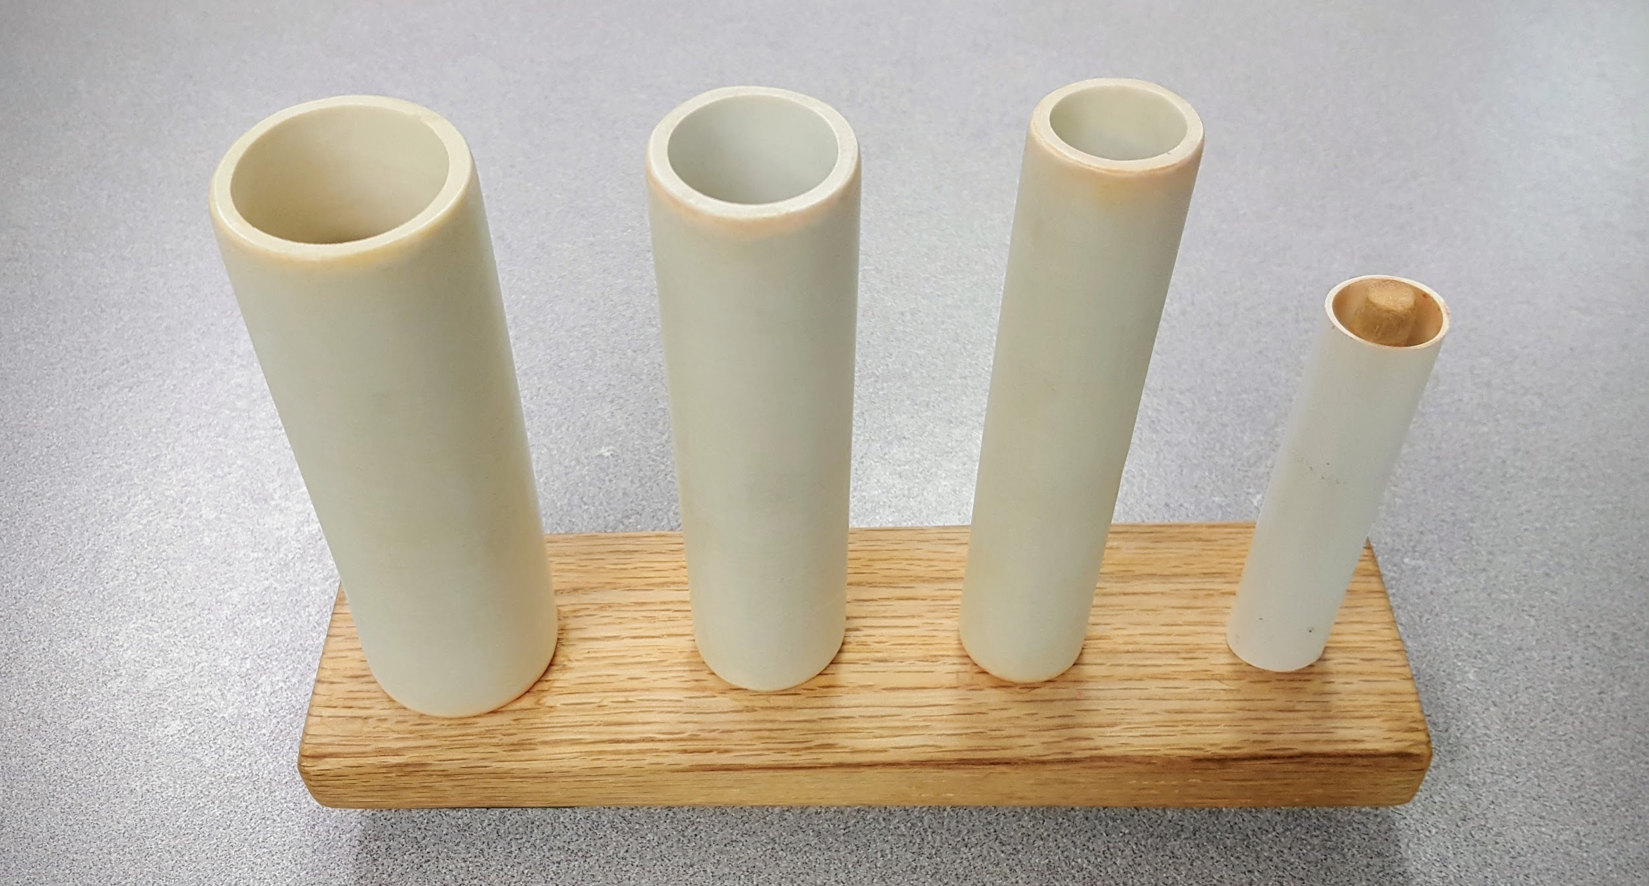
Treatment: Loading

Slide 55
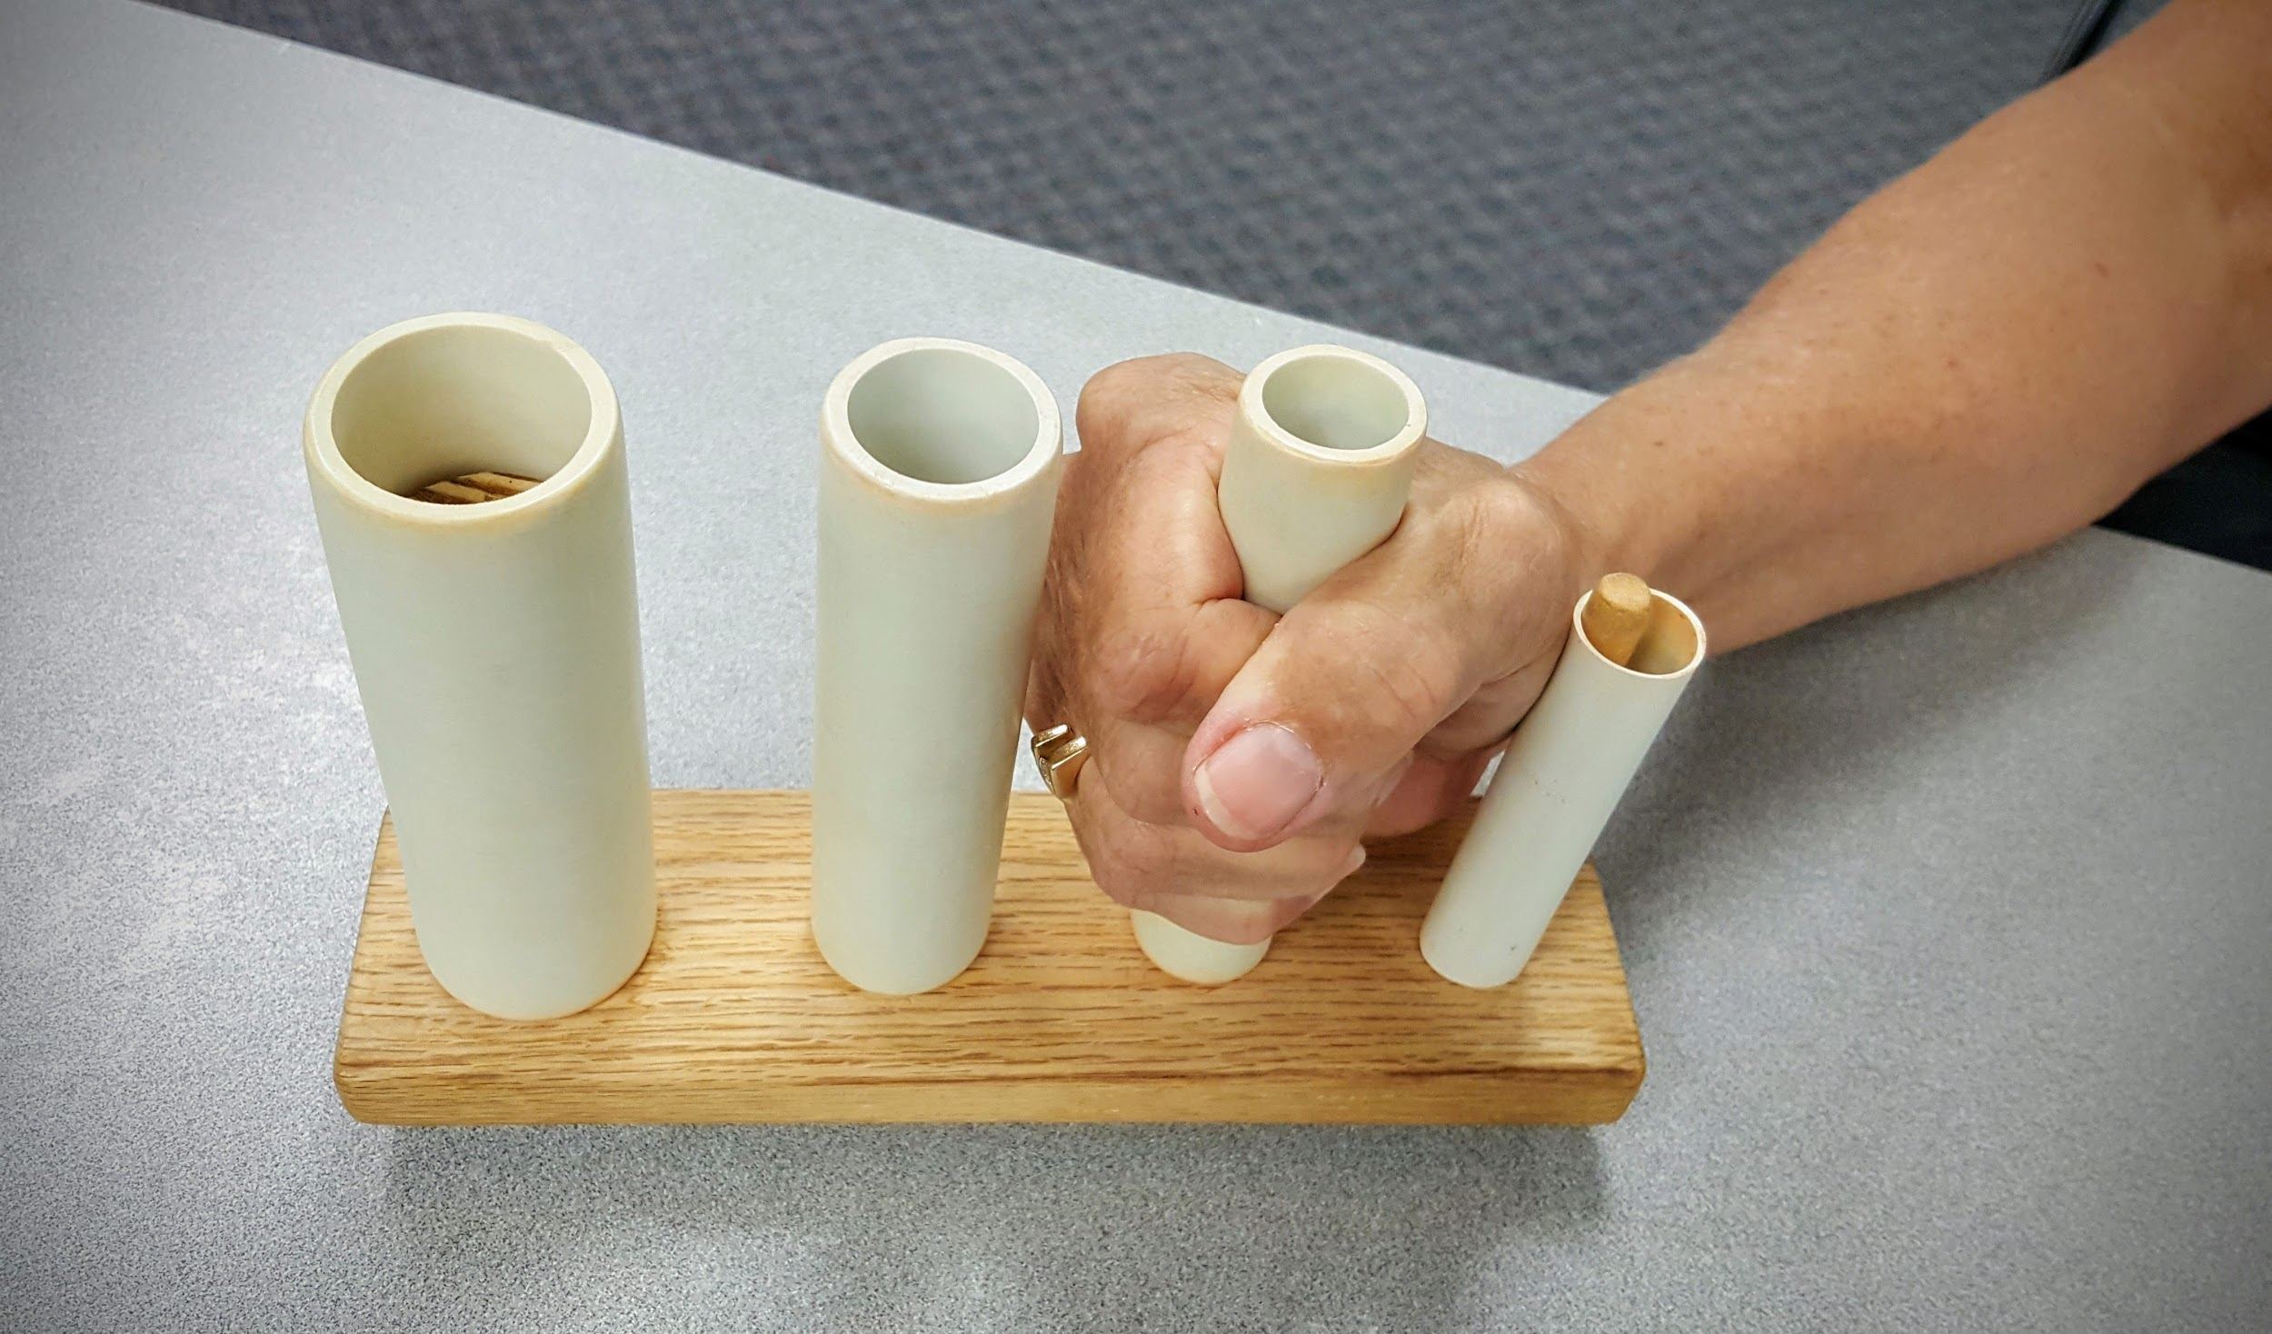
Treatment: Loading

Slide 56
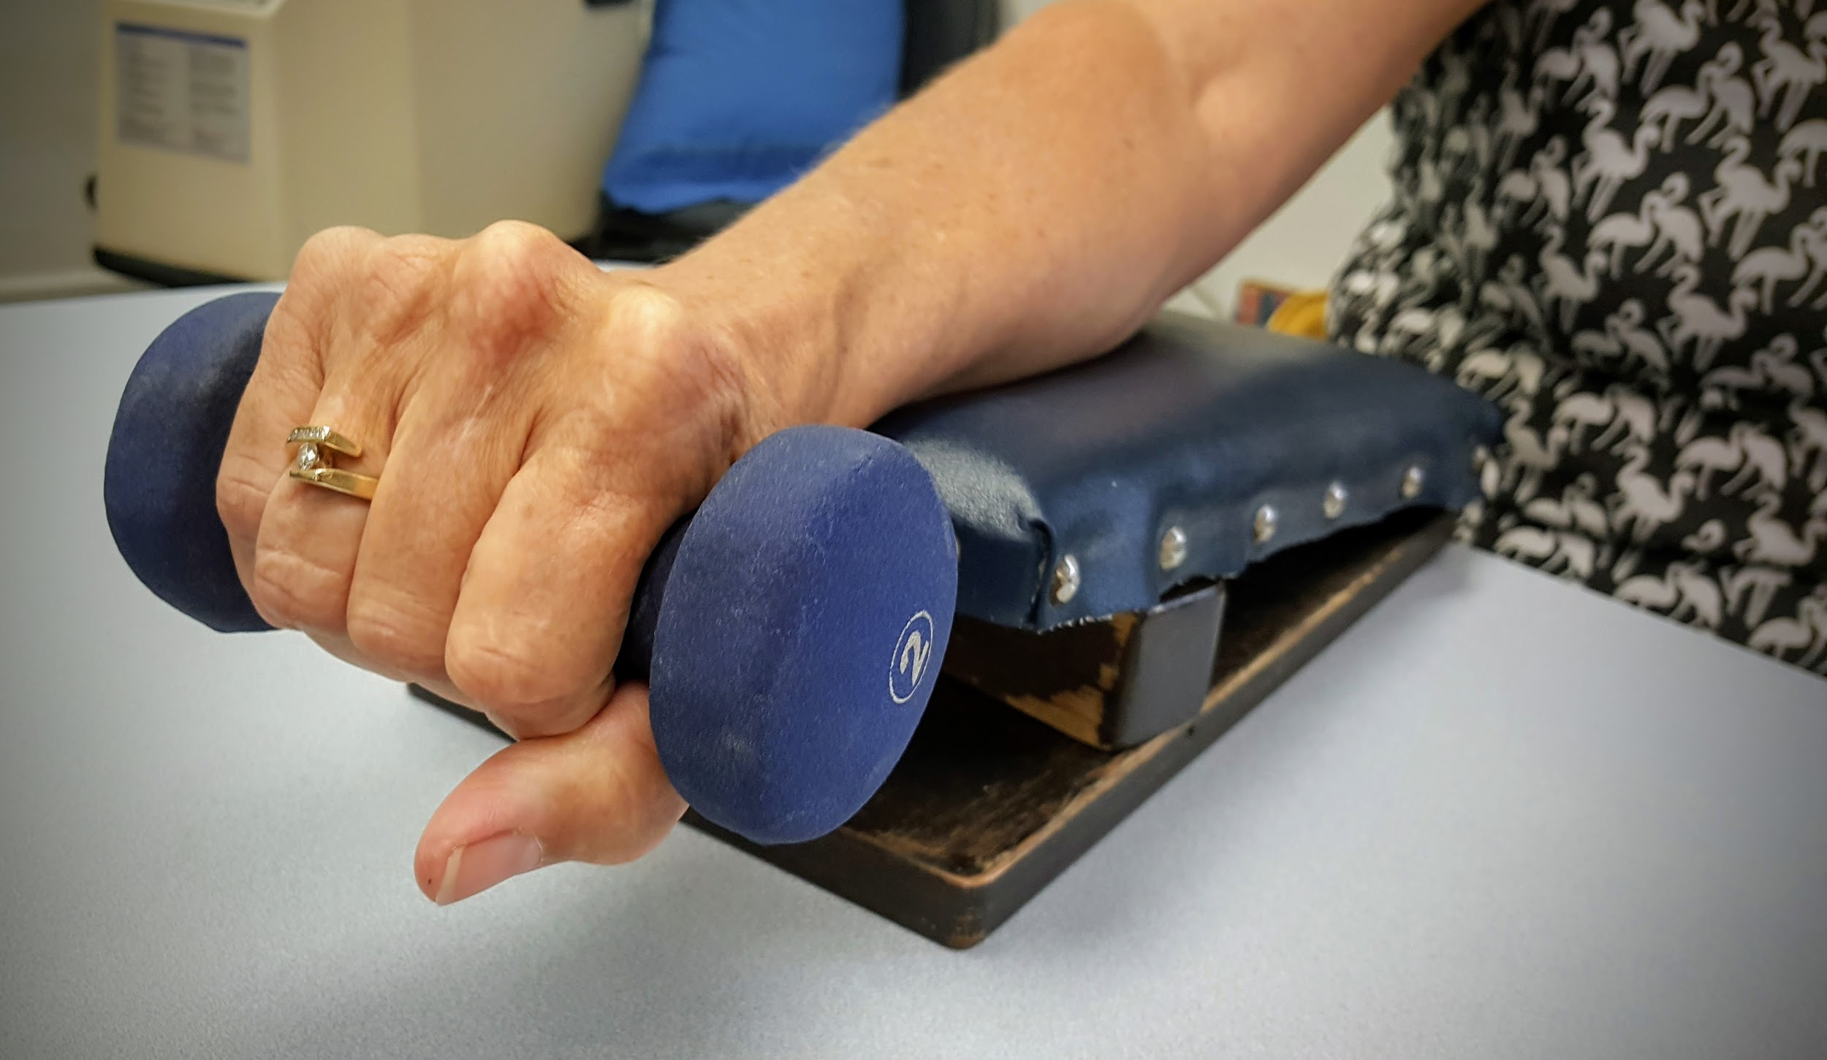
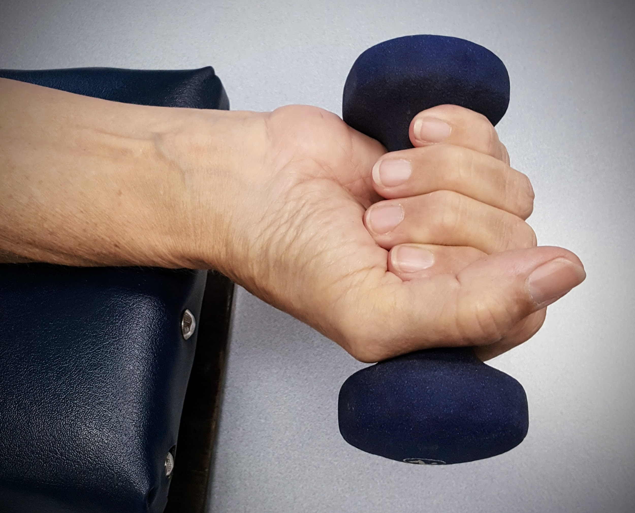
Treatment: Simple Exercise

Slide 57
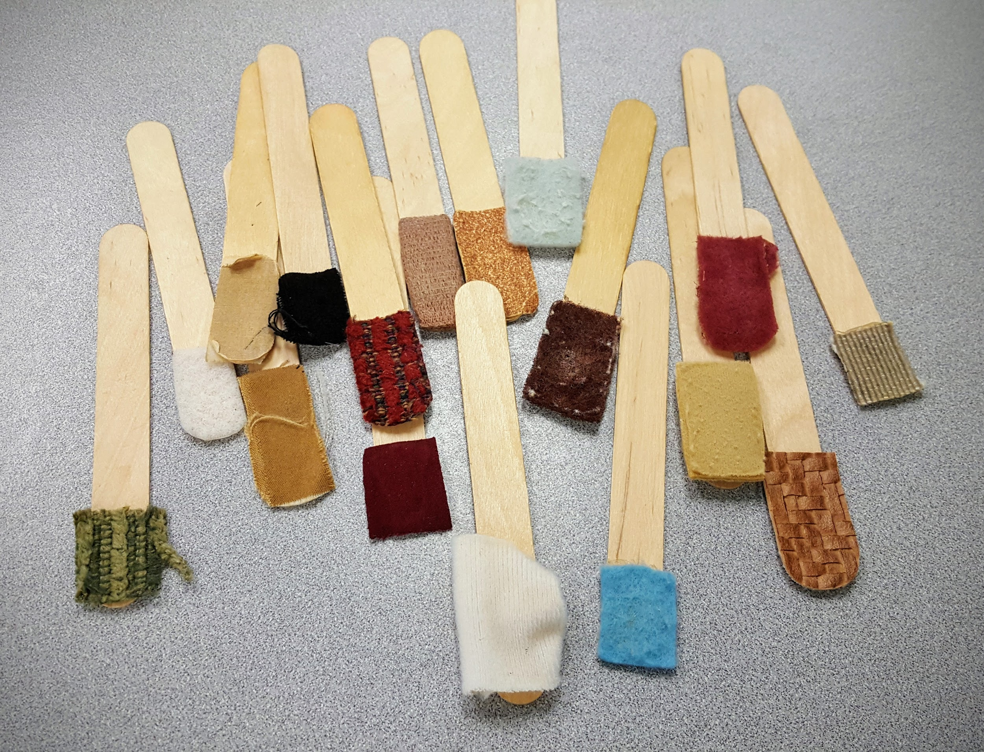
Treatment: Desensitization

Slide 58
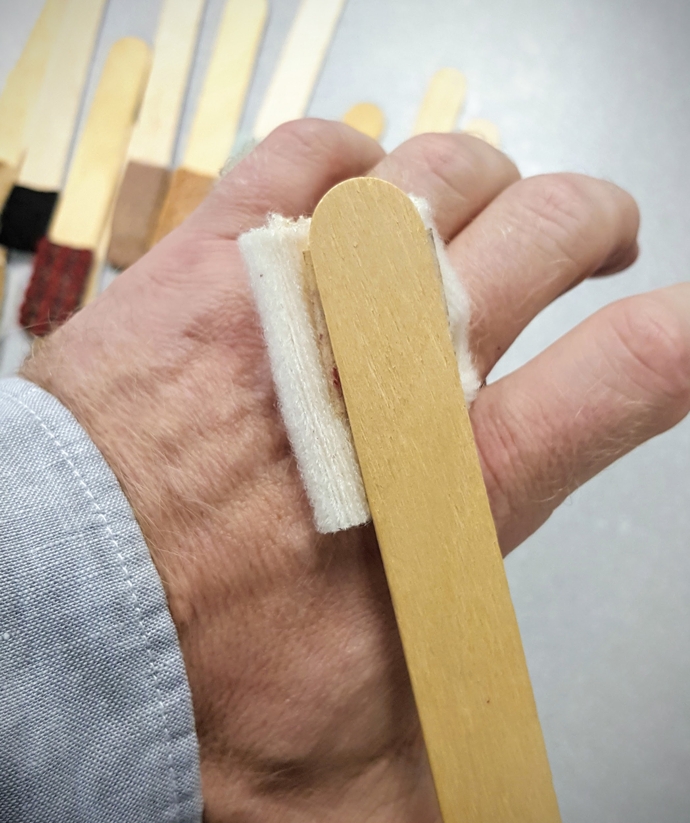
Treatment: Desensitization

Slide 59
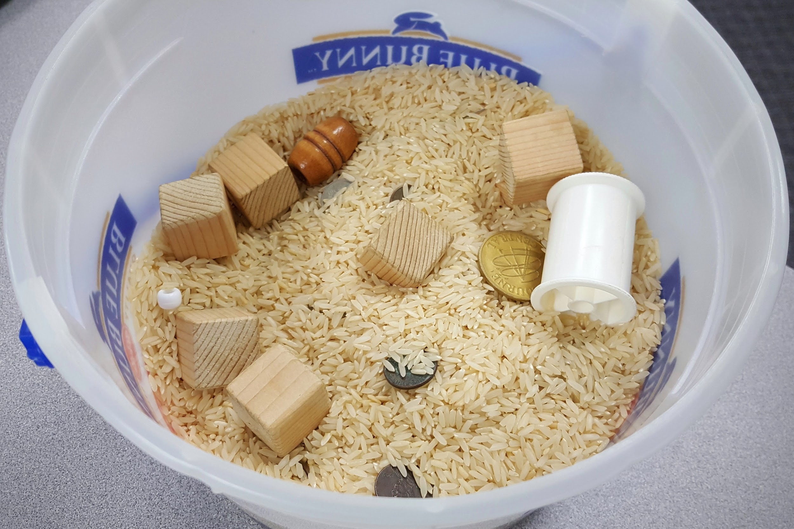
Treatment: Desensitization

Slide 60
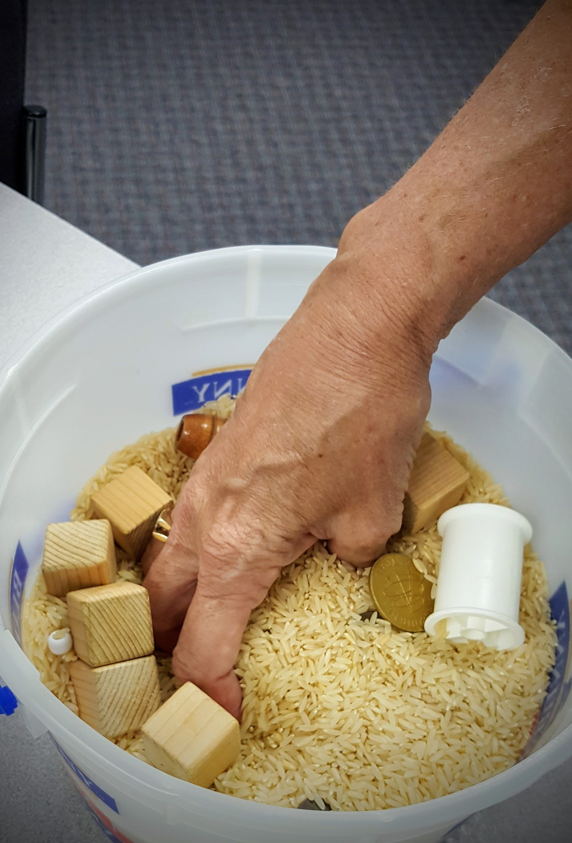
Treatment: Desensitization

Slide 61
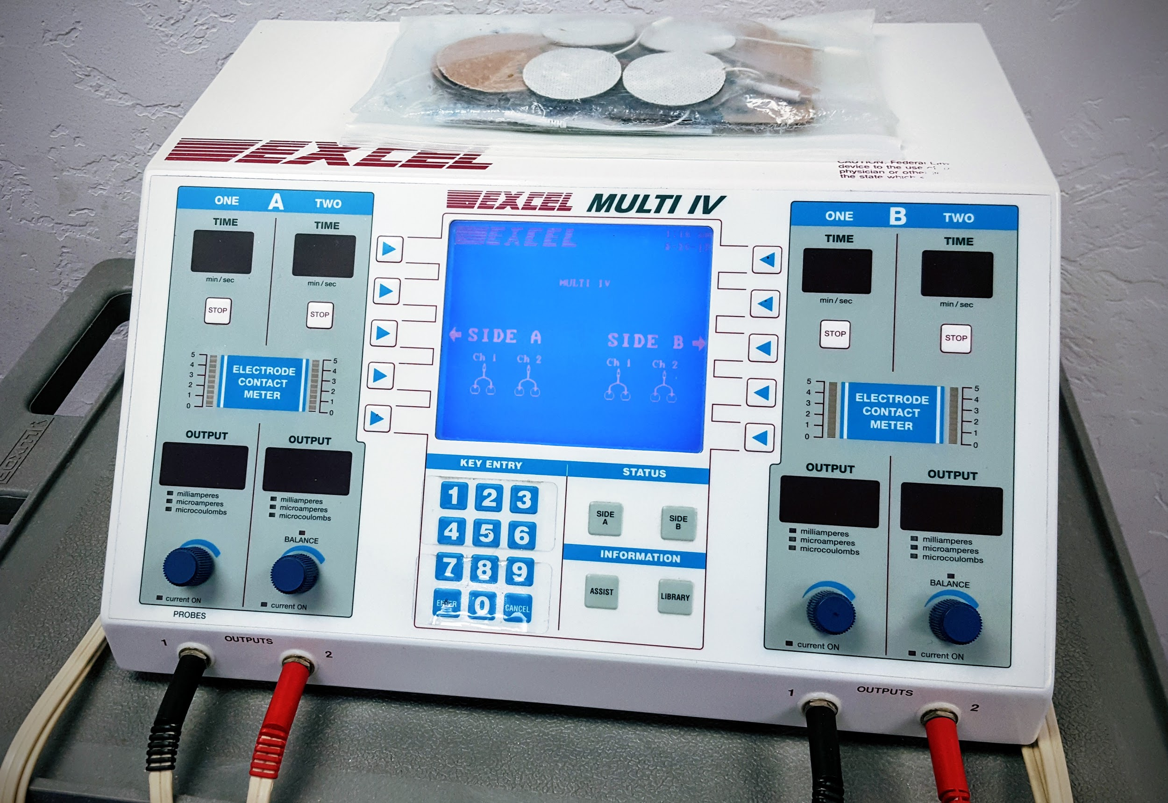
Treatment: Electrical Modalities

Slide 62
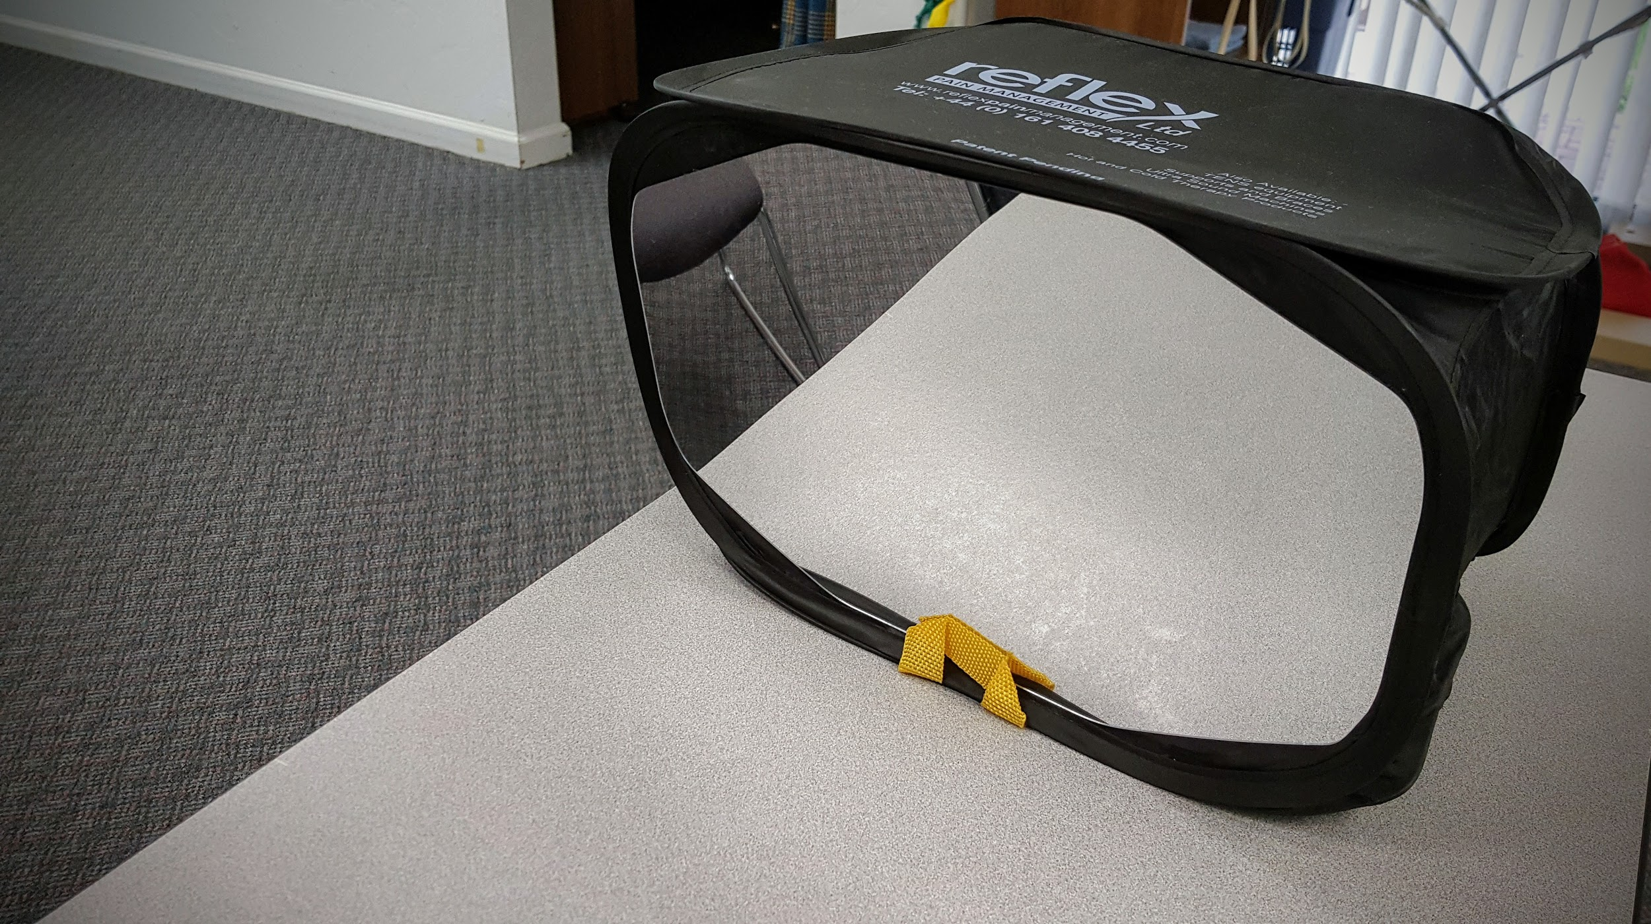
Treatment: Mirror Box

Slide 63
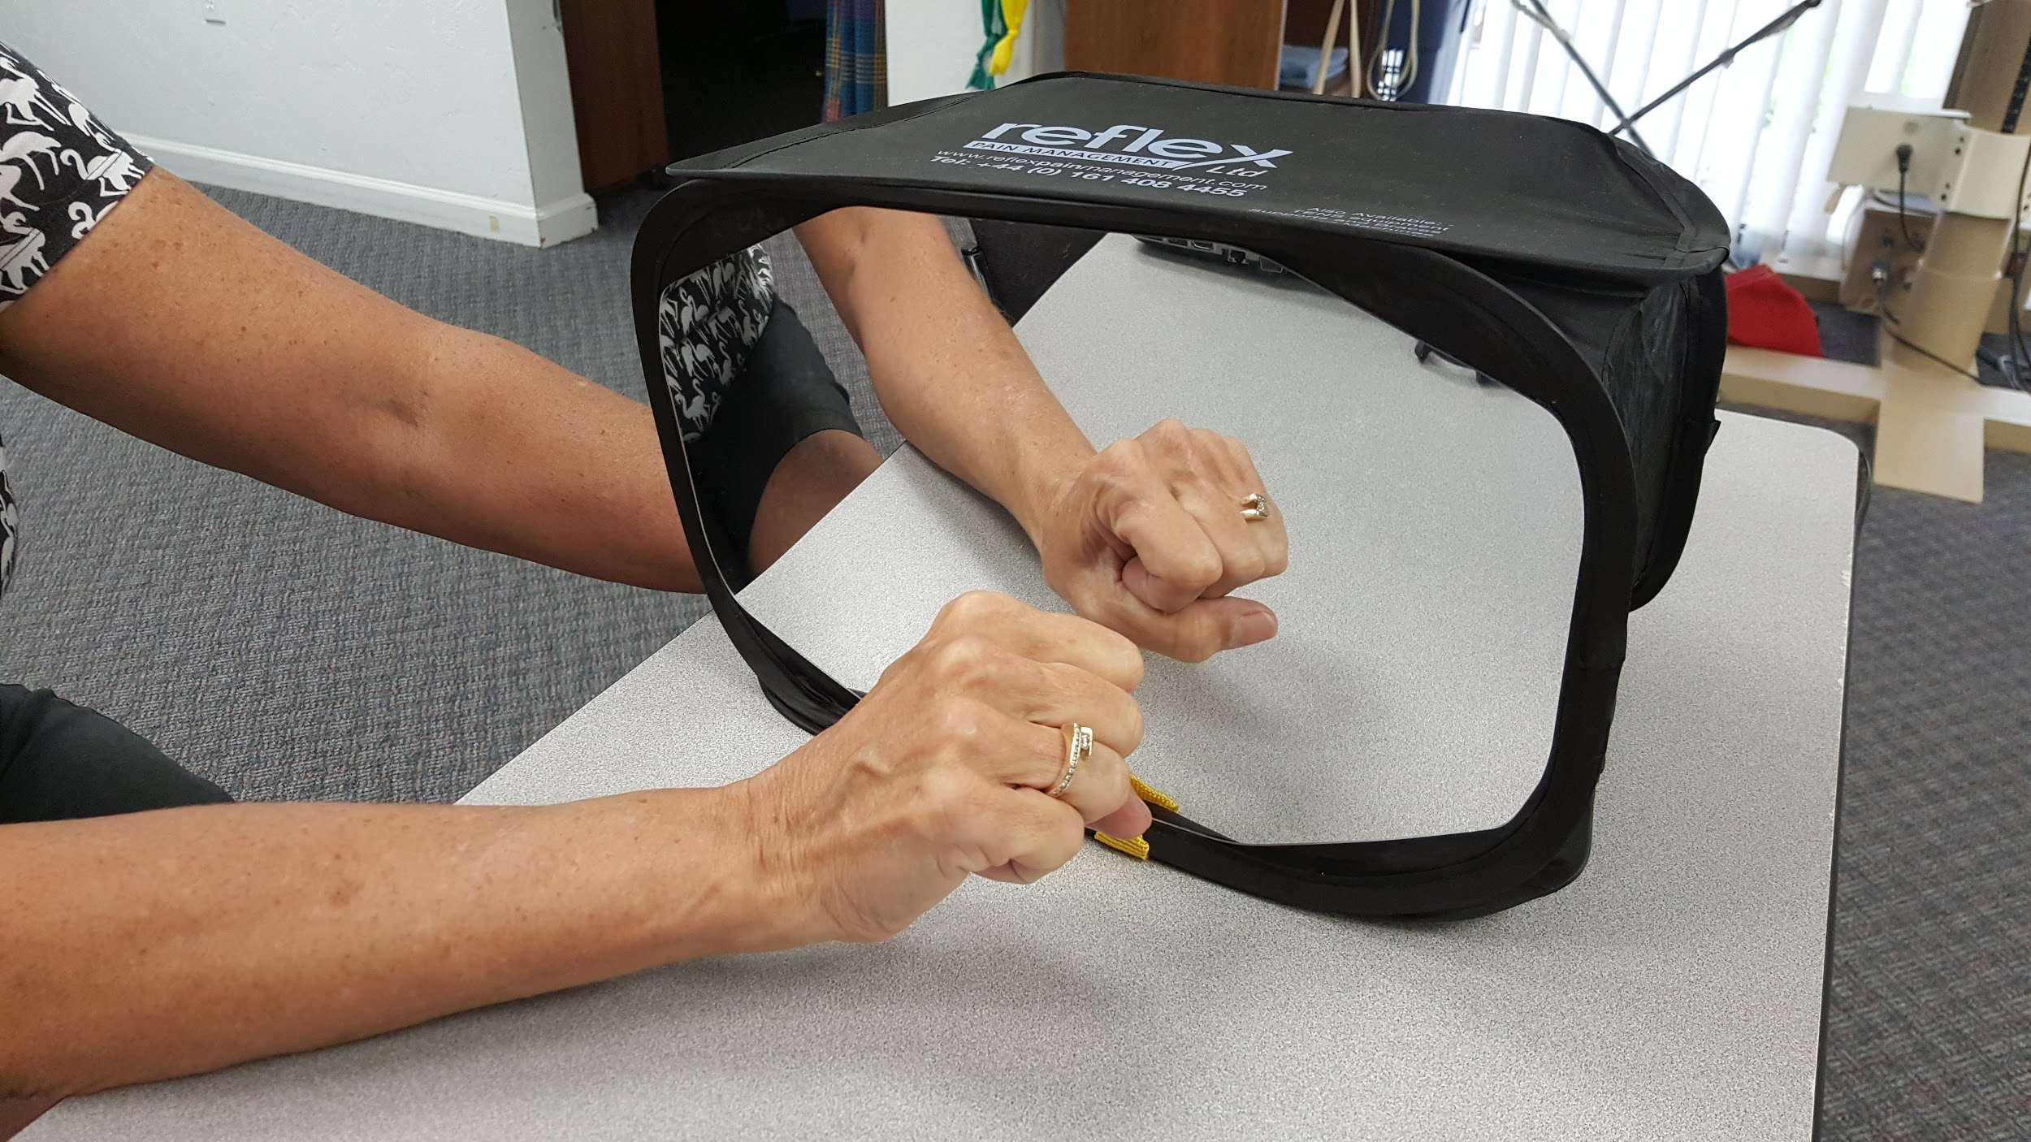
Treatment: Mirror Box

Slide 64
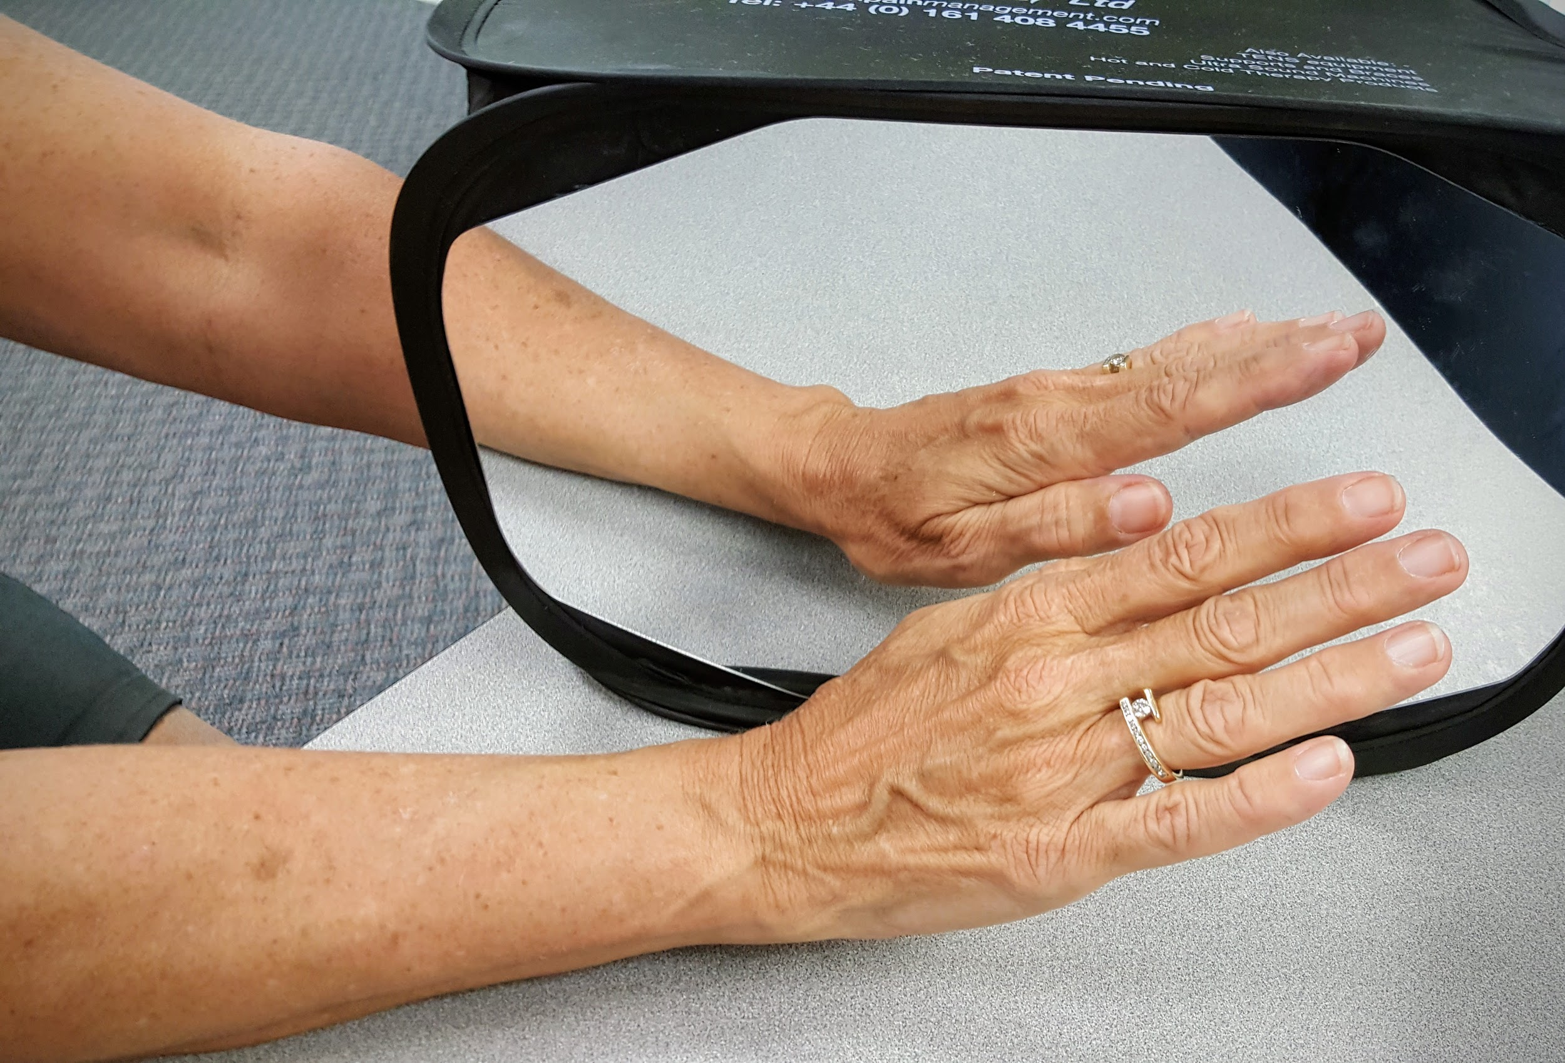
Treatment: Mirror Box

Slide 65
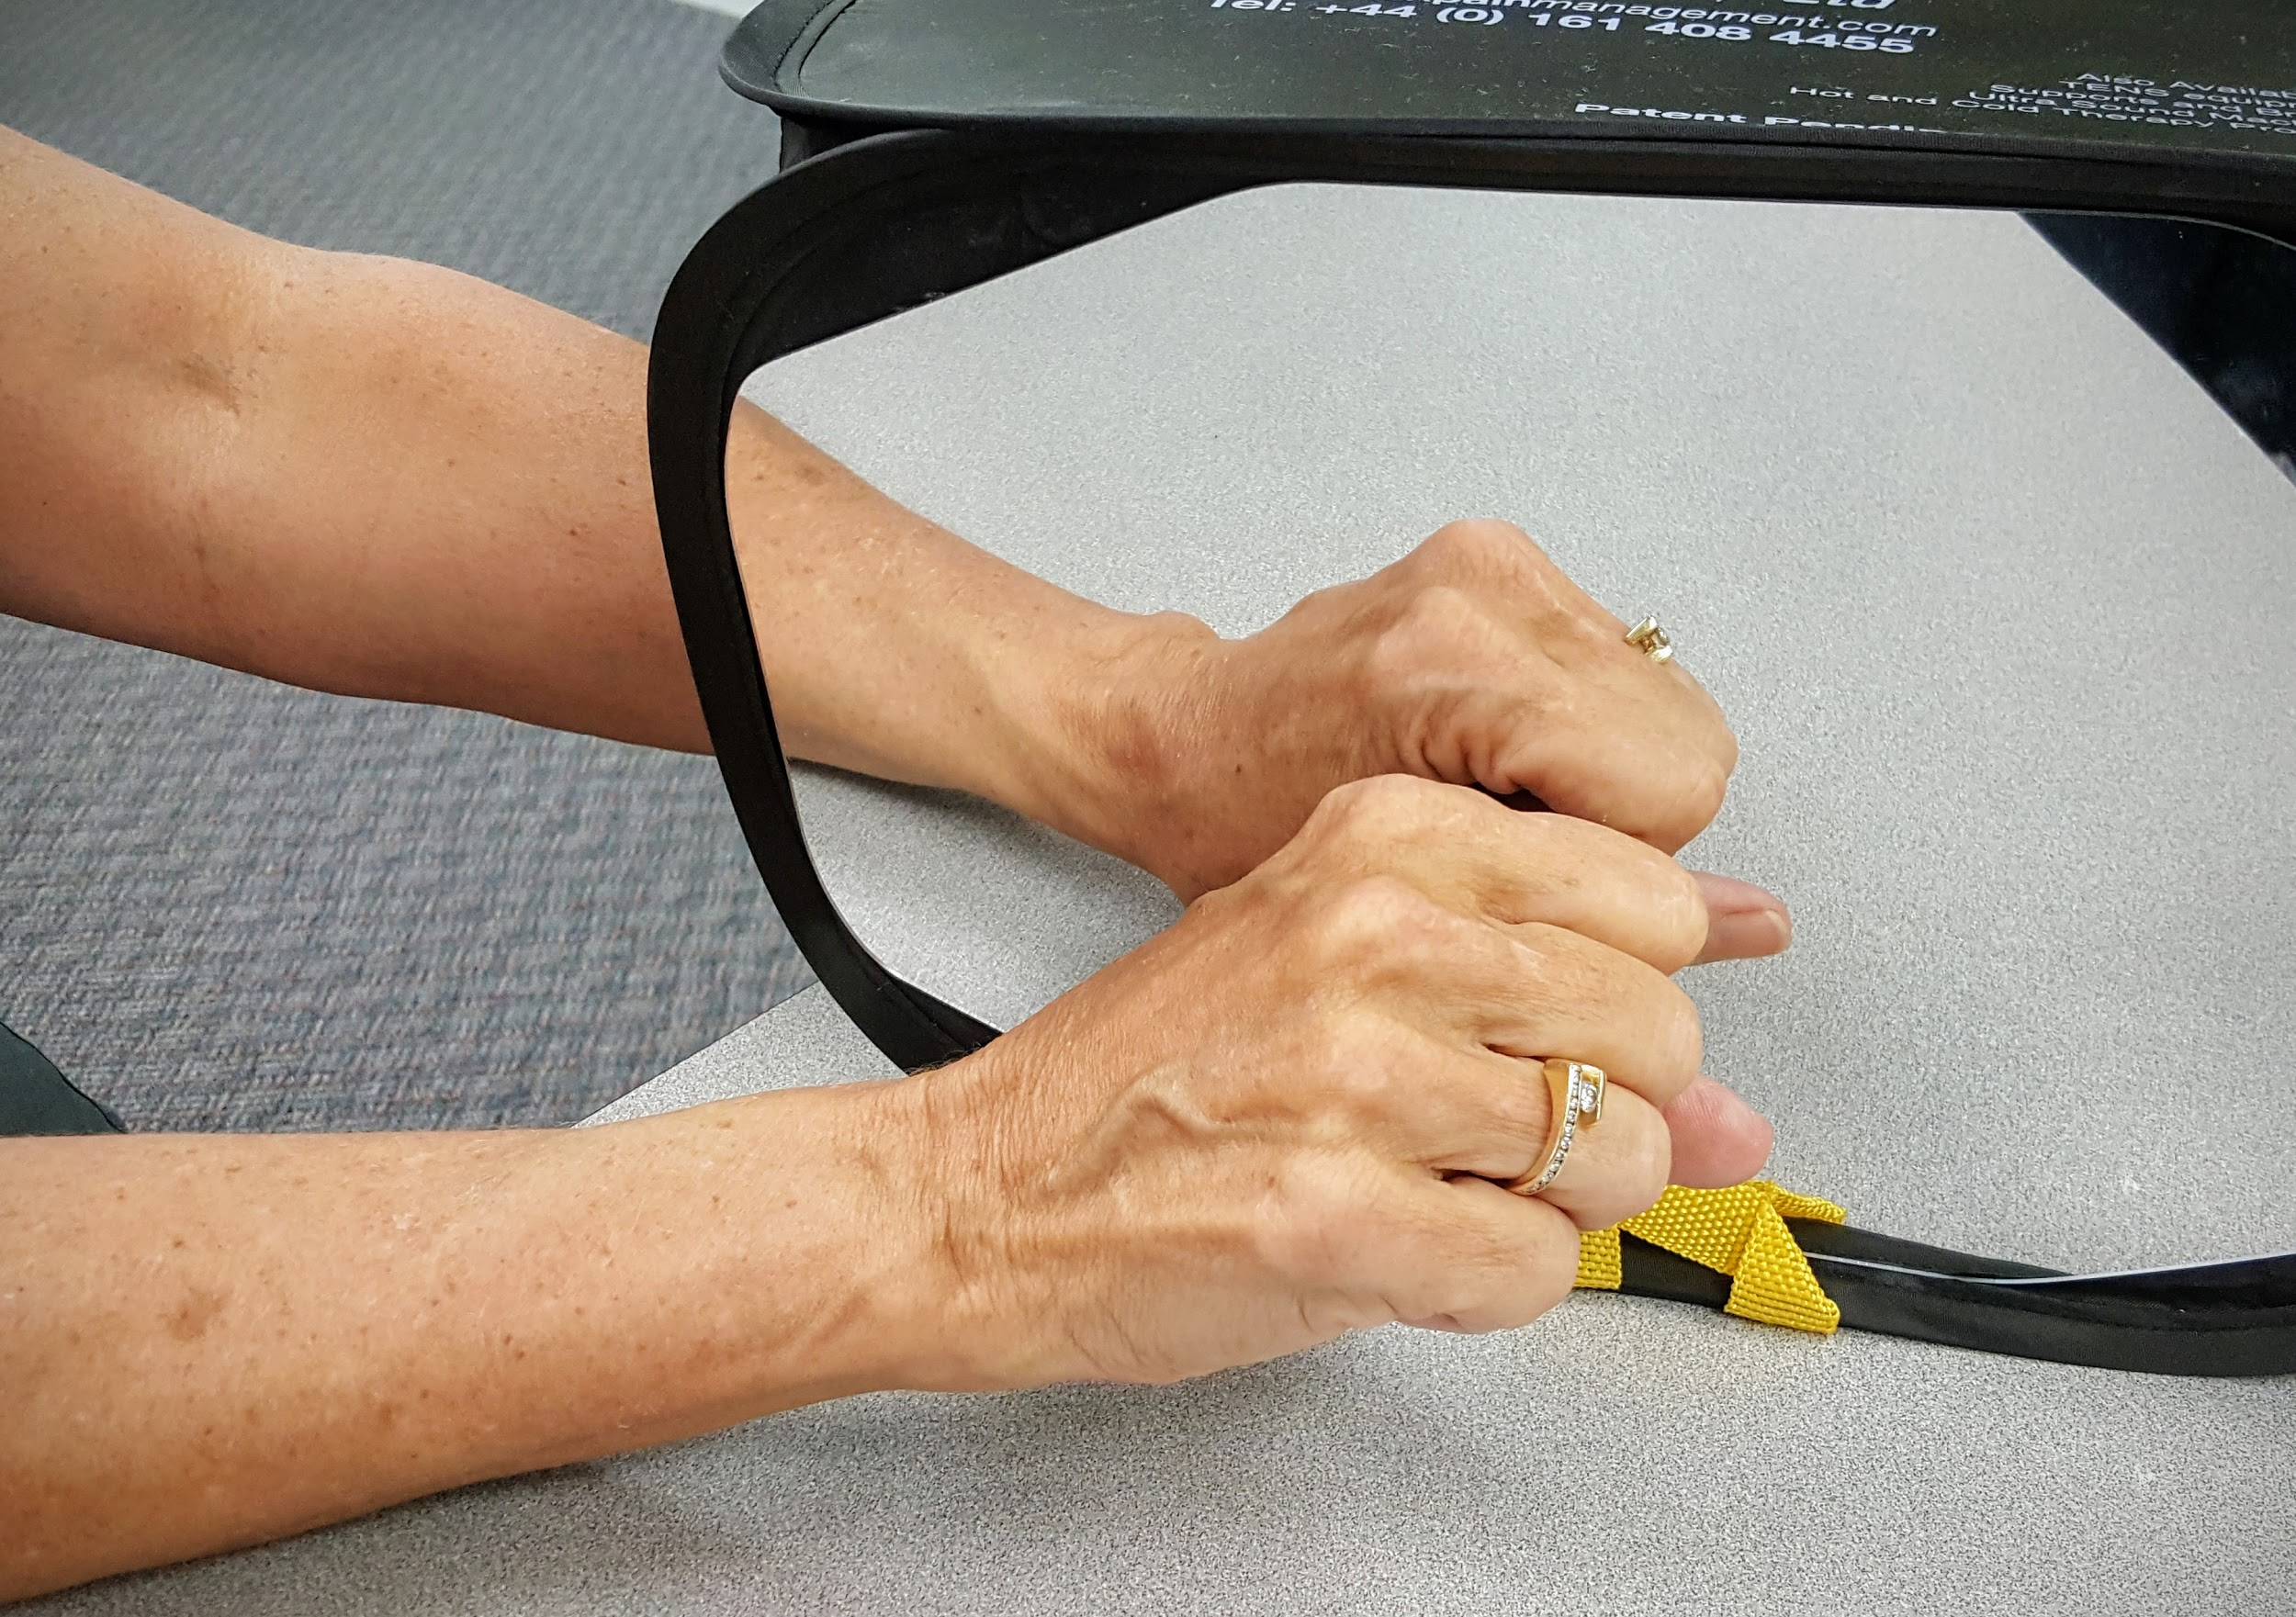
Treatment: Mirror Box

Slide 66
Conclusion

Slide 67
Therapist Goals for Dystrophy
Decrease Pain - Don’t increase pain
Work, but don’t work through pain
Support, but don’t coddle
Be flexible with fluctuating signs and symptoms
Strength/Loading before range of motion
Emphasize Function - No useless limbs!
Patience, but appropriate adaptations of treatment

Slide 68
Dystrophy Treatment ‘Accents’
Avoid aggressive passive stretch
Use caution with casts and splints
Emphasize Stress-Loading
Emphasis Active Motion

Slide 69
:-)

