Slide 1
Shoulder Instability: Therapy Role in Non-Op and Operative Treatment
Trevor R. Born, M.D.
Sarasota Orthopedic Associates

Slide 2
Disclosure Statement
No financial interest or contractual relationships with any commercial interest to disclose.

Slide 3
Potential Subjects to Discuss
Case Report: IV Drug Abuser with 10 trigger fingers and how it cured their addiction
Correlation of a Physician’s Beard with Patient Respect
Lie Detectors: A Worker’s Compensation Adjuster’s Best Friend?
Hoverboard injuries in the Villages: An Epidemic?
Shoulder Instability and the Therapist’s Role

Slide 4
Trevor R. Born, M.D.
Born and raised in Bradenton, FL
Graduated from Bayshore High School
Parents and 2 siblings still live here
Continued education
University of Florida- Undergraduate
University of South Florida College of Medicine
Mayo Clinic- Orthopedic Surgery Residency
Brown University- Sports Medicine Fellowship

Slide 5
The Basics
If it popped out the front, don’t abduct/externally rotate the arm
If it popped out the back, don’t adduct/internally rotate the arm

Slide 6
Thank You

Slide 7
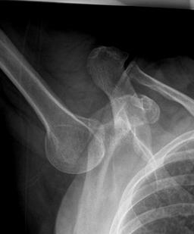
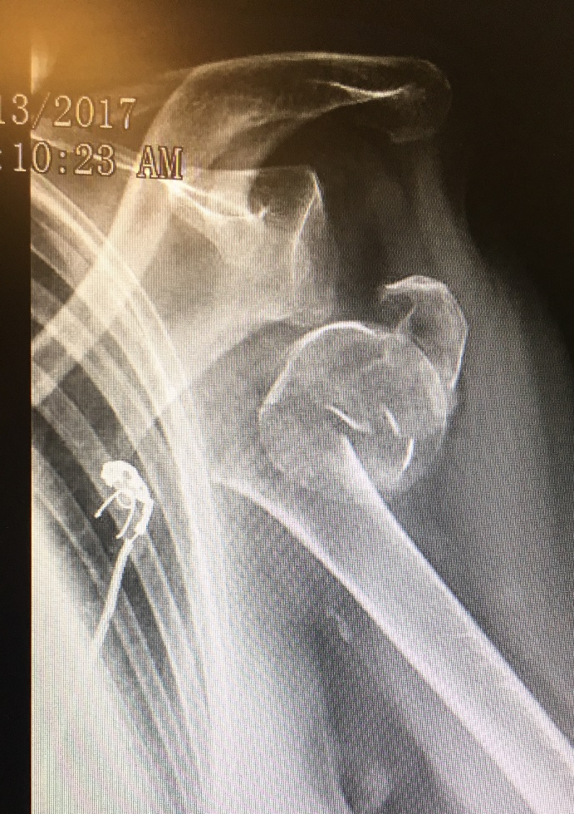
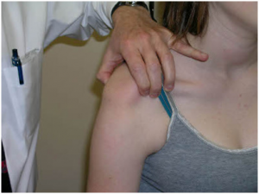
Not All Instability is the Same
Posterior Shoulder
Dislocation
Luxatio Erecta
Proximal Humerus Fracture-Dislocation
Traumatic
Anterior
Dislocation
Multidirection Instability

Slide 8
Anatomical Considerations
Pathophysiology
Dynamic Restraints
Rotator cuff muscles (SITS)
Scapular stabilizing muscles
Static Restraints
Labrum, Capsule, IGHL/MGHL/SGHL
Anterior band of the IGHL is most important restraint in abduction, external rotation

Slide 9
Anatomical Considerations
Capsule/Ligaments
Inferior Glenohumeral Ligament Complex
Heavily involved in maintaining shoulder stability
Forms a hammock with anterior and posterior bands
Primary stabilizer limiting anterior, posterior & inferior humeral translation at 90° abduction
Bankart lesion= detachment of anterior band off glenoid
Middle Glenohumeral Ligament
Primarily effective at 45° abduction
Helps limit external rotation, inferior and anterior humeral translation
Superior Glenohumeral Ligament
Minor role in preventing anterior instability
Mainly effective at limiting inferior translation and ER with arm at side/adducted
Notes:
There is minimal bony containment of the humeral head in the glenoid cavity which allows a wide ROM.
The articular surface area of the humeral haead is 2-4x that of the glenoid and the humeral head is nearly twice as wide as the glenoid when measured in the transverse plane.
Ligamental anatomy of the shoulder includes the superior, middle and inferior glenohumeral ligaments. The inferior glenohumeral ligament includes an anterior and posterior band. The ligaments come into play only at the extremes of motion.
The labrum provides depth to the glenoid and attachment of the GH ligaments and biceps tendon.

Slide 10
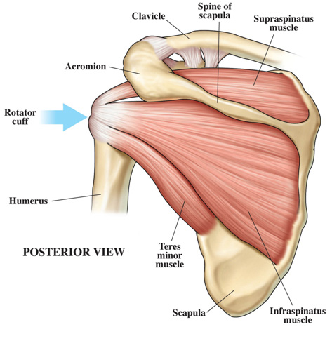
Anatomical Considerations
Rotator Cuff
EMG Studies show that all (with deltoid) are active throughout full ROM of flexion, abduction and elevation
Co-contraction helps hold humeral head in center of glenoid throughout arc of motion
Create GH compressive force that helps stabilize joint

Slide 11
Anatomical Considerations
Scapulothoracic stability has been emphasized as an important component of GH stability.
Dysfunction can lead to failure of scapular rotation beneath the humeral head, permitting abnormal translation
Trapezius, serratus anterior and rhomboids all influence scapular movements
Notes:
Imaging analysis has shown that patients with shoulder instability have scapulothoracic dysfunction that is manifested as winging.
To provide a stable platform under the humeral head, the scapula and humerus need to move in syncrony and the orientation of the glenoid needs to adjust to changes in arm position—the trapezius and serratus anterior contribute to prduce scapular elevation and upward rotation

Slide 12
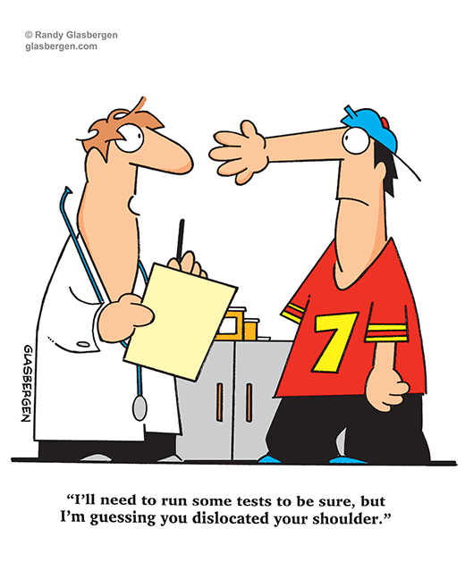

Slide 13
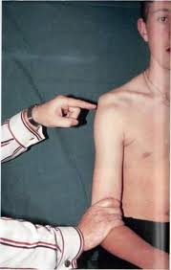
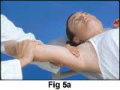
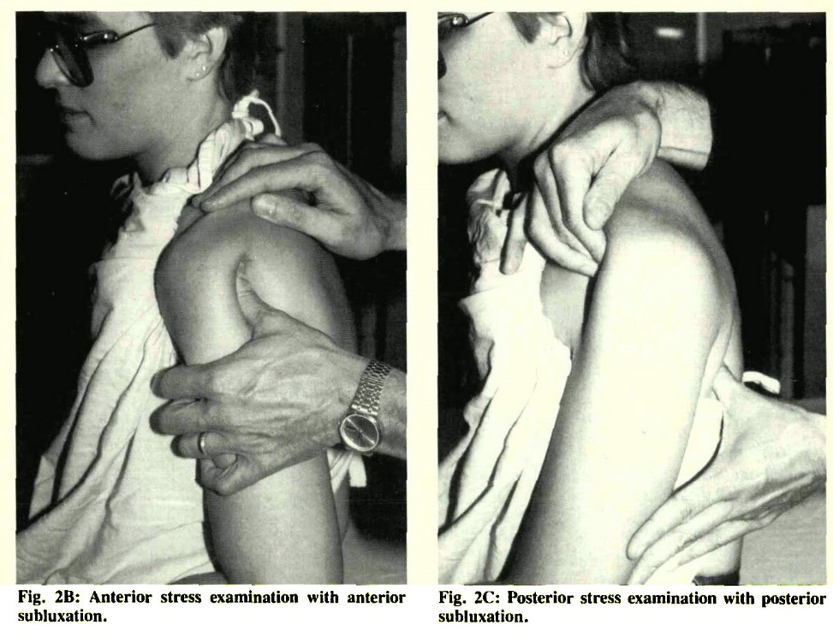
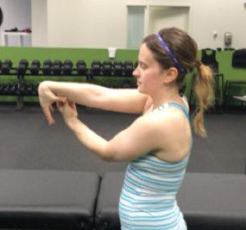
Patient Evaluation
Physical Exam
Strength
Muscle atrophy and scapular winging
Motor and sensory exam
ROM assessment
Soft-tissue laxity
Beighton Score
Special tests
Sulcus Sign
Load and Shift
Apprehension Test
Relocation
Jerk Test
Notes:
Sulcus test assesses the superior glenohumeral ligament. When there is a sulcus sign of 2 cm or more, the likelihood of shoulder instability is high (likelihood ratio 6:1)
Load and Shift—arm placed at 90 degrees of abduction and medial rotation and humeral head is loaded into glenoid to ensure that it is centered. Examiner then attemps to shift the humeral head anterior, inferior and posterior. Thi test has a high specificity of 98-100%; however poor reproducibility---this is significantly improved when patient is anesthetized.
Apprehension test—arm placed in same position as load and shift test, but examiner does not load the joint. Rather, the arm is then abducted and externally rotated to 90 degrees and then gradually rotated furtehr an extended. A positive test occurs when the patient become apprehensive.

Slide 14
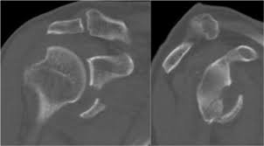
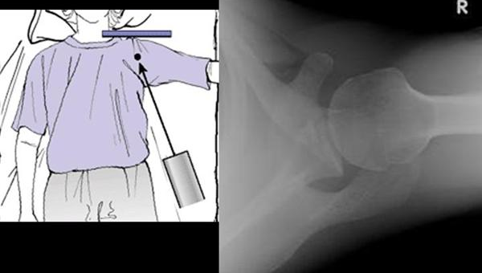
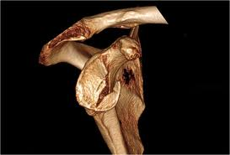
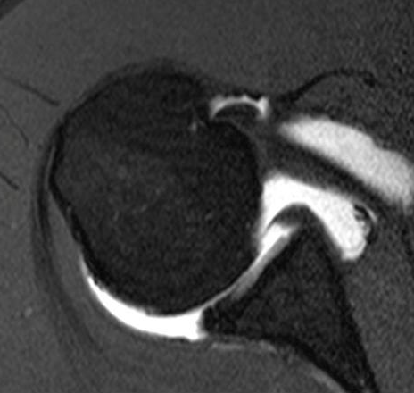
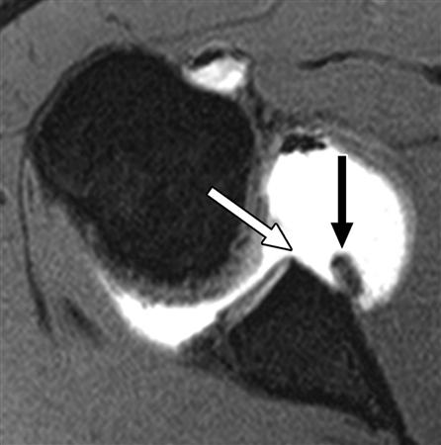
Shoulder Instability Imaging
Radiographs
CT
Best to assess bone stock
3D reconstructions
MRI
With or without arthrogram
Evaluate the soft-tissues

Slide 15
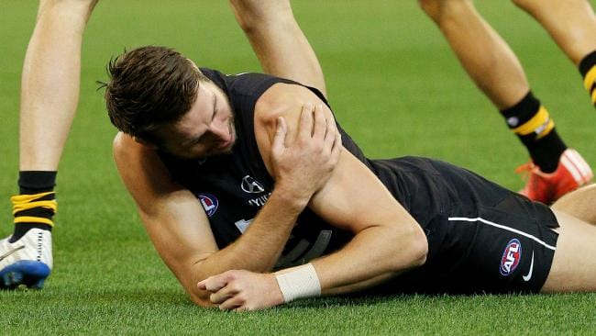
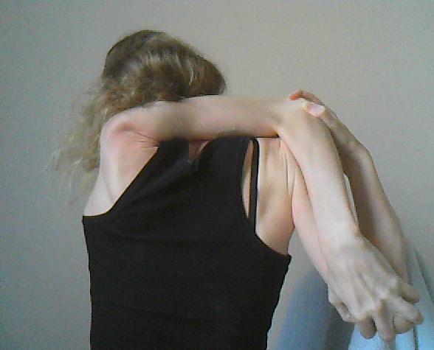
Shoulder Instability
Traumatic vs. Atraumatic
Direction of Instability
Age
Single episode vs. Recurrent
Arm dominance
Activities/Sports
Contact vs. Non-contact, overhead
Co-Morbidities

Slide 16
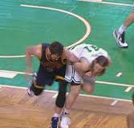
Anterior Instability
Anterior Instability
>90% of Dislocations
Abducted and externally rotated arm
Recurrent Dislocation
Under 20 years old: Wide variation between studies (<25% to >90%)
Less likely as age increases
Males higher risk than females at all ages
Higher risks in contact sports
Rotator Cuff Tears
After 40 yrs old – 40%
Initial Management
Reduction, immobilization

Slide 17
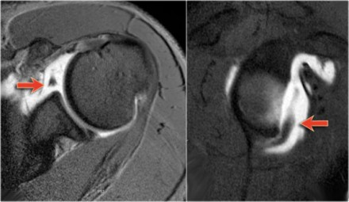
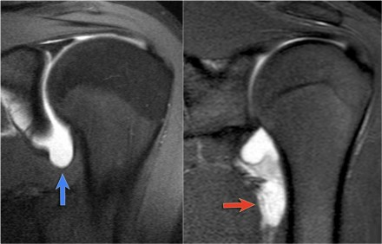
Anterior Instability
Bankart Lesion and avulsion of IGHL from glenoid
>90%
Includes bony component at times
Humeral Avulsion of Glenohumeral Ligament (HAGL)
<10%

Slide 18
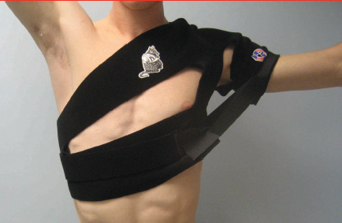
Treatment
Immobilization in internal vs. external rotation
No consensus, no apparent benefit in ER
In season dislocations:
AJSM 2004 study (Buss et al) showed 87% return to sport that season
Averaged 1.4 incidents of recurrent dislocation
>50% had surgery the following off-season

Slide 19
Treatment
Risks with non-operative management in a first time dislocator, especially young male in contact sports
Recurrent instability
Damage to joint, glenoid over time necessitating open procedure
Reported correlation with number of dislocations and risk of failing surgical management
Arthropathy

Slide 20
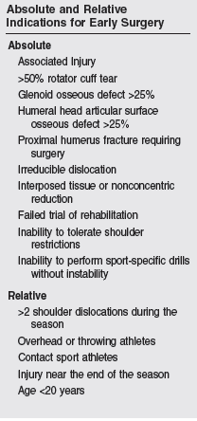
Surgical Treatment
Open vs. Arthroscopic procedures
Level 1 study showed no difference (AJSM 2006)
Systematic review (Sports Health 2011)
No significant difference in redislocation rate, return to activity, or functional outcomes
Better ROM in arthroscopic group
High level contact athletes, some argue open is preferred method
Bony deficiencies
Glenoid- restore bone stock
Latarjet Procedure
Humerus (Hill-Sachs deformity)- fill in space
Remplissage

Slide 21
Arthroscopic Management (Bankart Lesion)

Slide 22
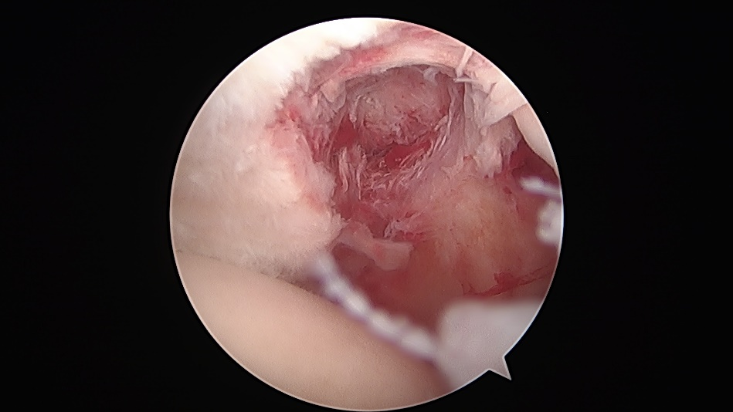
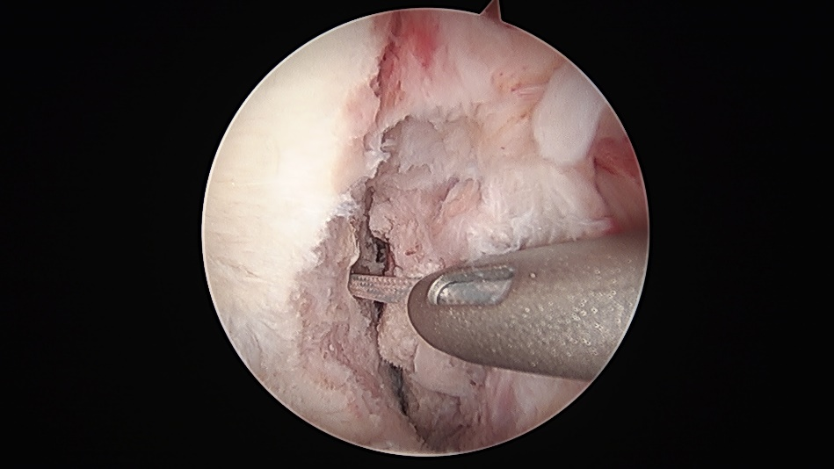
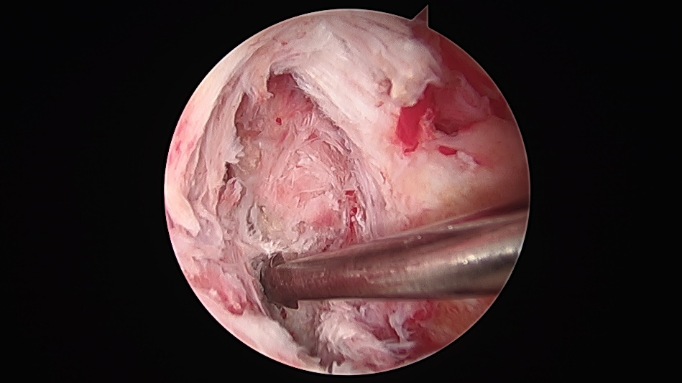
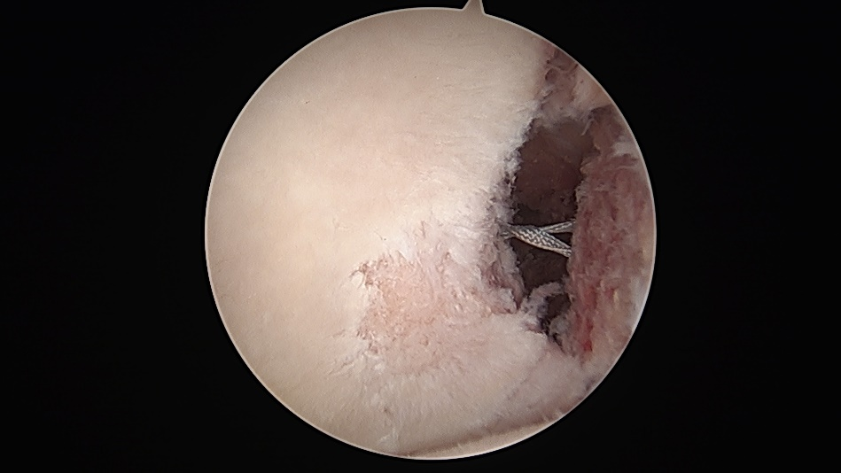
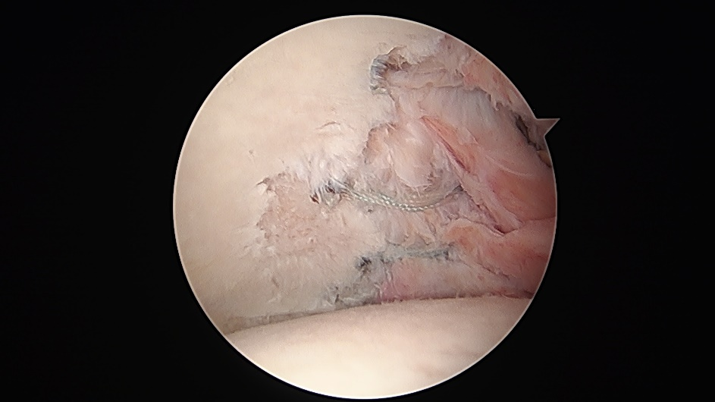
Arthroscopic Management (Bony Bankart)

Slide 23
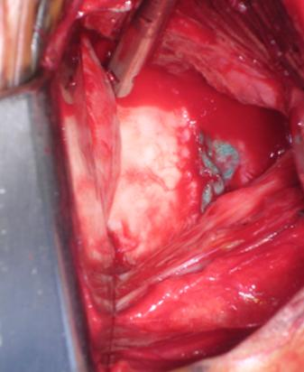
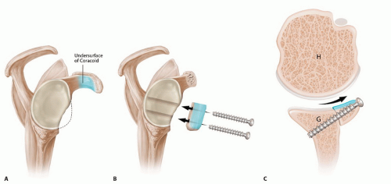
Open Management
Latarjet Procedure

Slide 24
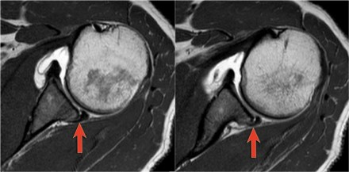
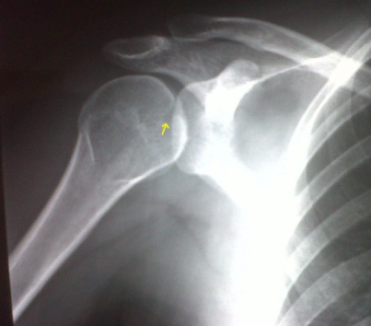
Posterior Instability
4% of all glenohumeral dislocations
High energy, seizure, electric shock
Can see from repetitive use/stress
e.g. Football linemen
50-80% missed at initial presentation
Often present with internally rotated, adducted upper extremity
Radiographs – Axillary view essential
Posterior Subluxation
Apprehension sign: posteriorly directed force with the adducted arm flexed 90° and internally rotated 90°

Slide 25
Treatment
Reduction if needed
Traction, external rotation, abduction
Immobilization 4-6 weeks in neutral rotation
Surgical stabilization for
Chronic instability/dislocations
Articular fractures >20%
Large glenoid rim fractures
Displaced lesser tuberosity fracture
Humeral head replacement
Chronic dislocations > 3-6 months
Fracture of humeral head >50%

Slide 26
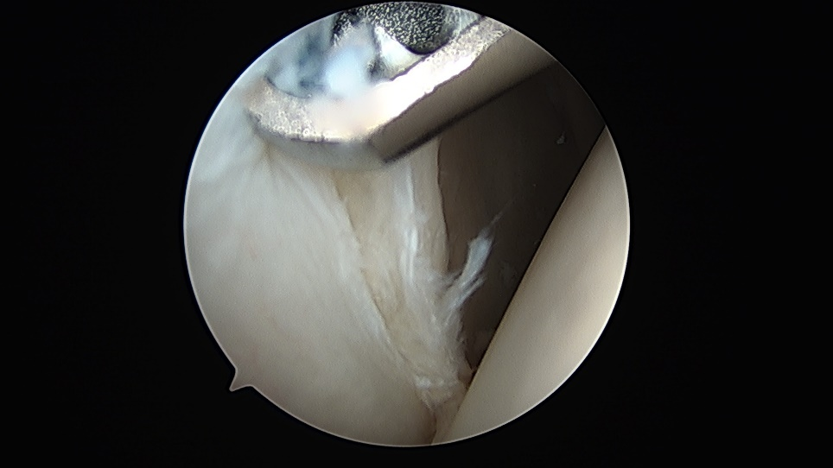
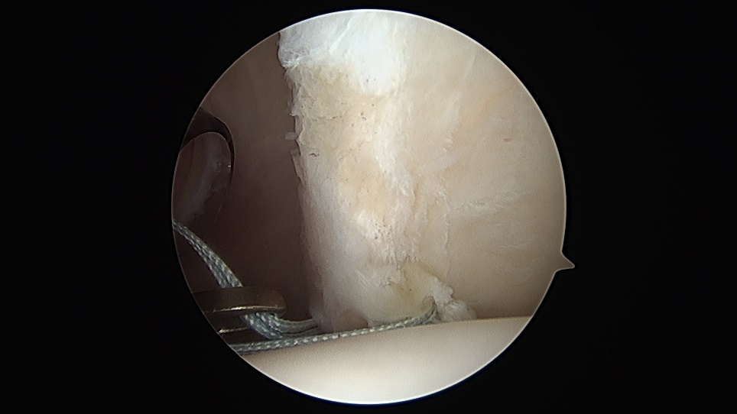
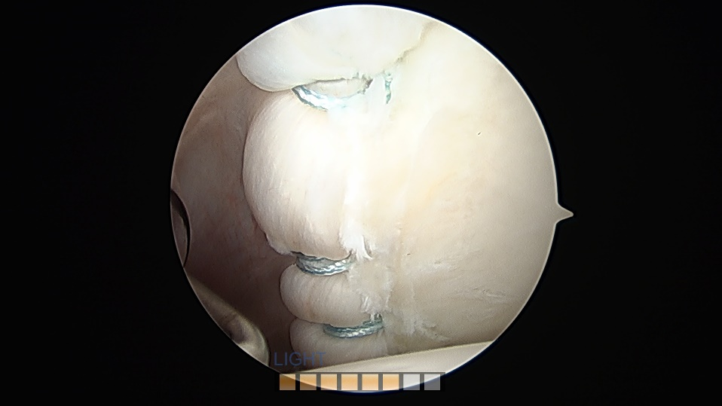
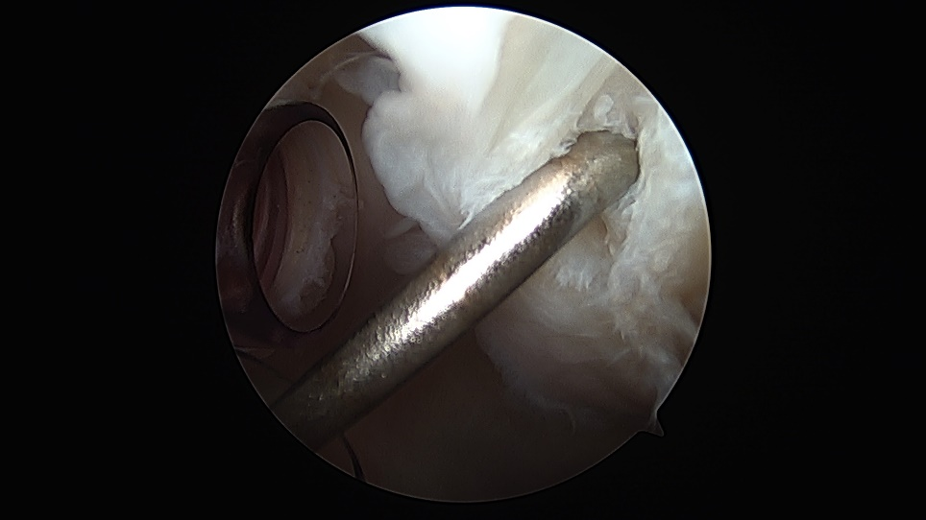
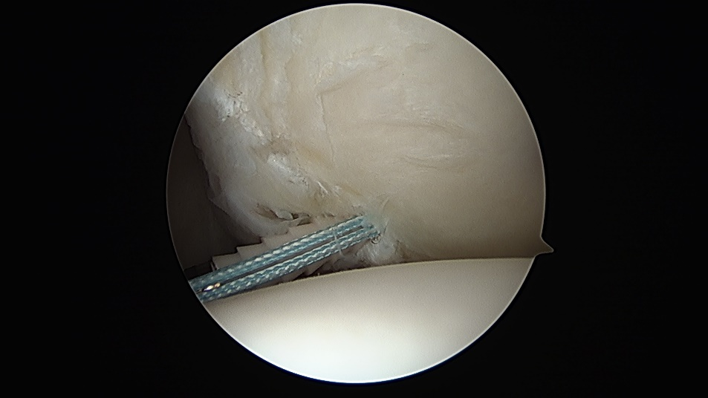
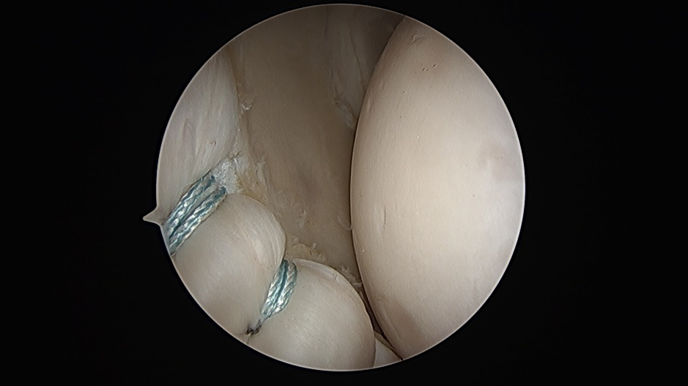
Arthroscopic Management

Slide 27
Open Management
McLaughlin Procedure

Slide 28
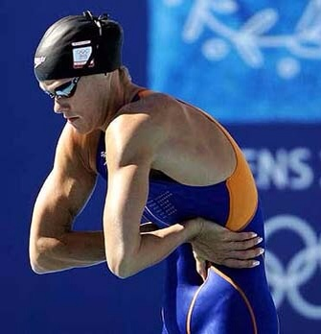
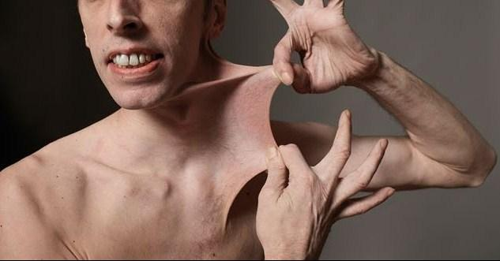
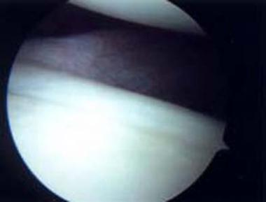
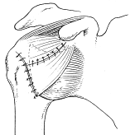
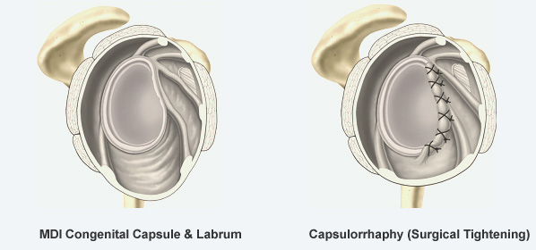
Multidirectional Instability (MDI)
Can be from overuse (microtrauma)
Swimmers, gymnasts, volleyball, throwers
Associated with connective-tissue disorders
Marfan’s, Ehler-Danlos
Will possess patulous inferior capsule and deficient rotator interval
Primary treatment is always non-operative
Dynamic strengthening
Surgical treatment reserved for patients who failed prolonged conservative management
Focus on the capsule

Slide 29
Non-operative and post-operative rehab will essentially follow similar principles

Slide 30
Rehabilitation
No scientific studies available to support one specific rehab regimen in preference to another
Key to pain-free shoulder function for sporting activities is functional stability or a balance between stabilizers of the shoulder and forces applied to the shoulder
Rehab should aim to optimize the performance of the dynamic stabilizers
Post-operatively, key is initial protection of repaired structures, followed by introduction of sequential strengthening/stabilization exercises

Slide 31
The Basics
If it popped out the front, don’t abduct/externally rotate the arm
If it popped out the back, don’t adduct/internally rotate the arm

Slide 32
Rehabilitation
Dynamic compression—1st mechanism of functional stability
Subscapularis co-contracts with infraspinatus and teres minor to center and compress humeral head into glenoid fossa
Interior fibers of rotator cuff co-contract with anterior deltoid to help keep head centered on glenoid
Dynamic ligament tension—2nd mechanism of functional stability
Rotator cuff tendons blend with shoulder capsule at their point of insertion and serve to tighten capsule on contraction
Reactive neuromuscular control—3rd mechanism of functional stability
Involves exercising the unstable shoulder in positions that maximally challenge dynamic stabilizers
Plyometrics helps to retrain neuromuscular control

Slide 34
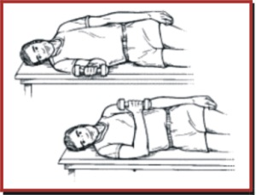
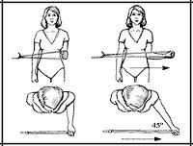
Exercises
Subscapularis
Internal rotation activities
Isometric against wall, side-lying, prone, standing
Infraspinatus
External rotation activities
Isometric against wall, side-lying, prone, standing
Teres Minor
External rotation activities
Isometric against wall, side-lying, prone, standing
Notes:
Scaption with thumbs down recruits subscap as well as ant and middle delts and suprasinatus—standing or prone
Prone Horizontal abduction with thumb up is key to isolation of infraspinatus, teres minor and posterior delt
External rotation with arm in 90 degrees of abduction has been shown to enhance recruitment of infraspinatus and teres minor---may want to do this in prone to help stabilize shoulder and then move to standing
Other exercises to target rotator cuff muscles include:
Rows, prone row with external rotation, standing horizontal abduction, PNF patterns (wall washes, t-band cross)

Slide 35
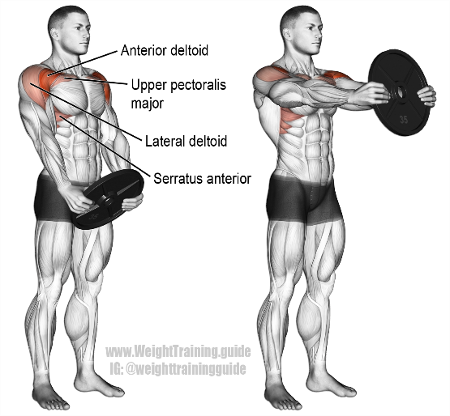
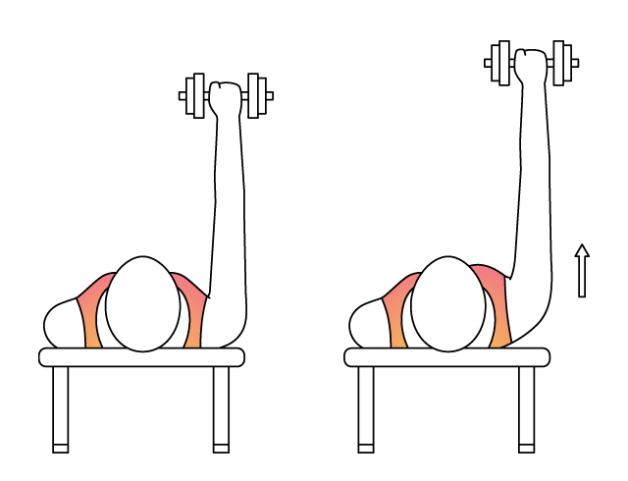
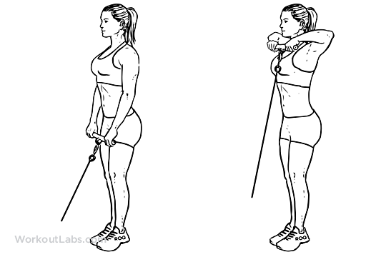
Exercises
Anterior deltoid
Forward flexion exercises
Supine, prone, standing forward flexion-thumb up
Push ups- wall, counter, floor
Serratus Anterior
Serratus punches, push up plus, rows
Latissimus Dorsi
Lat pulls, seated press ups
Isometric contraction
Rhomboids
Rows, scapular squeezes, standing horizontal abduction
Notes:
Military press will improve strength of all deltoid muscle fibers---clearly this should be done later in rehab program

Slide 36
It’s not just the ball and socket

Slide 37
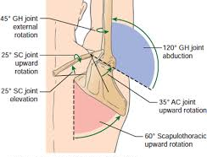
Rehabilitation
Scapulothoracic motion
Provision of stable platform under humeral head requires the scapula and humerus to move in synchrony and allows orientation of glenoid to adjust in responses to changes in arm position
Trapezius and serratus anterior contribute to 2 important force couples that produce scapular elevation
Rotator Cuff
Positions of protraction limit maximal rotator cuff strength
Decreased strength by 23%
Supraspinatus strength increased 11-24% when the scapula was in a position of retraction (Kibler, AJSM 2006)
Maximal strength at neutral protraction/retraction

Slide 38
Scapular Dyskinesis
Multidirectional Instability
Altered biomechanics and muscle activation
Increased protraction of scapula often seen.
Pectoralis minor and latissimus dorsi increase activation
Lower trapezius and serratus anterior less active
Results in hyperactive rotator cuff and biceps
Humeral head migrates away from center
Correction of scapular positioning can successfully treat MDI

Slide 39
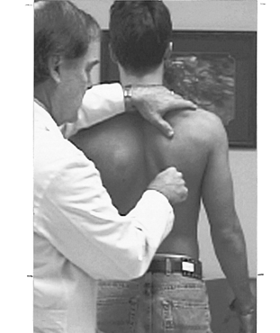
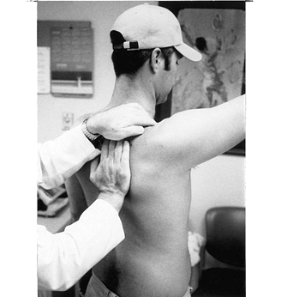
Evaluation of the Scapula
Expose the scapula
Evaluate resting posture
Evaluate dynamic motion
Repetitive motions may reveal weakness
Scapular Assistance Test
Evaluates scapular contributions to impingement and rotator cuff strength
Scapular Retraction Test
Evaluates contributions to rotator cuff strength and labral symptoms

Slide 40
Treatment of Scapular Dyskinesis
First must optimize surrounding anatomy
Treat any nerve dysfunction or structural injury
Rehab emphasis should “start proximally and end distally”
Core strength and stability
3-dimensional control of the scapula
Serratus anterior & lower trapezius strengthening
Acute Phase: Low row, inferior glide, Closed-Kinetic chain
Recovery Phase: lawnmower, robbery exercises, wall slides
Maintenance Phase: medicine ball toss, tubing plyometrics
Rotator cuff strengthening after scapula stabilized
Coordinate scapular motion with trunk and hip motion

Slide 41
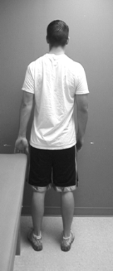
Treatment of Scapular Dyskinesis – First Exercises
Low Row
Inferior Glide
Push hand maximally against surface
Adduct arm maximally against surface

Slide 42
Treatment of Scapular Dyskinesis – Later in Progression
Lawnmower
Robbery

Slide 43
Summary
Not all shoulder instability is the same
Not all patients are the same
Age/activities/co-morbidities
Need to know direction(s) of instability/what was repaired
Don’t forget the scapulothoracic joint
Younger, male, contact athletes- higher risk of failure with non-op management
i.e. Recurrent dislocations
Rehab focused on dynamic rotator cuff strengthening and scapular stabilization

Slide 44
Shoulder Instability Pearls
Do not need to immobilize in ER after anterior dislocation
Patient had seizure, shoulder pain with “negative” x-ray and can’t ER→ think posterior dislocation
Patient older than 40 with dislocation and can’t raise arm a few weeks after surgery→ rotator cuff tear
Protect repaired structures early on during rehab, early isometrics
Multidirectional instability→ ask about family history of connective tissue disorders

Slide 45
Thank You

