Slide 1
Outpatient Total Hips and Bundled Payments: How Much PT do we need
Sean R Dingle, M.D.
Kennedy-White Orthopaedic Center

Slide 2
Sean R. Dingle, M.D.
Native Floridian
Graduate of University of Florida and University of South Florida
Previous Chief of Orthopedics and Chief of Staff at SMH
Specialize in Hip and Knee Replacements
Joined Kennedy-White Orthopaedic Center in 2003

Slide 3
Kennedy-White Orthopaedic Center

Slide 5
Evolution of Orthopaedics
Constantly Changing and Improving
Previously unimagined is now the norm

Slide 6
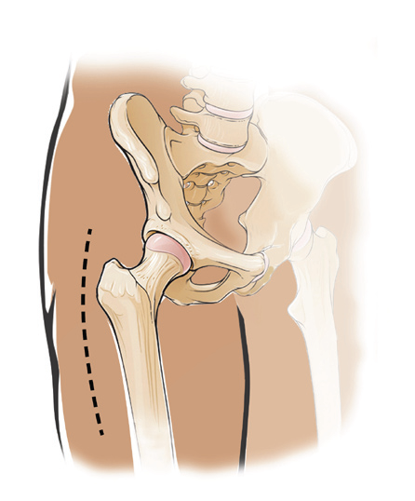
Standard Total Hip Replacement
10 -12” incision
4 - 5 day hospital stay
Ambulating with a walker for 3 - 6 weeks
Back to work in 3 months

Slide 7
Outpatient Total Joints
Previously thought impossible
Years of experience in select patients
Safe and reproducible
Young and Healthy Patients
Mostly primary joints

Slide 8
Outpatient focused joint arthroplasty is the future:Midwest center for joint replacement experience
Journal of Arthroplasty, 2018 Jun(33)
1230 total joints in 2 years
98% good or great patient satisfation
No readmissions for pain
2% readmission rate

Slide 10
Bundled Payments
CMS or Private Payer
Contract with Surgeon or Hospital
May share in savings, or be penalized for cost

Slide 11
Total Hip Costs
Total Cost average $23000
Hospital $12500
Surgeon $1200
SNF
HH
Outpatient PT
DME

Slide 14
Total Hip Discharge
Home
Home HH
SNF
Intensive Rehab

Slide 15
Formal Physical Therapy after Total Hip is not required: a randomized controlled trial J Bone and Joint Surgery 2017, 19;99(8) 648-655
120 patients
Control group: (54) 2 weeks in home PT, 8 weeks outpatient PT
Study Group: (54) Self-directed home exercise program 10 weeks
No difference in outcomes
HHS, WOMAC and SF36

Slide 16
Supervised or Unsupervised Rehabilitation after Total Hip Replacement Provide Similar Improvement for Patients: Randomized Controlled Trial Arc Phys Med Rehabil 2017 Nov;98(11) 2253-2264
98 Patients
Control Group (56) Center Based supervised therapy
Study Group (42) Unsupervised home based exercise
Followed up at 6 months
No differences in outcomes
WOMAC, SF-36, UCLA activity scale, timed up and go test

Slide 17
Randomised controlled trial to evaluate a physiotherapy-led functional exercise programme after total hip replacement Physiotherapy 2017 sep;103(3) 283-288
63 Patients
Control group (31) Usual post op care, no exercise intervention
Study group (32) 12-18 weeks of twice weekly functional exercise
Study group better: WOMAC, Walking speed
No differnce in Abductor Strength

Slide 19
Lexi Finn Jack

