Slide 1
Wrist Arthritis Update: Treatment Options
David Chan, MD, PT
Suncoast Orthopaedic Surgery & Sports Medicine
Venice, FL

Slide 2
FINANCIAL DISCLOSURES
Notes:
I’m also a PT
Acknowledge therapists and their good works

Slide 3
DISCUSSION GOALS
REVIEW COMMON ARTHRITIS PATTERNS
REVIEW HISTORICAL SURGICAL INTERVENTIONS
REVIEW NEWER SURGICAL INTERVENTIONS

Slide 4
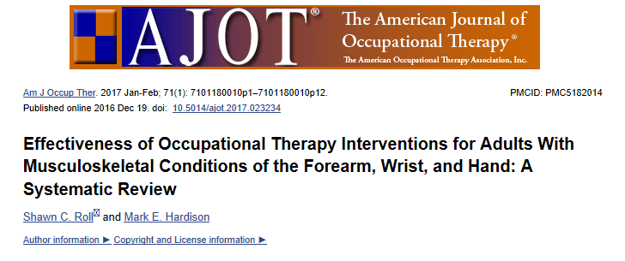
EDUCATION / EXERCISE LIMITED
SPLINTING MIXED

Slide 5
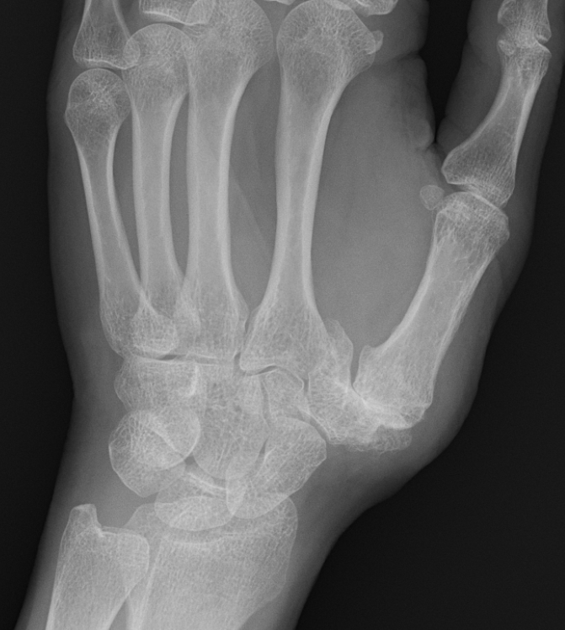
THUMB CMC

Slide 6
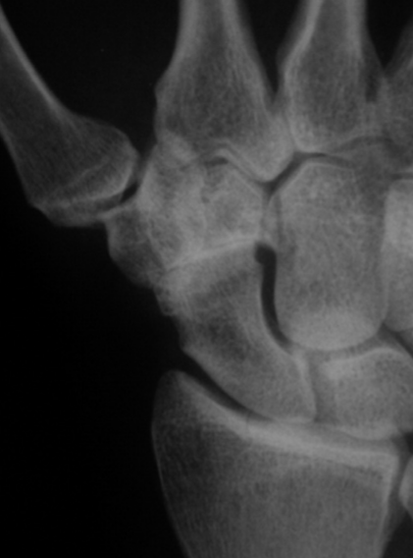
STT / TRISCAPHE

Slide 7
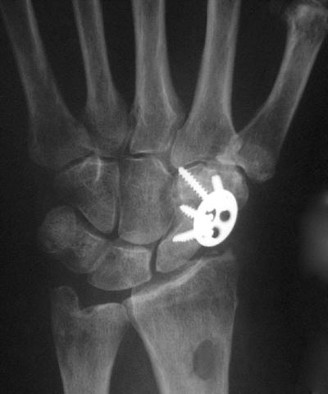
STT ARTHRODESIS

Slide 8
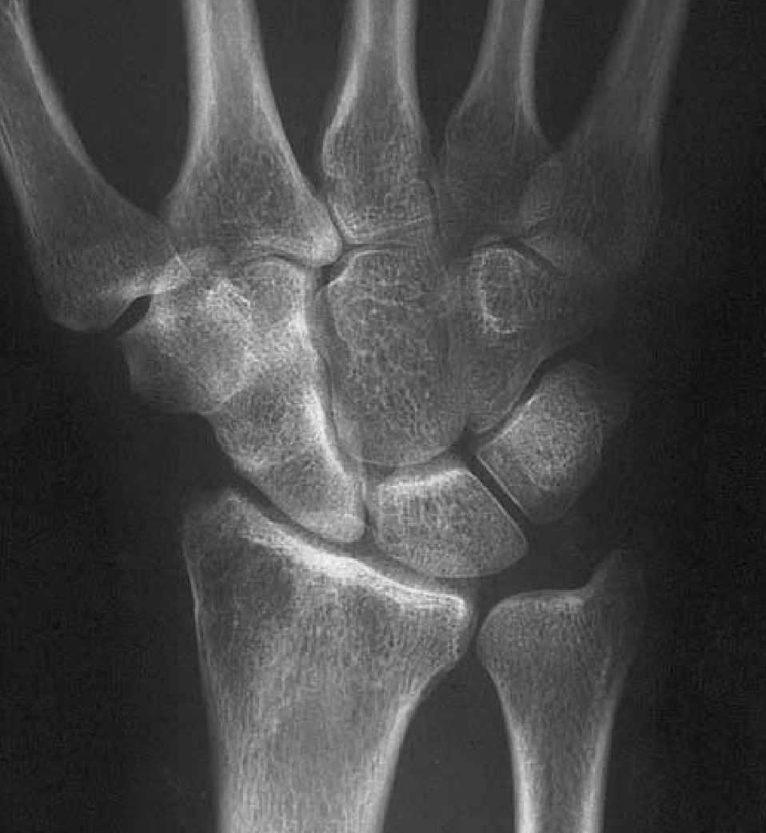
STT ARTHRODESIS
COMPLICATION RATE
NONUNION 4-29%
PERSISTENT PAIN 35%
DRSN NEURITIS
SECONDARY SURGERIES
Notes:
Radial styloid overgrowth

Slide 9
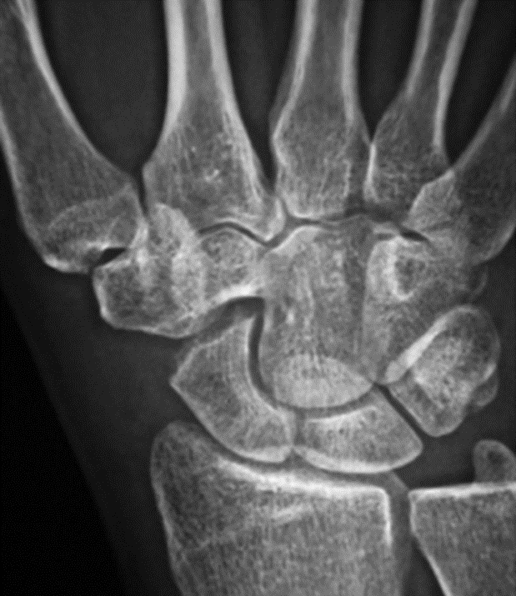
SCAPHOID DISTAL POLE EXCISION
COMPLICATIONS
DISI CARPAL INSTABILITY
ANT STT LIG
DIC LIGAMENT
Notes:
Not option for all, especially if capitolunate arthritis
No RCT comparing arthrodesis vs excision

Slide 10
STT NEWER OPTIONS
EXCISIONAL INTERPOSITION
ARTHROPLASTY
FCR TENDON
PYROCARBON IMPLANT

Slide 11
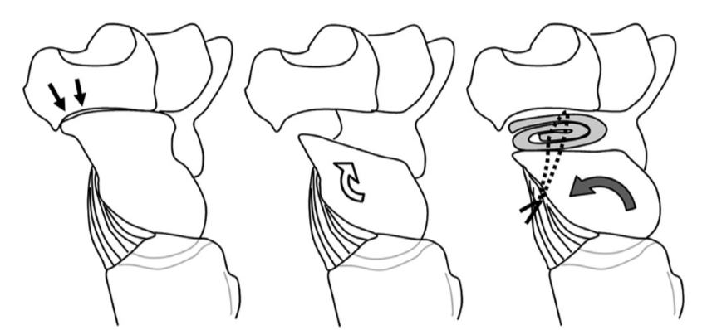
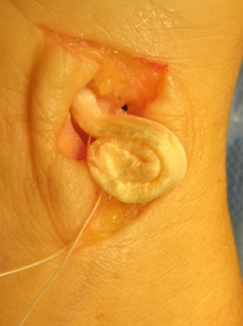
STT EXCISIONAL ARTHROPLASTY
FCR
PALMAR RSC
LIGAMENT ADVANCEMENT
Notes:
PROSPECTIVE STUDY. TECHNIQUE PAPER WITH GOOD SHORT TERM OUTCOMES AND NO DISI INSTABILITY SEEN IN THE SHORT TERM

Slide 12
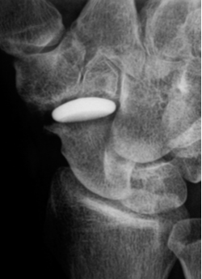
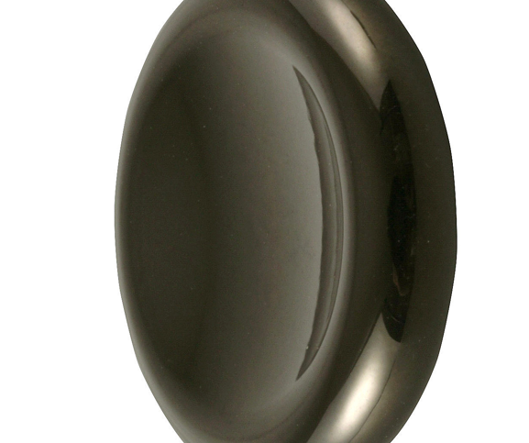
PYROCARBON IMPLANT INTERPOSITION
3-4 YEAR OUTCOMES GOOD
2 YEAR RESULTS COMPARABLE
SIMPLE ARTHROSCOPIC DISTAL
POLE EXCISION
ARTHROSCOPY
Notes:
HANDFULL REPORTS EUROPEAN AND AUSTRALIAN LIT ~20 PTS, 3-4 YEAR OUTCOMES GOOD
ARTHROSCOPIC DISTAL EXCISION = DRSN / RADIAL ARTERY RISKS

Slide 13
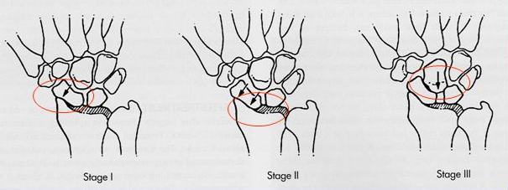
S-capho L-unate A-dvanced C-ollapse (SLAC)
I Radioscaphoid / Distal pole
II Scaphoid Fossa / Proximal Pole
III Midcarpal / Capitolunate

Slide 14
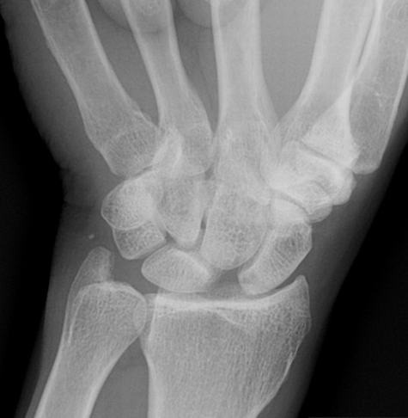
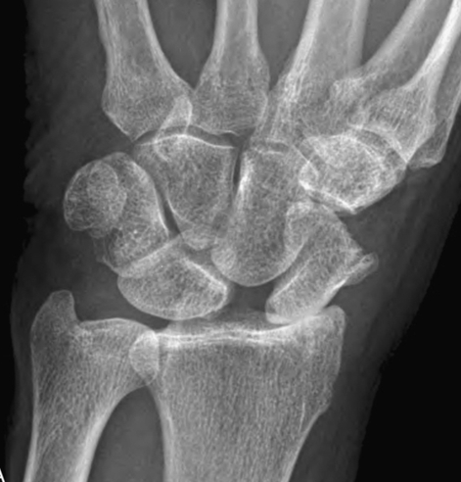
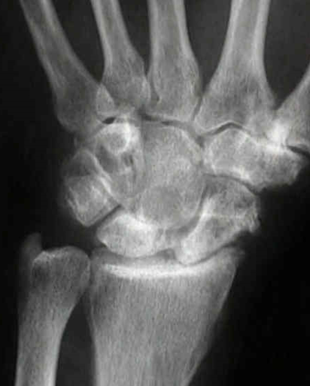
S-capho L-unate A-dvanced C-ollapse (SLAC)

Slide 15
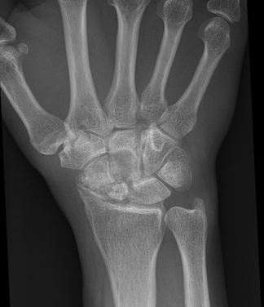
S-caphoid N-onunion A-dvanced C-ollapse (SNAC)

Slide 16
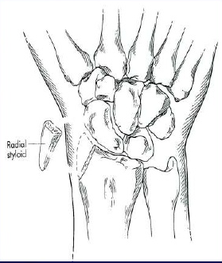
SLAC I RADIAL STYLOIDECTOMY

Slide 17
SLAC II – Proximal Row Carpectomy (PRC)

Slide 18
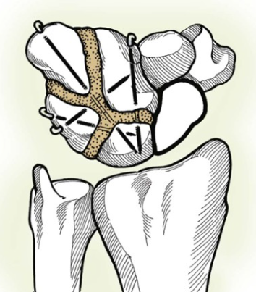
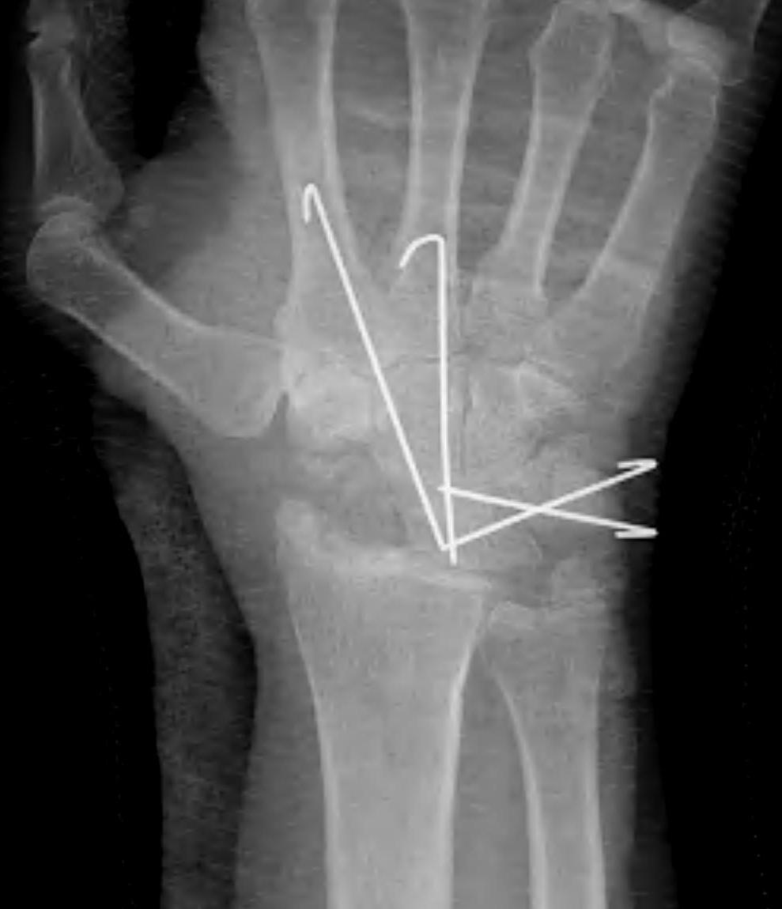
SLAC II & III Scaphoid Excision & 4 Corner Fusion

Slide 19
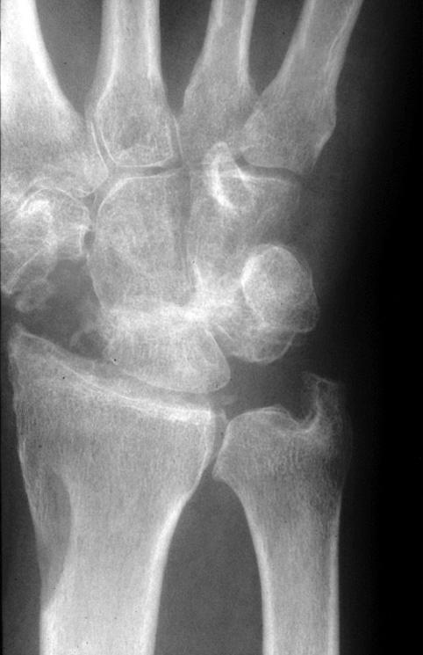
PRC vs 4-Corner
PRC
earlier motion
no fusion or hardware
4 Corner
better grip strength
less risk lunate fossa wear

Slide 20
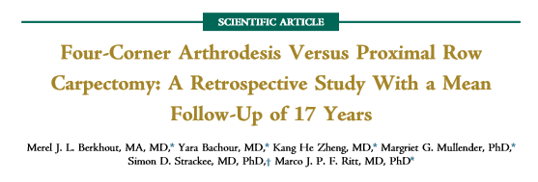
PRC
slightly better motion
less complications
No differences
grip strength
xray degenerative changes
pt satisfaction

Slide 21
PRC: Minimum 20-Year Follow-Up. Stern et al. JHS, 2013
65% survival rate
Flexion extension arc 68 degrees
Contralateral grip 72%
Mild to moderate pain
Notes:
Do not do in patients younger than 35-40 yo

Slide 22
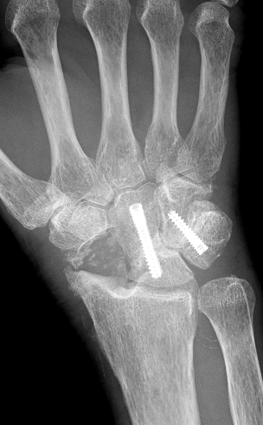
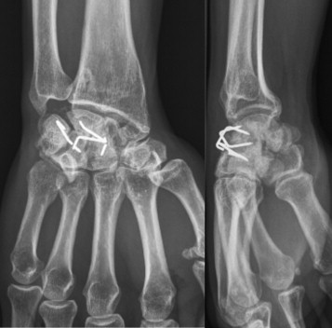
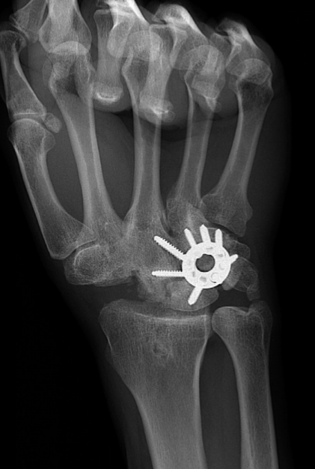
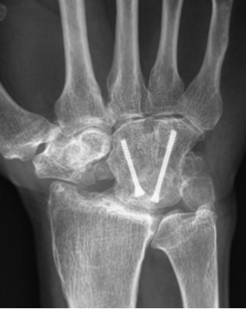
NEWER OPTIONS
STAPLES
INTRAOSSEOUS SCREWS
CIRCULAR PLATES
3 CORNER FUSIONS
Notes:
Staples, screws, k wires high fusion rates
Circle plates: 3 studies 2005-2007 high nonunion rates
2 later studies 100% union

Slide 23
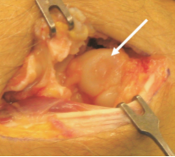
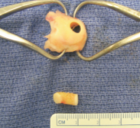
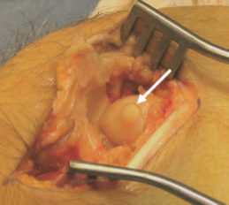
OSTEOCHONDRAL RESURFACING PRC
Notes:
UPMC IMBRIGLIA 2007 GOOD SHORT TERM RESULTS 18 MONTHS

Slide 24
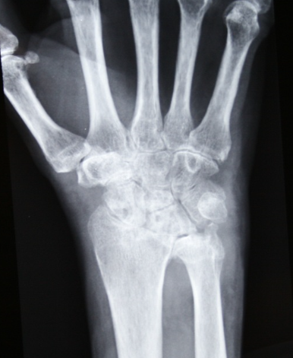
T G T N M W

Slide 26
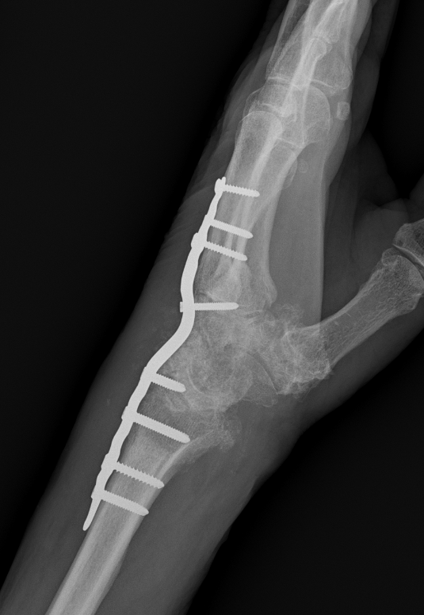
TOTAL WRIST ARTHRODESIS
LOW COMPLICATION RATE
ADL’S DIFFICULT
Notes:
15-30 WRIST EXTENSION BEST FOR GRIP STRENGTH AND EDURANCE

Slide 27
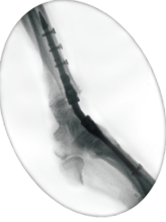
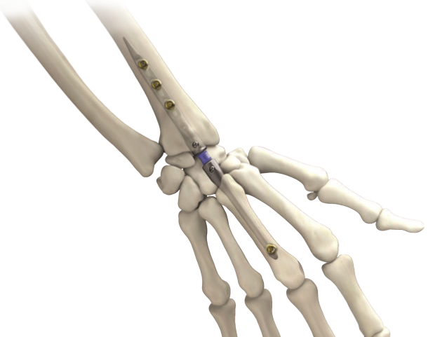
WRIST FUSION NAIL

Slide 28
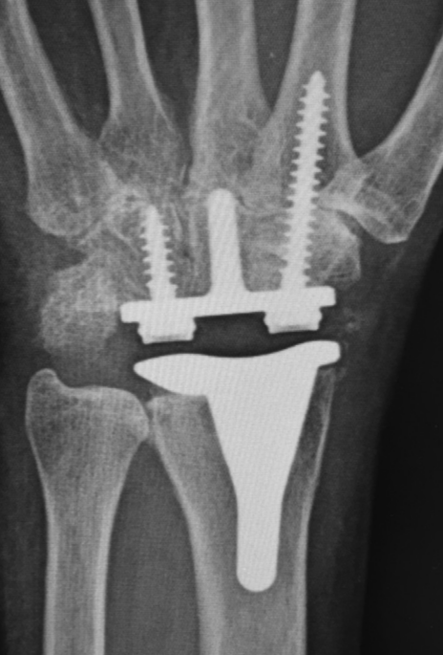
TOTAL WRIST ARTHROPLASTY
MOTION SPARING
RA
POSTTRAUMATIC ARTHRITIS
Notes:
BETTER IN RA THAN OA (LOWER DEMAND)

Slide 29
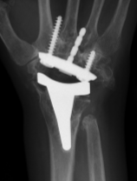
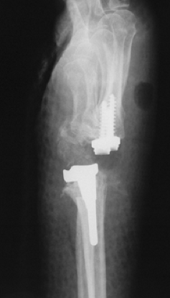
TOTAL WRIST ARTHROPLASTY
COMPLICATIONS
CARPAL COMPONENT
LOOSENING
DISLOCATION
Notes:
3rd gen implant, metaanalysis Complication rate 20%
Infections rare ~1%
REViSION RATE BC LOOSENING 30% @ 5 YRS IN PTS <60 YO

Slide 30
TOTAL WRIST ARTHROPLASTY
4TH GENERATION – DESIGN CHANGES
5-7 YR MIDTERM RESULTS GOOD
ACUTE COMMINUTED DR FRACTURES

Slide 31
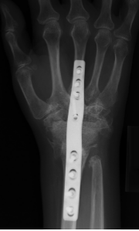
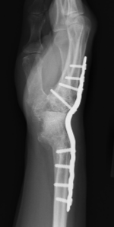
REVISION
LOSS OF BONE STOCK
REVISION ARTHROPLASTY
REVISION ARTHRODESIS
Notes:
REVISION ARTHROPLASTY LIMITED TO CASE REPORTS
PREVIOUS REPORTS WITH LOW FUSION RATES (STEINMAN PINS)
FEMORAL HEAD ALLOGRAFT GOOD FUSION 4 MONTHS, DOING WELL 3 YRS OUT

Slide 32
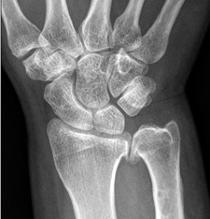
DRUJ

Slide 33
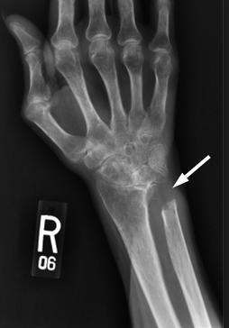
DARRACH
Notes:
ULNAR IMPINGEMENT, ULNAR TRANSLOCATION CARPUS

Slide 34
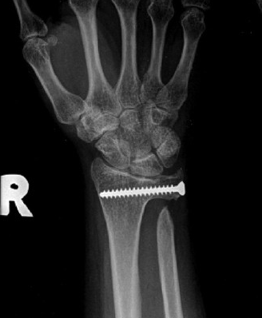
SAUVE-KAPANDJI
Notes:
LONG TRACK RECORD GOOD SUCCESS
ULNAR IMPINGEMENT
OSSIFICATION PSEUDOARTHROSIS
EXTENSOR TENDON RUPTURE

Slide 35
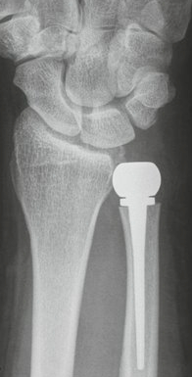
NEWER OPTIONS
ULNAR HEAD ARTHROPLASTY
INTERMEDIATE RESULTS MIXED
LOW DEMAND BETTER
Notes:
5-15 YEAR SURVIVAL GOOD
FUNCTIONAL SCORES LOW

Slide 36
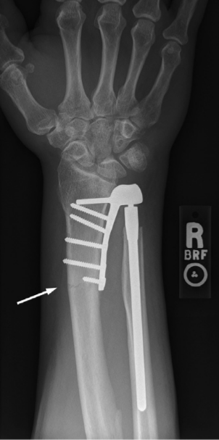
NEWER OPTIONS
DRUJ ARTHROPLASTY
UP TO 35% COMPLICATION RATE
< 5 YRS
RA < 40 YO
95% SURVIVAL RATE 5 YRS
Notes:
SEMI CONSTRAINED DESIGN TO BETTER ACCOMODATE LOAD ACROSS THE WRIST, IE HOLD A GALLON OF MILK

Slide 37
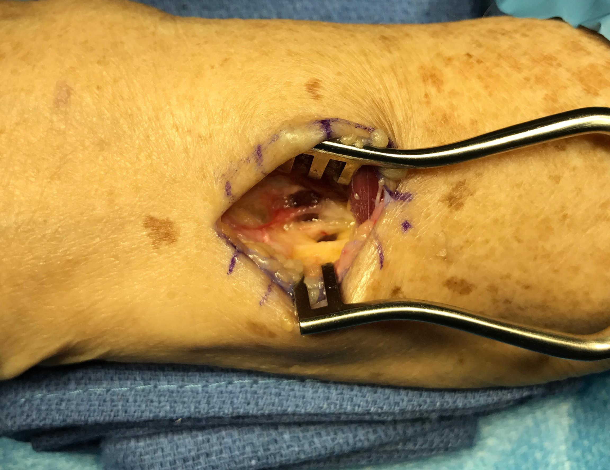
WRIST DENERVATION
PALLIATIVE
LOW RISK

Slide 38
WRIST DENERVATION
71% NONOP AT 6.5 YRS
29% SALVAGE PROCEDURE ~ 2 YRS

Slide 39
PLATELET RICH PLASMA
7 RCTs
5/7 PRP significantly better than HA
KNEE & HIP OA
high variability in study designs
Notes:
Trend towards better result in younger pts and earlier OA

Slide 40
MESENCHYMAL STEM CELLS
EARLY CLINICAL TRIALS / BASIC SCIENCE JOURNALS
HIGH VARIABILITY
SMALL SAMPLE SIZES AND SHORT TERM F/U
EARLY DATA SAFE, EFFICACIOUS,
BUT NO QUALITY RCT

Slide 41
THANK YOU

Slide 42
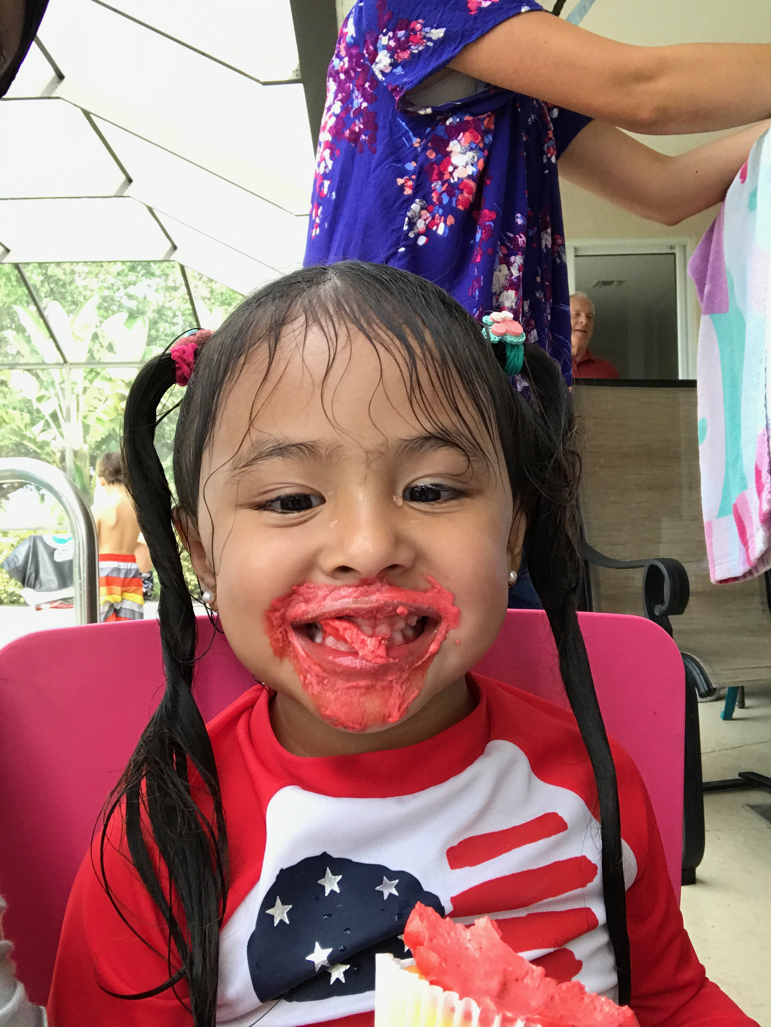

Slide 43
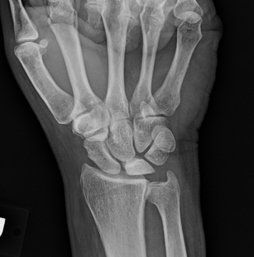
KIENBOCK’S DISEASE

Slide 44
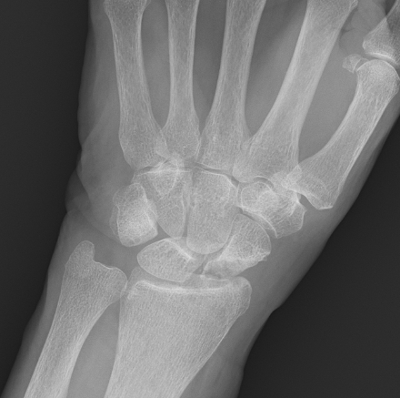
PREISER’S DISEASE

