Slide 1
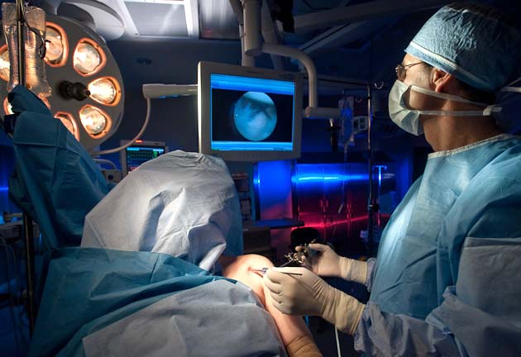
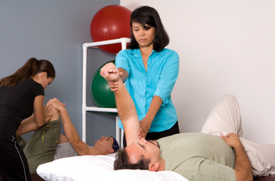
The Surgeon-Therapist Relationship
Derek Cuff, M.D.
Suncoast Orthopaedic Surgery and Sports Medicine

Slide 2
Goals
Discuss the role therapy plays
Discuss ways to improve communication
Examples of effective communication

Slide 3
Surgeon-Therapist Relationship
Surgery is a team sport
Surgeon
Patient
Operating room personnel
Nursing
Therapists

Slide 4
Surgeon-Therapist Relationship
Therapist are a critical part of the team
Multiple interactions post-op
Involved through duration of healing process

Slide 5
Surgeon-Therapist Relationship
Best outcomes when both excel
Bad surgery + great therapy = bad outcome
Great surgery + bad therapy = bad outcome

Slide 6
Surgeon-Therapist Relationship
Open line of communication is critical
Instructions should be detailed and clear
Interact with your surgeons beyond PT notes
Phone, email, text etc if needed
Alert us to compliance issues

Slide 7
Surgeon-Therapist Relationship
Expanding your education is key
Learn more about the procedures
Go watch a surgery
Incredible online access as well

Slide 8
Surgeon-Therapist Relationship
4th year doing GORC
Some great interactions with therapists
Want to share some examples

Slide 9
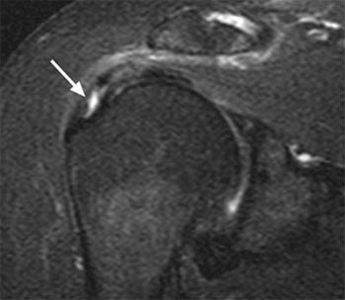
Surgeon-Therapist Relationship
Case 1
62 year old female
Mid grade partial supra tear
DM and hypothyroid

Slide 10
Surgeon-Therapist Relationship
In PT
Active FE 140, passive FE 140
Active ER 20, passive ER 20
Active IR to greater troch
3 weeks of PT with minimal improvement and RTC repair is recommended at surgeon follow up visit

Slide 11
Surgeon-Therapist Relationship
Therapist emails me
Frozen shoulder active AND passive ROM loss
More common in females 45-65
More common in DM and hypothyroid patients
55% of patients > 60 have partial RTC tears on MRI
Surgery on a frozen shoulder can exacerbate the condition

Slide 12
Surgeon-Therapist Relationship
Patient sees me in 2nd opinion
Cortisone shot
Back to PT
4 weeks and has full ROM and no pain
THERAPIST SAVED THIS PATIENT FROM A SURGERY

Slide 13
Surgeon-Therapist Relationship
Case 2
64 year old
s/p large RTC repair
10 weeks post op has near full active ROM

Slide 14
Surgeon-Therapist Relationship
10 week PT visit
Patient says he feels great
Ready to start strengthening
Has golf outing in 2 weeks, wants to play

Slide 15
Surgeon-Therapist Relationship
Therapist emails me
Cuff tears not healed for at least 12 weeks
Strengthening or return to play prior to that =Risk of recurrent tear
I contact the patient and re-enforce rehab timeline
Complication potentially averted

Slide 16
Surgeon-Therapist Relationship
Case 3
75 year old s/p reverse TSA
12 weeks post op doing great
Resumes normal activity
2 days later severe shoulder pain

Slide 17
Surgeon-Therapist Relationship
At PT session later that day
Posterior-lateral shoulder pain to palpation
Cant abduct arm
Therapist calls me immediately
Remembers that there is a 3-4% incidence of acromial stress fracture after RTSA

Slide 18
Surgeon-Therapist Relationship
Patient sent in to office next morning
Arm immobilized
CT ordered revealing fracture
Sling for 6 weeks, fracture healed
Resumed activity and great outcome

Slide 19
Surgeon-Therapist Relationship
3 case examples
Therapist using their knowledge
Highlights importance of communication
Positive impact on patient outcomes and avoided potential complications

Slide 20
Surgeon-Therapist Relationship
Conclusion
Continuing therapist education is important
Relationship between surgeons and therapists must be fostered
Communication and collaboration critical

Slide 21
Thank You

