Slide 1
ACL Reconstruction and Postop Rehabilitation
Joseph Noah, M.D.
Suncoast Orthopaedic Surgery and Sports Medicine

Slide 2
ACL Injuries
Estimated 175,000- 200,000 ACL surgeries performed annually
As many as 50% are the result of noncontact injuries
Untreated injuries can result in severe disability and can have long term effects on function

Slide 3
Diagnosis: ACL Injuries
History
Hemarthrosis
Physical exam
Associated injuries
Lachmans Test
Pivot Shift
X-Rays
MRI

Slide 4
Rehabilitation: Preoperative
Focus on reducing swelling and inflammation
Regaining motion, especially extension
Regaining good quadriceps muscle control
Possible role for pre-op steroid injection
May need to allow time for MCL healing
Surgery when ROM restored

Slide 5
ACL Injuries: Reconstruction
Various methods and grafts have shown to be effective (single bundle vs double bundle)
Anatomic reconstruction
Auto graft vs Allograft
Grafts include patella tendon, hamstrings and quad tendon
Meniscal preservation, repair when at all possible

Slide 6
Goals of ACL Reconstruction
Return normal function and stability
Restore confidence in the knee
Resuming preinjury level of activity
Prevent re-injury or re-tear
Greatest risk is in the first 1-2 years postop
Data from Multicenter Ortho Outcomes Network (MOON) found 5.8% re-tear rate (5 yr. F/U)
Up to 20% chance of contralateral ACL tear
Only 60-80% of elite athletes return to preinjury level of sports

Slide 7
ACL Reconstruction: Anatomic
Drilling femur from an anteromedial portal
Auto-graft in patients under 40 yrs. of age (unless multiple ligaments involved or revision)
Rigid fixation to allow early motion

Slide 8
ACL Reconstruction Return to Play
MOON data for high school and college athletes studied (football and soccer)
Similar findings for both sports
63% for high school
69% for college
50% of non-returning athletes cited fear of re-injury or further damage

Slide 9
ACL Reconstruction: Postop What I Do
Postop hinged rehab brace locked in extension
Decrease swelling and inflammation
Allow early weight bearing
Allow motion when Quad control regained
Protect graft and graft fixation

Slide 10
ACL Reconstruction Rehab Early Goals (weeks 0-4)
Minimize pain
Minimize swelling
Patella mobility
ROM 0-120º
Muscle control 3/5
Restore normal gait
Protect graft
CPM has no benefit

Slide 11
ACL Reconstruction Rehab (0 – 4 weeks)
Accelerated style rehab program (even with meniscus repair)
Regaining full extension by week 2. Heel prop and prone extension.
Full weight bearing ( by 2 weeks) heel/toe and retro walking
Advance brace to encourage normal gait

Slide 12
ACL Reconstruction Rehab (0 – 4 weeks)
Flexion is achieved with high knee walking, heel slides and wall slides.
Use of stationary bike (well leg biking)
Encourage weight bearing flexion, mini squats 0-45º

Slide 13
ACL Reconstruction Rehab (0 – 4 weeks)
Closed kinetic chain quad strengthening
Leg press 70º-10º
Aqua jogging
Single leg balance
Light resistance cycling
Hip muscle strengthening

Slide 14
ACL Reconstruction Rehab Goals weeks 5-10
No pain
Minimal effusion
ROM 0-135º
Muscle control 4/5
Minimal inflammation
Symmetrical gait

Slide 15
ACL Reconstruction Rehab (5 -10 weeks)
Hamstring Curls (active, 0-90º)
Knee extension with resistance(90º-30º)
Increase proprioception (balance board/2 legged)
Lateral step ups
Watch for P-F symptoms

Slide 16
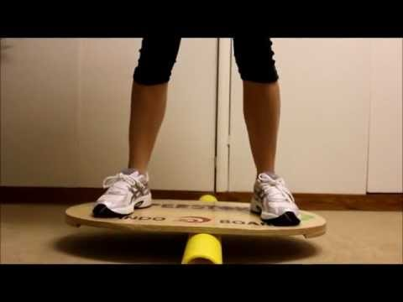
ACL Reconstruction Rehab (3 months postop)
Must have normal motion by this point
Straight ahead jogging
High speed isokinetic (with anti-shear device) testing and strengthening (30% deficit quad and hams)
Advance proprioceptive activities (single leg stance, resistance band walking)

Slide 17
ACL Reconstruction rehab ( 16 - 24 weeks)
Agility drills (cross over and figure of 8) based on high speed testing 65% strength ratio
Gradual terminal extension strengthening 90º-0º
Develop sport specific skills
Help develop patient confidence(single leg hop)
Timing for return to sport (controversial)

Slide 18
ACL Reconstruction Rehab Return to Sports
Return to sport is patient specific
Knee stability
Isokinetic testing (90% symmetry) Quad/Ham ratio
Unusual for athlete to reach prior to 6 months postop
Psychological factors (fear of re-injury)
Sport readiness tests: single leg hop, triple hop, crossover hop ($≥$90% of the normal limb)
Functional bracing(does it matter?) May improve patient confidence but limited evidence for decreasing re-injury

Slide 19
ACL Injury Prevention
Data supporting injury prevention exercises
Effective in reducing incidence of injury or re-injury particularly in female athletes
Goal of program is to increase power and strength. Improve neuromuscular control
www.sportsmed.org

Slide 20
THANK YOU

