Slide 1
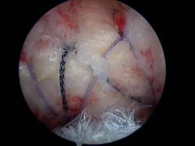
Rotator Cuff Rehab: Where are we in 2018?
Derek Cuff, M.D
Suncoast Orthopaedic Surgery and Sports Medicine
Gulfcoast Orthopaedic Rehab Conference 2018

Slide 2
Goals
Discuss primary post-op objectives
Define the different protocols
Discuss most recent published data

Slide 3
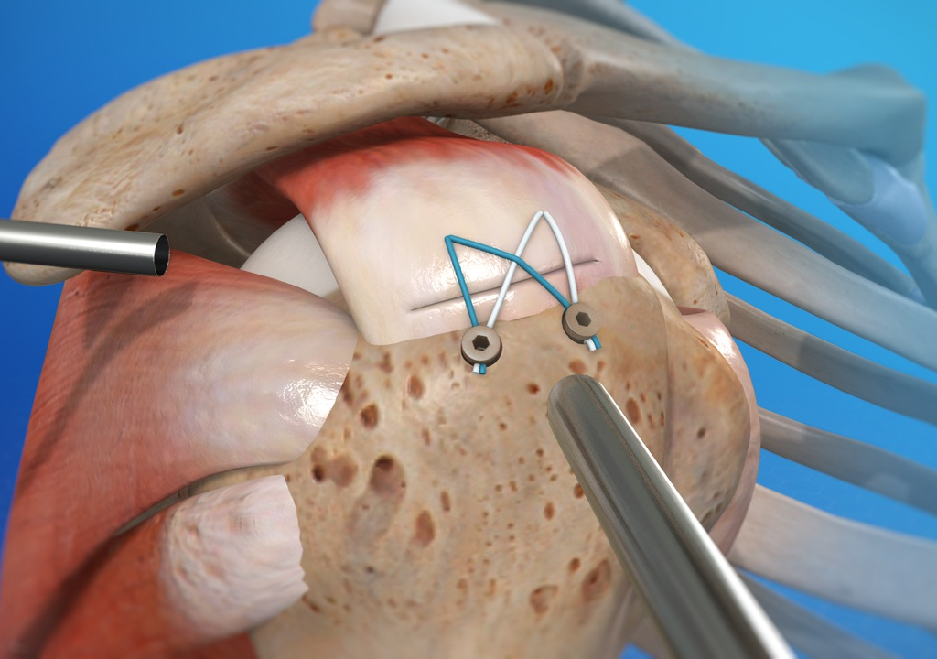
RTC Rehab 2018
Primary objectives after repair
Prevent stiffness
Improve ROM
DO NOT COMPROMISE THE REPAIR

Slide 4
RTC Rehab 2018
Historical perspective
Concerns about adhesions
Early ROM to prevent frozen shoulder

Slide 5
RTC Rehab 2018
Early range of motion protocol
Early passive forward elevation and external rotation
Used as early as POD #1
Sling still used to protect repair

Slide 6
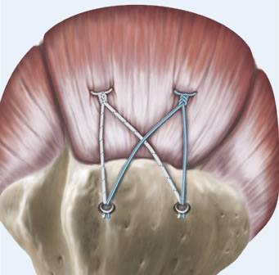
RTC Rehab 2018
Pros- Decrease chances for stiffness
Cons- Does this early motion stress the repair site???

Slide 7
RTC Rehab 2018?
What does the data say?
Dockery et al, Orthopedics 1998
McCann et al, CORR 1993
EMG studies looking at RTC during passive ROM:
RTC muscles do fire even with passive ROM

Slide 8
RTC Rehab 2018
Why is that important?
Sonnabend et al., JBJS Br 2010- Repairs are “histologically immature” until about 6 weeks post-op
Hatakeyama et al., Amer J of Sports Medicine 2001- Cadaver study showed passive ROM caused low level strains at repair site
“even this low level of force can cause repair failure if applied repetitively”

Slide 9
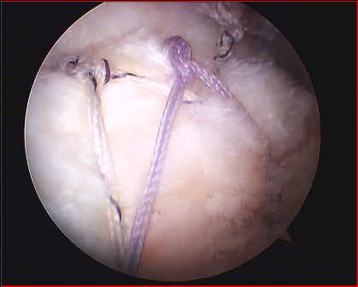
RTC Rehab 2018
With modern arthroscopic repair do you need early ROM?
Minimally invasive
Less dissection
Less chance for adhesions and scar tissue

Slide 10
RTC Rehab 2018
Can you protect the repair by avoiding early ROM?
Does this = stiffness and limited final ROM?

Slide 11
RTC Rehab 2018
Delayed Range of motion protocol
No passive forward elevation during first 6 weeks
I do allow pendulums
Do allow light use of elbow/wrist/hand

Slide 12
RTC Rehab 2018
Anecdotal evidence
Stiffness really isn’t a problem after arthroscopic rotator cuff repair
Unnecessary to stress repair first 6 weeks
MUST HAVE DATA TO PROVE IT

Slide 13
RTC Rehab 2018
Study ran for 12 months 2007-2008
Prospective and randomized study
68 patients with RTC repair and decompression
33 in early protocol
35 in delayed protocol
Digital video to measure ROM
Ultrasound to eval cuff healing

Slide 14
RTC Rehab 2018
What did we find?
At 6 months early group slightly better ROM
At 1 year NO SIG DIFFERECNE in ROM
Identical ASES outcome scores (91.9 vs. 92.8)
Early group 85% healed; delayed 91% healed

Slide 16
RTC Rehab 2018
Kim et al- Amer Journal of Sports Med
Lee et al- Journal of Arthroscopy
2 studies out of Asia with the exact same results

Slide 17
RTC Rehab 2018
Flourish of studies
Multiple publications
Close to 20 studies over 4 continents

Slide 18
RTC Rehab 2018
Problem?
Study fragility- numbers issue
Difficult to interpret data due to high fragility index
Meta-analysis tried to circumvent fragility
Heterogeneity in meta-analysis problematic

Slide 19
RTC Rehab 2018
Saltzman et al.- 2017 JSES
9 MA reviewed
No difference in outcomes
Healing rates and re-tear rates equivocal
Slightly better ROM in early group
Subgroup analysis- larger tears=higher re-tear rate with early ROM
Houck et al.- 2017 Am J of Sports Med
7 MA reviewed
Early protocol had better ROM
Early protocol had higher re-tear rate

Slide 20
RTC fixation and rehab
What do the experts say?
Mollison et al- 2017 Ortho J of Sports Med
Survey of AAOSM and AANA
704 responses, huge variability in protocols
No consensus BUT trend towards delayed protocol

Slide 21
RTC fixation and rehab
Thigpen et al.- JSES 2016
“The American Society of Shoulder and Elbow Therapists' consensus statement on rehabilitation following arthroscopic rotator cuff repair.”
2 weeks immobilization
Weeks 2-6 passive ROM
Weeks 6-12 AAROM then Active
Strengthening at 12 weeks.

Slide 22
RTC fixation and rehab
Gestalt from literature in 2018
1. Data all over the place
2. Trend towards delayed protocol over last 5-10 years
3. Tear size may play a role, may want to individualize protocol

Slide 23
RTC fixation and rehab
My preferred protocol
1. Delayed protocol with immobilizer and pendulums only for 6 weeks
2. ROM work progresses weeks 6-12
3. I just don’t think you get much ranging them right away
Increased pain
Stresses repair

Slide 24
RTC Rehab 2018
Why is this important?
Cost
Patient’s pain levels

Slide 25
Summary
Ton of conflicting data out there in 2018
Trend towards more delayed ROM rehab protocols
Can use literature to justify whichever approach you want
Specify you rehab to you surgeons preference

Slide 26
Thank You

