Slide 1
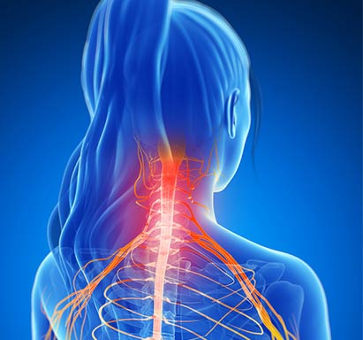
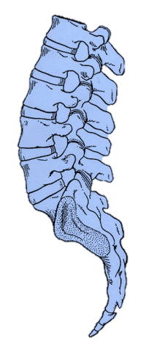
Cervical Radiculopathy: Clinical Signs and Treatment
Eric Sundberg, M.D.
Coastal Orthopedic Spine Surgery
-----------------------------------------------------------------
Coastal Orthopedics
Sports Medicine | Pain Management

Slide 2
Disclosures

Slide 3
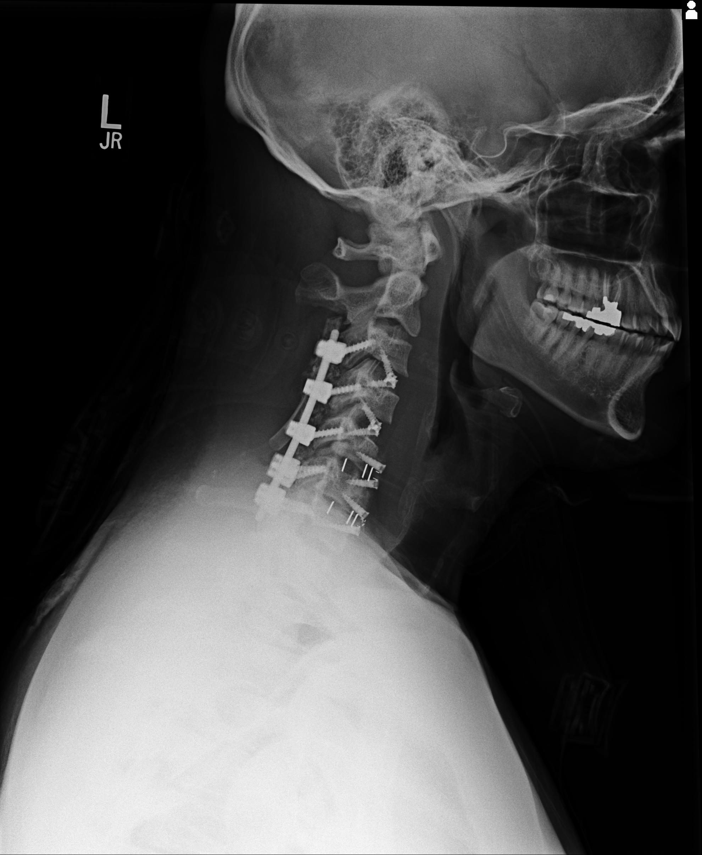
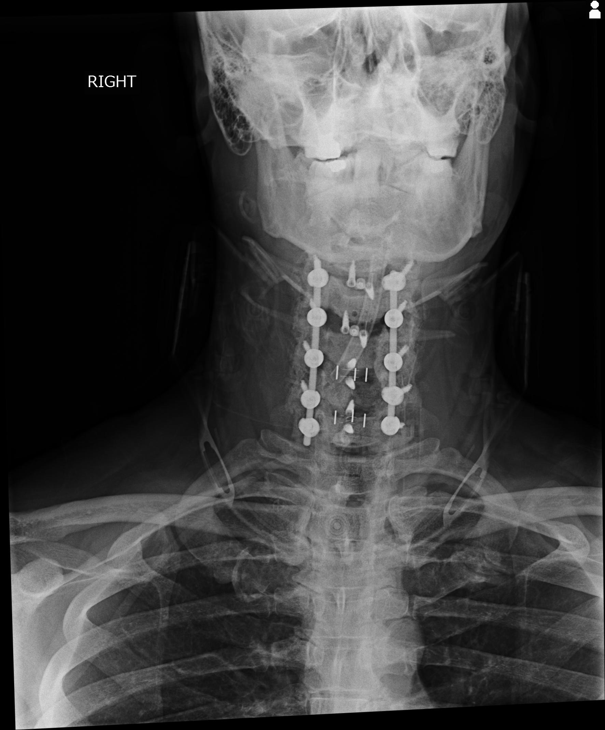
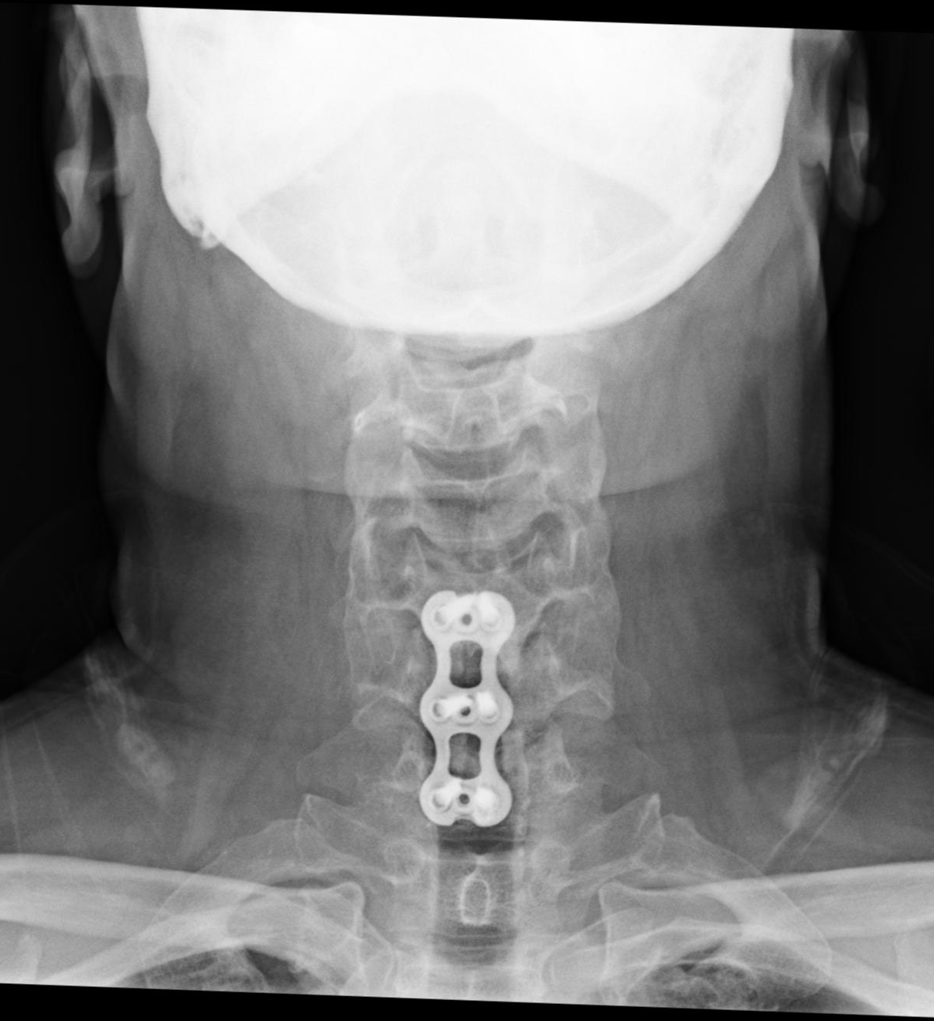
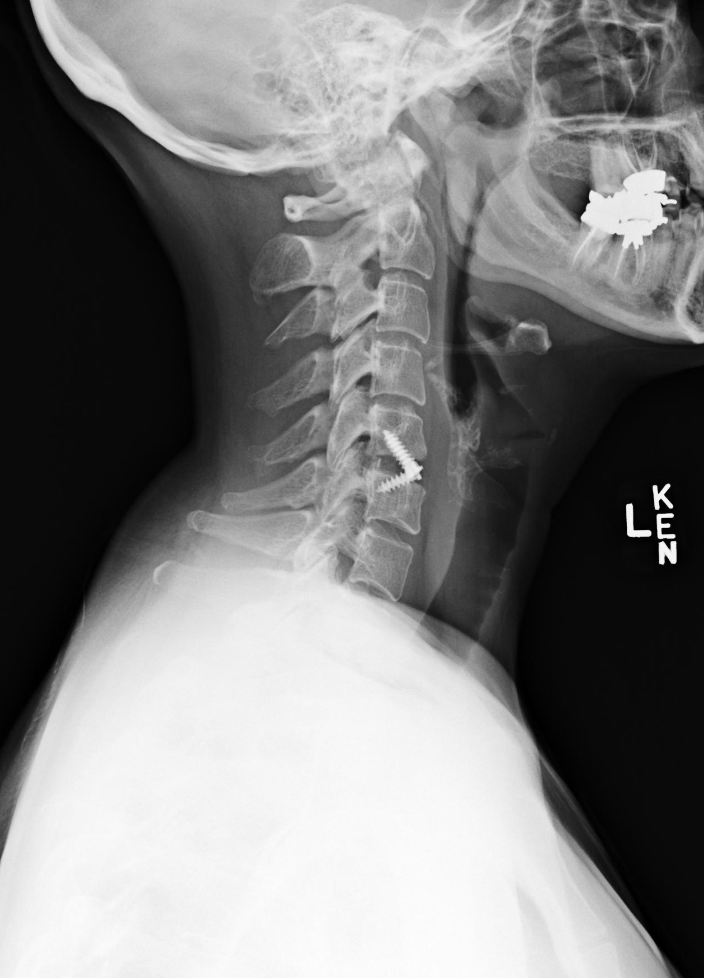
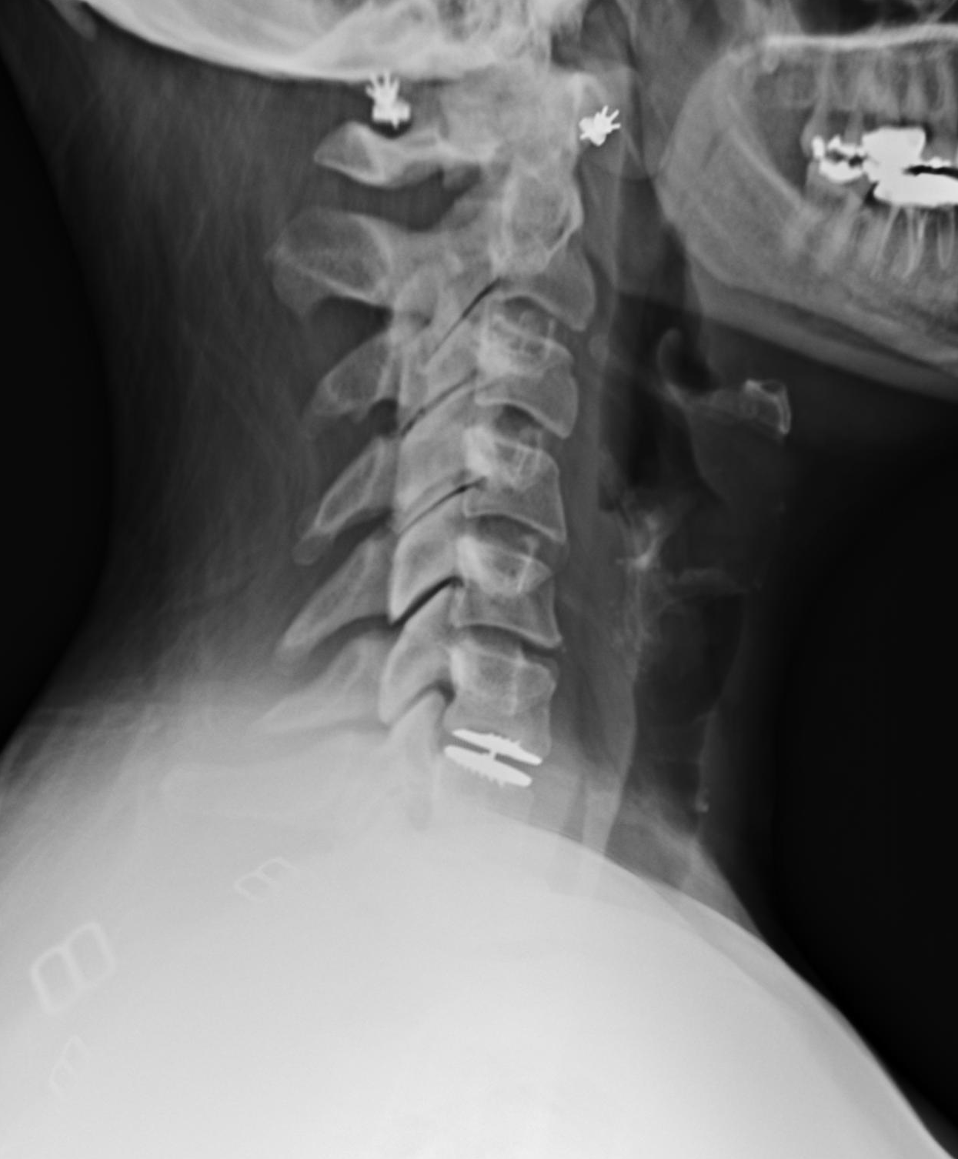

Slide 4
Cervical Radiculopathy
The clinical condition of pain and/or neurologic symptoms resulting from any type of condition that irritates a nerve in the neck
Pathoanatomy: commonly caused by compression of the exiting nerve root as it enters the neuroforamen
Symptoms: neck pain (often unilateral, but not always), ipsilateral dermatomal radiating pain (not always), numbness, weakness

Slide 5
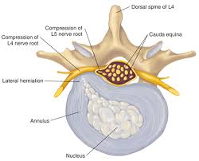
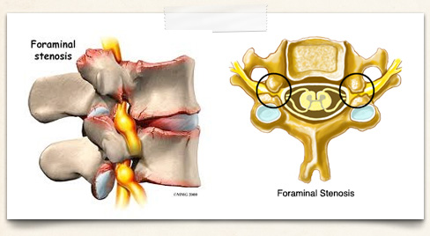
Cervical Radiculopathy
Etiologies: Cervical HNP, Disc Degeneration, Spondylosis (uncovertebral joint hypertrophy, facet hypertrophy), Tumor, Infection (Discitis), Instability, Trauma

Slide 6
Red Flags
May Include:
Progressive Weakness
Symptoms of Myelopathy
Lhermitte Sign (electrical sensation down the spine with neck flexion)
Recent Trauma (High Energy)
Signs of Malignancy (unintentional weight loss)
Signs of Infection (esp in immunocompromised)

Slide 7
Radiculopathy v. Myelopathy
Myelopathy
Neck Pain
Arm/Leg Pain
Weakness
Numbness/Tingling
Balance/Coordination
Fine Motor Skills
Bowel/Bladder
Increased Reflexes
Radiculopathy
Unilateral Neck Pain
Ipsilateral Arm Pain
Weakness
Numbness/Tingling
Diminished Reflexes

Slide 8
Nonoperative Management
In most cases a course of nonoperative management for at least 6weeks to 3 months is advisable
-Physical Therapy
-Home Exercise Program
-Medication (NSAIDs)
-Epidural Injections
Physical Therapists may be first line providers in many cases

Slide 9
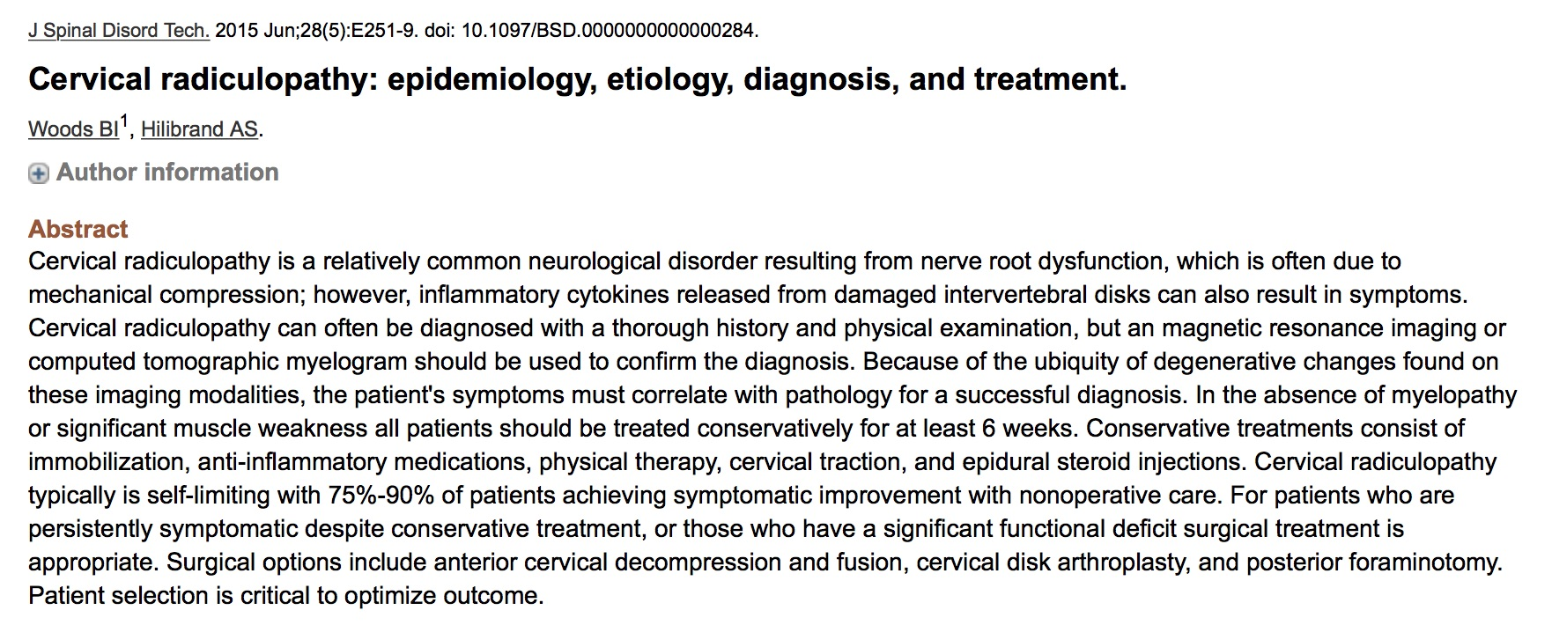
Nonoperative Management

Slide 10
Nonoperative Management
70-90% of patients achieving symptomatic improvement with nonoperative care

Slide 11
Operative Indications
Persistent/Recurrent Pain Unresponsive to Conservative Management
Progressive Neurologic Deficit
Static Neurologic Deficit with Significant Radicular Pain
Consistent Imaging Studies

Slide 12
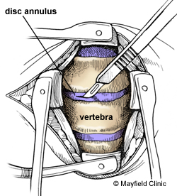
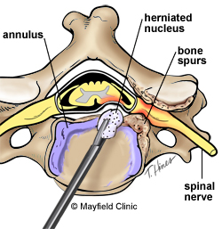
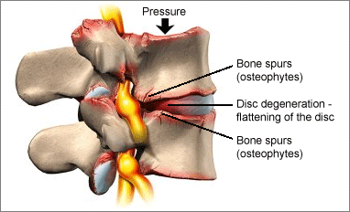
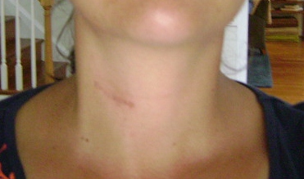
ACDF

Slide 13
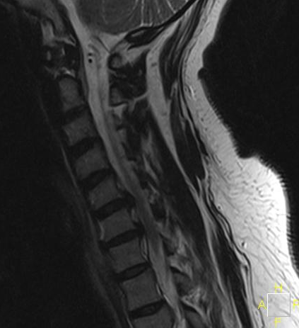
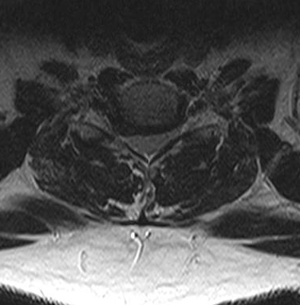
ACDF

Slide 14
ACDF

Slide 15
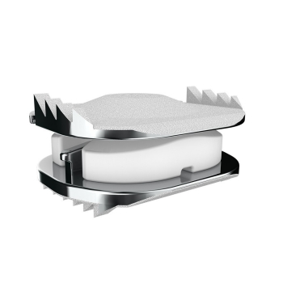
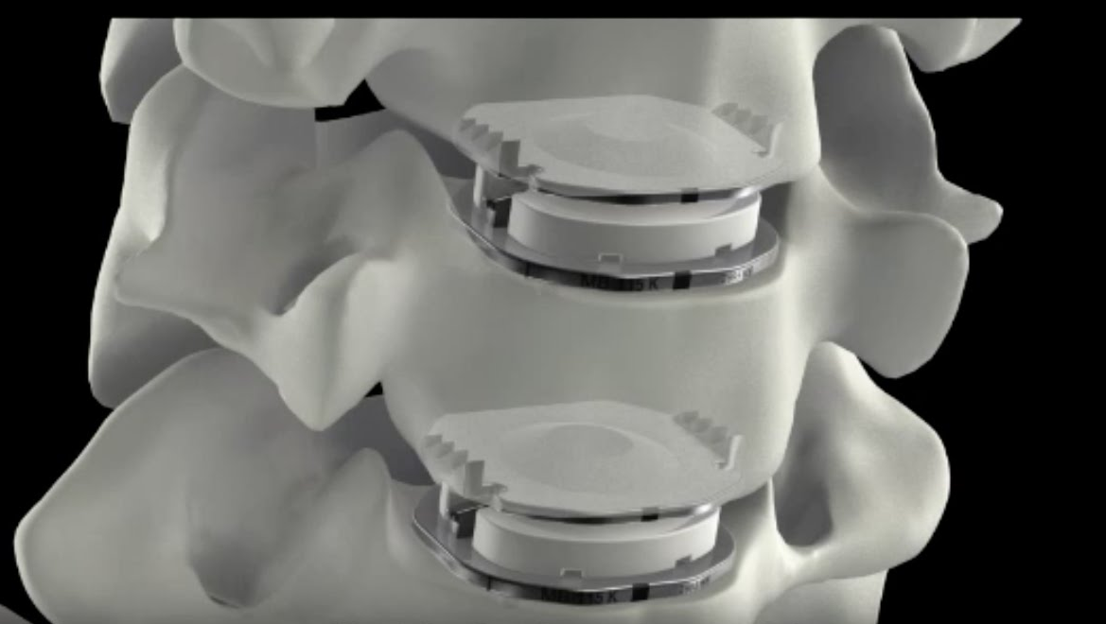
Disc Arthroplasty

Slide 16
Disc Arthroplasty

Slide 17
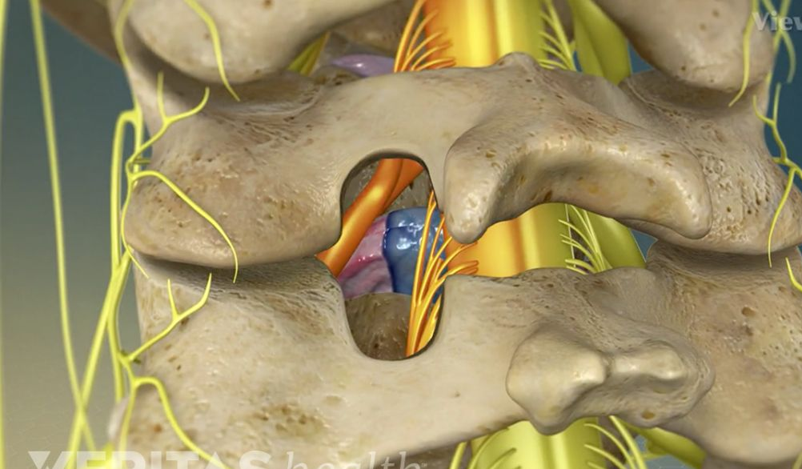
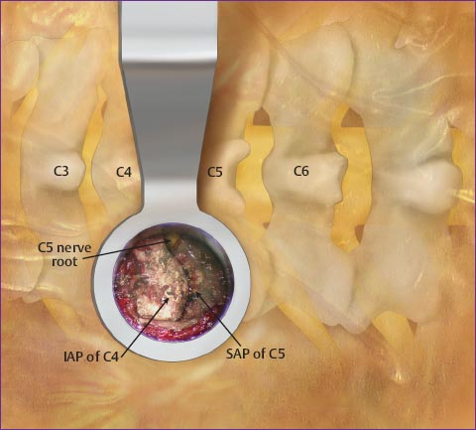
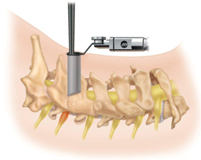
Posterior Foraminotomy

Slide 18
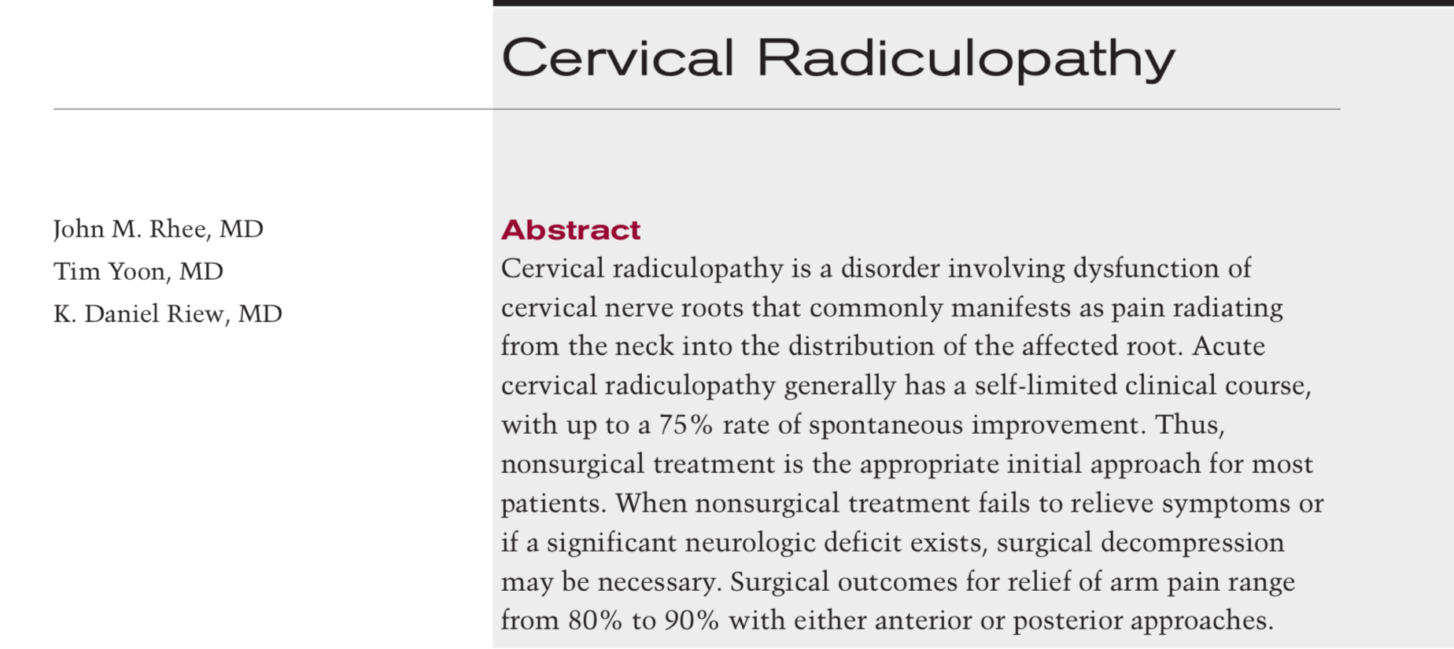
Rhee et al, JAAOS 2005

Slide 20
Postoperative Rehabilitation
ACDF
Week 0-6 Protective Phase
-avoid BLTs, 25 lbs
-no specific exercises, soft collar for comfort
Weeks 6-12: Strengthening Phase
-gradual progressive strengthening
-goal is to have proper neuromuscular control, posture, stabilization
Weeks 12+
-return to sport
*single level fusions are put in an accelerated protocol

Slide 21
Postoperative Rehabilitation
CDA and Foraminotomy
Week 0-2 Protective Phase
-avoid BLTs, 25 lbs
-no specific exercises, soft collar for comfort
Weeks 2-4: Strengthening Phase
-gradual progressive strengthening
-goal is to have proper neuromuscular control, posture, stabilization
Weeks 6+
-return to work/sport

Slide 22
Thank You

