Slide 1
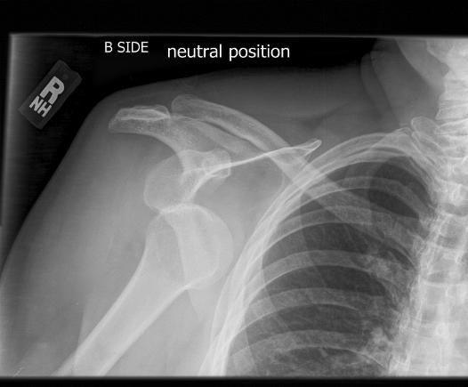
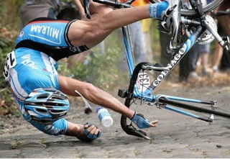
Shoulder Instability and the Role of PT/OT
Derek Cuff, M.D.
Suncoast Orthopaedic Surgery and Sports Medicine
Gulfcoast Rehab Conference, Aug 17 2019

Slide 2
Goals
Discuss various types of instability
Discuss Pathology
Discuss PT role in non-op management
Discuss PT role in post-op management

Slide 3
Normal Anatomy
Shoulder is a ball and socket type joint
Highly mobile joint
The labrum is a structure that attaches to the socket to help increase stability of the joint

Slide 4
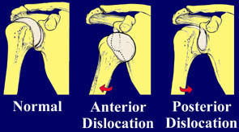
Shoulder Instability
Most commonly dislocated joint in the body
Most common direction of dislocation is anterior

Slide 5
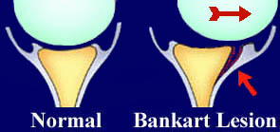
Shoulder Instability

Slide 6
Shoulder Instability
Traumatic anterior injury
Force applied with arm abducted and externally rotated
Labrum tears and shoulder dislocates

Slide 7
Shoulder Instability
Traumatic posterior injury
Force applied posteriorly to a flexed and adducted arm
*Also common mechanism is seizures

Slide 8
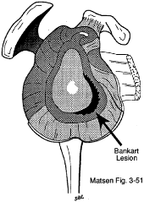
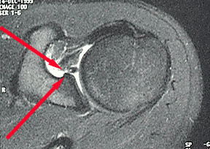
Shoulder Instability

Slide 9
Shoulder Instability

Slide 10
Shoulder Instability
Labral may not heal
Can lead to recurrent instability-depends on age of initial dislocation
-patient < 20 yrs old 80-90%
-patients 20-30 yrs old 50-75%
-patients >40 yrs old lower rates of repeat dislocations, higher rate of rotator cuff tear

Slide 11
Shoulder Instability
Treatment- some controversy
Non-op treatment has yielded success
Young contact athletes high risk of recurrence
I still believe in an attempt and non-op and PT

Slide 12
Shoulder Immobilization
Itoi et al, JBJS 2007
External rotation brace may put labrum in better position to heal
3 weeks of bracing

Slide 13
Shoulder Instability
PT can play a big role
Dedicated cuff strengthening can help give stability to joint
Possible prevent recurrence

Slide 14
Shoulder Instability
Four weeks of formal outpatient PT
Maintenance program to try and maintain stability

Slide 15
Shoulder Instability
Have had many successful cases with non-op and good PT
Even in contact athletes
2nd dislocation = surgery

Slide 16
Shoulder Instability
Significant controversy for contact athletes and young patients
Should we operate after 1st dislocation???
Discussion with patient and family
Timing of surgery plays a role
Nationally, many have gone to surgery for 1st time dislocation

Slide 17
Shoulder Instability
Goals of surgery
Repair labrum
Get it to heal
Restore stability and strength

Slide 18
Shoulder Instability
Arthroscopic is most common approach in 2019
Anchor the labrum to the anterior glenoid

Slide 19
Shoulder Instability

Slide 20
Shoulder Instability
Post-op
Shoulder immobilizer X 3 weeks
At 3 weeks PT/OT to restore ROM
Stiffness is a risk

Slide 21
Shoulder Instability
Post op
Limit ER to 30 degrees
Hyper-abduction and ER to be avoided
Ligament takes about 3 months to heal

Slide 22
Shoulder Instability
Post op
Start strengthening at 12 weeks
Clear for non-contact training
Contact sports at 6 months

Slide 23
Shoulder Instability
Results
5-15% recurrence rate after surgery
Higher for contact athletes
Slight loss of ER is common

Slide 24
Shoulder Instability
Overall
Good outcomes even in high demand athletes
Success defined as no repeat dislocations

Slide 25
Shoulder Instability
What if the soft tissue repair fails?
Must then move on to more complex bony procedures

Slide 26
Shoulder Instability

Slide 27
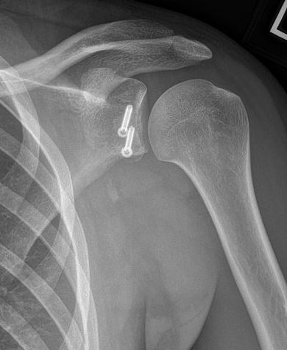
Shoulder Instability

Slide 28
Shoulder Instability
Significantly altering anatomy with Latarjet
Remains a revision/bail out procedure for me
Learning curve=high complication rate
Highly controversial- This is the go to procedure in Europe
I think you will see more of this procedure in the next 10 years

Slide 29
Shoulder Instability
Rehab after Latarjet
Immobilizer and no shoulder PT for 4 weeks
PROM weeks 4-6, AAROM 6-8, AROM 8-10
Start strengthening week 10
Contact sports 4-6 months

Slide 30
Summary
Shoulder dislocations and instability a common problem
Non-op treatment and PT has a big role
Operative results are good and PT post op is crucial

Slide 31
Thank You

