Slide 1
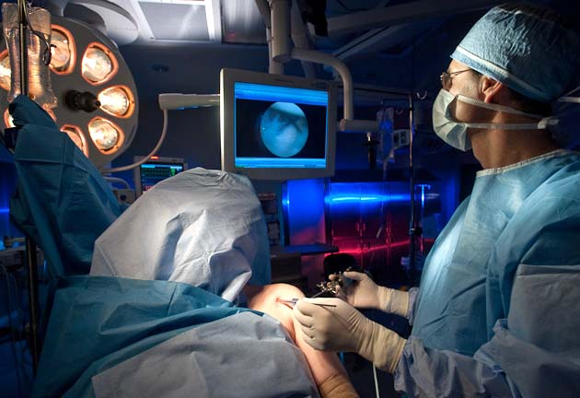
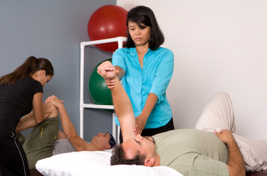
The Surgeon-Therapist Relationship
Derek Cuff, M.D.
Suncoast Orthopaedic Surgery and Sports Medicine

Slide 2
Goals
Discuss the evolving surgeon-therapist relationship
Discuss some of the changes I have seen over last 10 years
Discuss the future directions of the surgeon-therapist relationship

Slide 3
Surgeon-Therapist Relationship
The old days
Surgeons focused on anatomy
Technical aspects of the procedures
Feasibility of repair

Slide 4
Surgeon-Therapist Relationship
Ernest Codman, M.D.
Born 1869
Prominent surgeon in early 1900’s
First to describe RTC repair in 1911

Slide 5
Surgeon-Therapist Relationship
Pioneer
Butted heads with medical establishment
Felt hospitals were not interested in the “End Result”
Was the first to suggest long term follow up of patients

Slide 6
Surgeon-Therapist Relationship
“The common sense notion that every hospital should follow every patient it treats, long enough to determine whether or not the treatment has been successful, and then to inquire, ‘If not, why not?’ with a view to preventing similar failures in the future”

Slide 7
Surgeon-Therapist Relationship
Post injury/surgery rehabilitation of particular interest to Codman
Felt that therapy exercises affected long term outcomes

Slide 8
Surgeon-Therapist Relationship
PT/OT has major affects on outcome
Critical part of team of providers who interact with my patients
Seen PT/OT evolve in my 10 years in practice

Slide 9
Surgeon-Therapist Relationship
1. Improved communication
2. Better diagnostic skills
3. Quicker recognition of complications
4. Better understanding of the surgical procedures

Slide 10
Surgeon-Therapist Relationship
1. Improved Communication
Technology driven (secure email, text, phone calls)
Comfort level with surgeons
More open lines of communication

Slide 11
Surgeon-Therapist Relationship
2. Better diagnostic skills
More PT referrals with correct dx
Ex.- Frozen shoulder
Better recognition of surgical pathology
Ex.- RTC tear that fails PT
Ex.- Advanced arthritis

Slide 12
Surgeon-Therapist Relationship
3. Quicker recognition of complications
Wound issues
Post op set back
Plateau of progress

Slide 13
Surgeon-Therapist Relationship
4. Better understanding of procedures
More resources to learn about surgery (you tube, google etc, observation)
Some really astute/specific questions I am asked now
Examples- Double row RTC, subscap management after RSA, Latarjet techniques

Slide 14
Surgeon-Therapist Relationship
Benefits of better relationship
More cohesive team (patient appreciates)
Potentially less complications
Ultimately better outcomes

Slide 15
Surgeon-Therapist Relationship
What about the next 5-10 years??
Technical advances
Cost pressures
Value equation

Slide 16
Surgeon-Therapist Relationship
Tech advances
Telemedicine
Range of motion measurements
Outcomes tracking

Slide 17
Surgeon-Therapist Relationship
“In-Home Telerehabilitation Compared with Face-to-Face Rehabilitation After Total Knee Arthroplasty: A Noninferiority Randomized Controlled Trial” (Moffet et al)
2015 Journal of Bone and Joint Surgery
No difference in outcomes between 2 cohorts
Multiple studies reproducing these results now

Slide 18
Surgeon-Therapist Relationship
“The Role of Virtual Rehabilitation in Total and Unicompartmental Knee Arthroplasty” (Chughtai et al)
2018 Journal of Knee Surgery (Cleveland Clinic)
Instructional Avatar
3D motion measurement and analysis software
System tracks compliance
Real time track of progress via data capture

Slide 19
Surgeon-Therapist Relationship
Tech advances aren’t for every patient
Possible tough on geriatric patients
As younger patients age may be appealing to them
Value in hands on PT is lost with this approach

Slide 20
Surgeon-Therapist Relationship
Cost pressures and value equation
Cost cutting in health care remain an issue
Which services offer most value in outcomes?
Bundled payments

Slide 21
Surgeon-Therapist Relationship
Doctor gets bundle $$
$20,000 for 90 days
Implant
Hospital stay
Rehab services
Doctor keeps leftover $$
Hypothetical
$20,000
- Implant $5,000
- Hospital stay $10,000
- Rehab Home health+outpatient PT $3,000
Net $2000
But what if you can cut certain services???

Slide 22
Surgeon-Therapist Relationship
Potential to affect relationship
Doctors could feel pressure in a race to the bottom price
Could this affect patient outcomes negatively??

Slide 23
Summary
Therapists remain a vital part of ortho patient care
Personally have seen and improvement in the surgeon-therapist relationship over last 10 years
This relationship will continue to evolve
Value in us meeting each summer to foster this relationship

Slide 24
Thank You

